Slide 1
OneOfficeERP
Integrated, simple & complete operating system for the modern organization

Slide 2
Mission –
An integrated, simple & complete platform to empower productive teams

Slide 3
Introduction
OneOfficeERP → all functions needed by modern organizations
Latest technology → speed & performance
Multi-tenant
AI-enabled
All major verticals
  Services - Agriculture
  Distribution - Manufacturing
  Retail - Non-profit
  Education - Healthcare

Slide 4
Main Modules
Finances & Accounting
Sales Management
Point of Sale
HR & Payroll
CRM
Manufacturing
Projects
Inventory / Warehouses
Education & Learning
Asset Management
E-Commerce
Helpdesk & Support

Slide 5
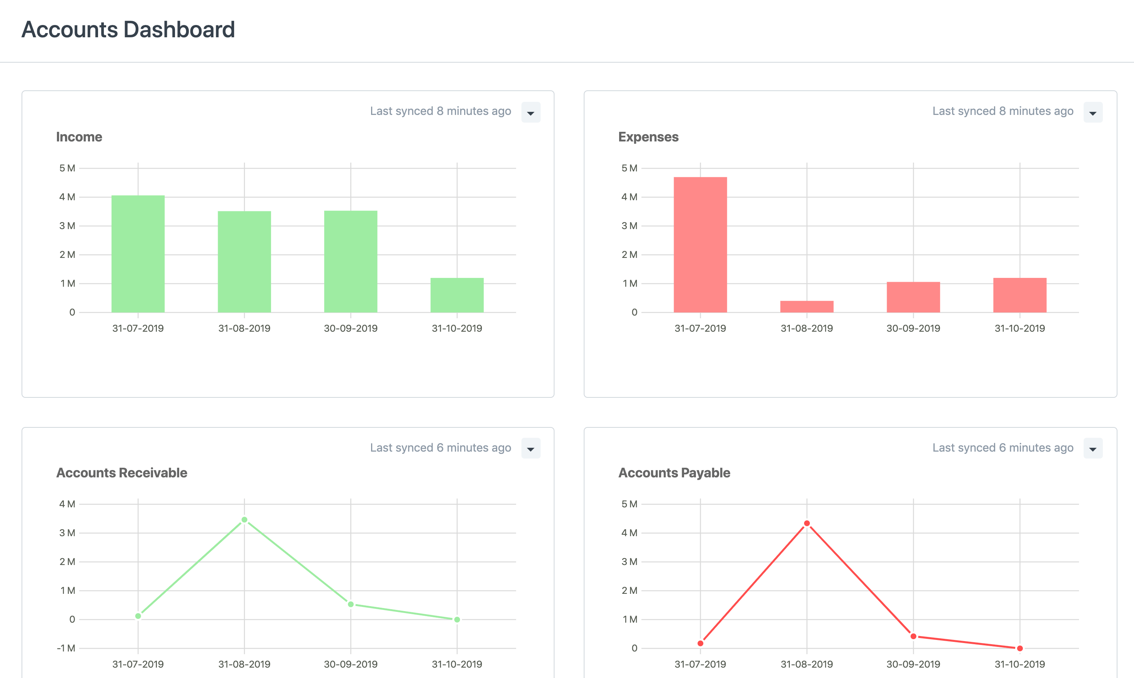
1. Finances & Accounting
Dashboards
Real-time books
Chart of accounts
Journals & payments
Billing & pricing
Multi-currency
Auto-invoicing
Banking

Slide 6
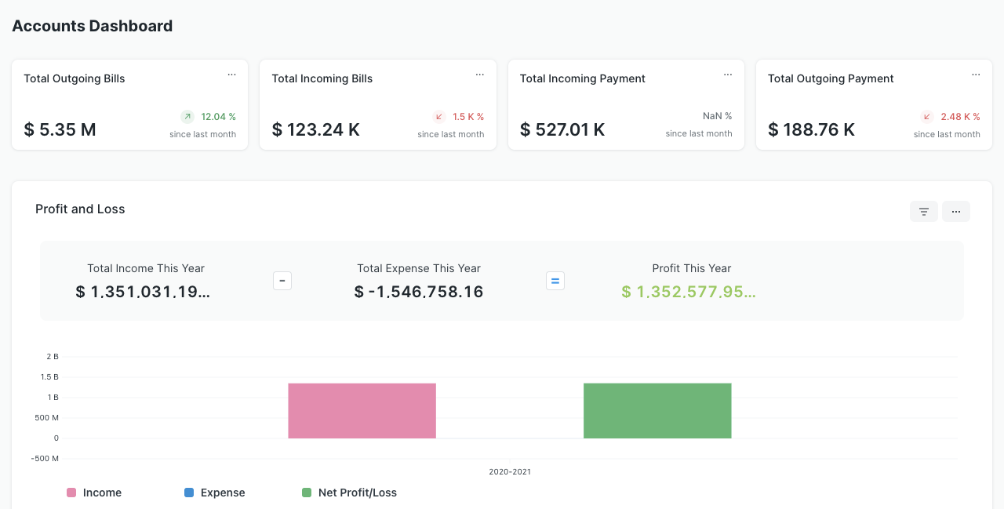
2. Sales Management
Multi-channel sales
Marketing tools
Customer access
Stock replenishment
Promotions
Vendor management
Supplier portal
A/P & A/R
Automated invoices

Slide 7
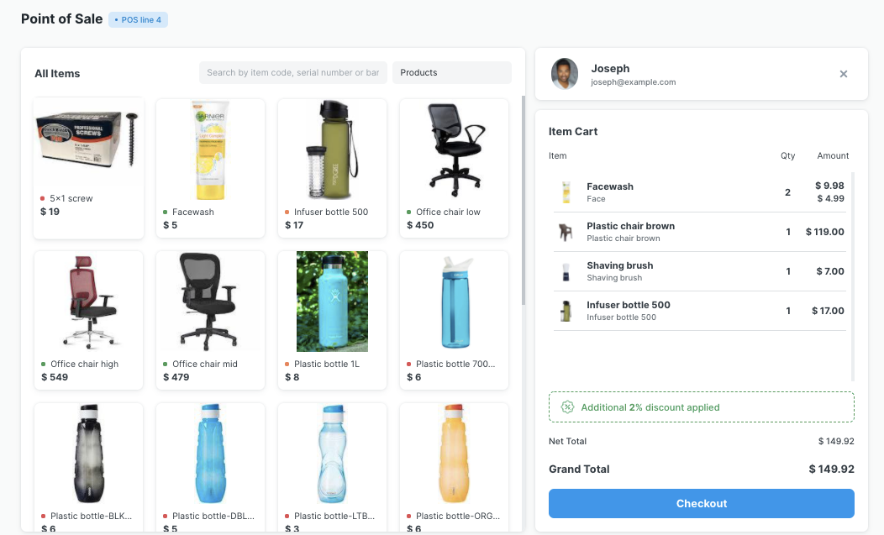
3. Point of Sale
User-friendly
Real-time inventory
Customer mgmt
Payment
Promotions
Loyalty system

Slide 8
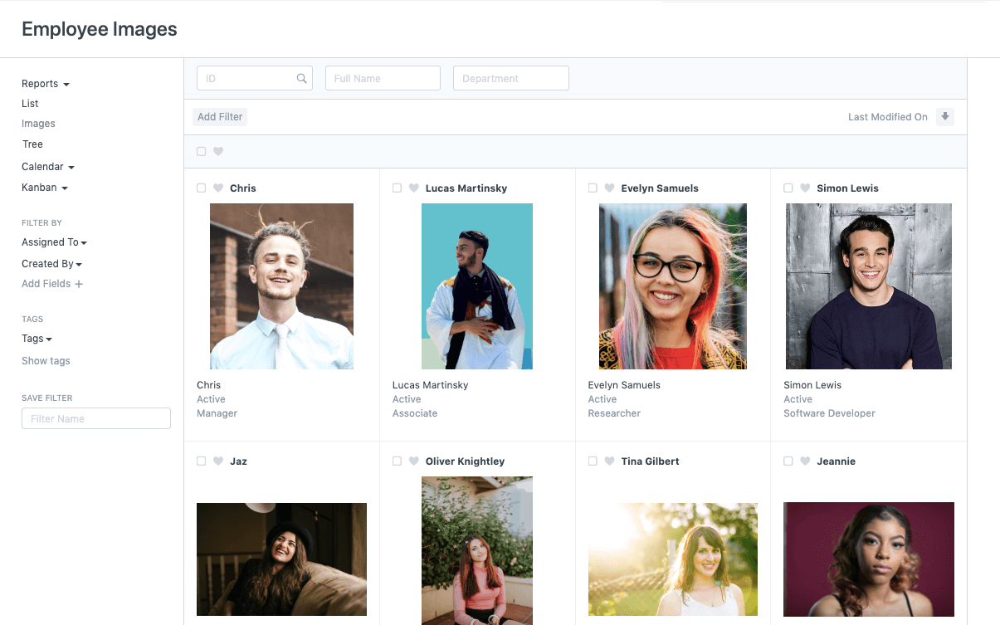
4. Human Resources
Talent acquisition
Employees
Training
KPIs
Expenses
Attendance
Leaves
Payroll & taxes
Salary structures
Timesheets
Variable pay

Slide 9
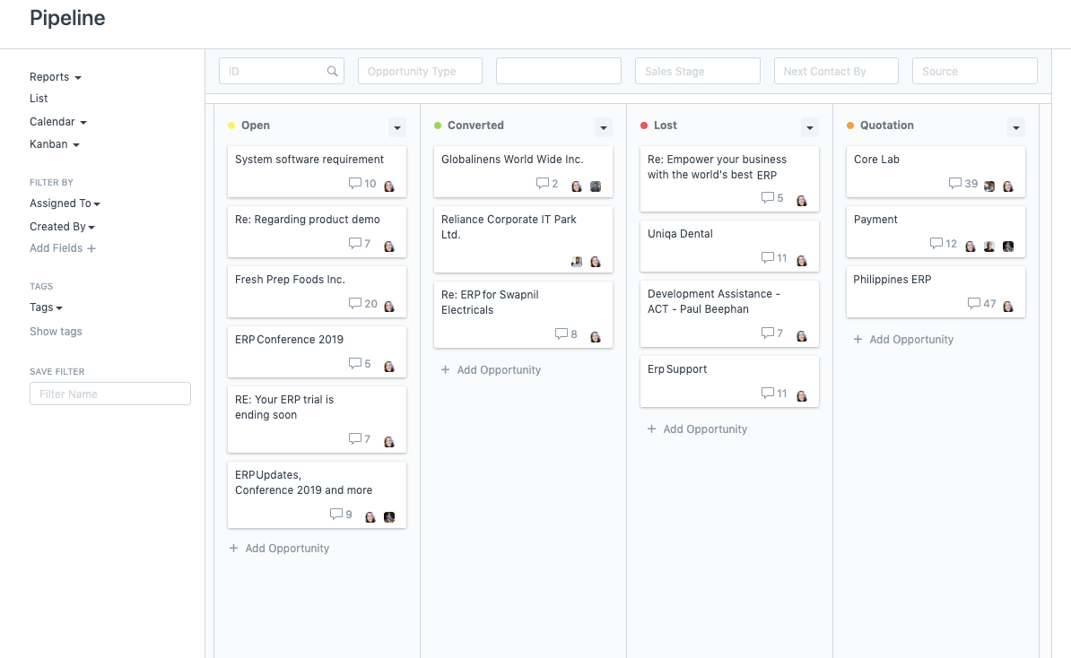
5. Customer Relationships
Omnichannel
Automated
Sales efficiency
360 visibility
Quotations
Digital marketing
Social Media
Notifications
Meetings & follow ups

Slide 10
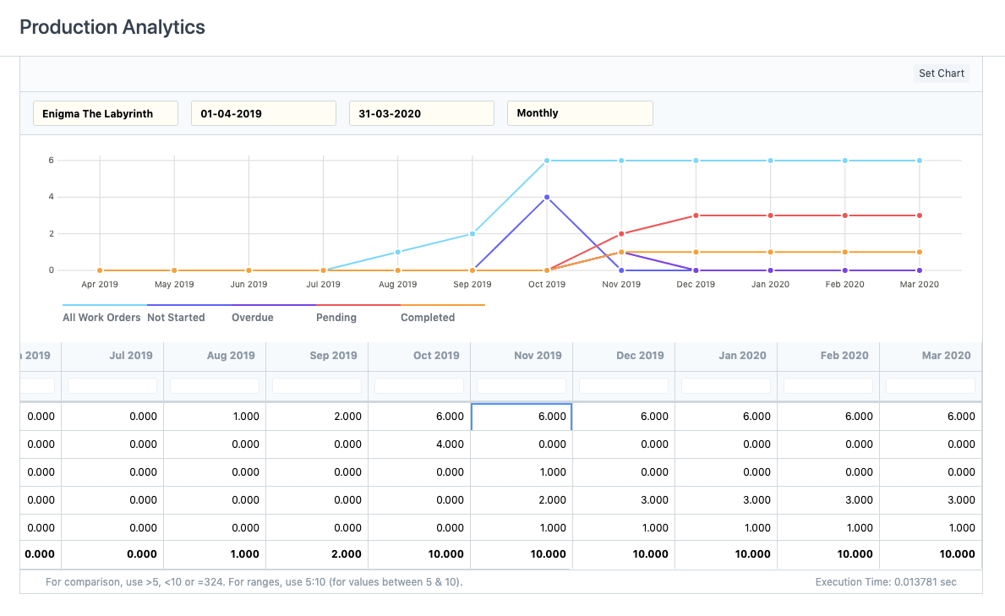
6. Manufacturing
Bill of Materials
Shop floor management
Subcontracting
Item variants
Batched inventory
Serialized inventory
Material resources
Capacity planning
Multiple UOMs
Quick balance
Stock replenishment

Slide 11
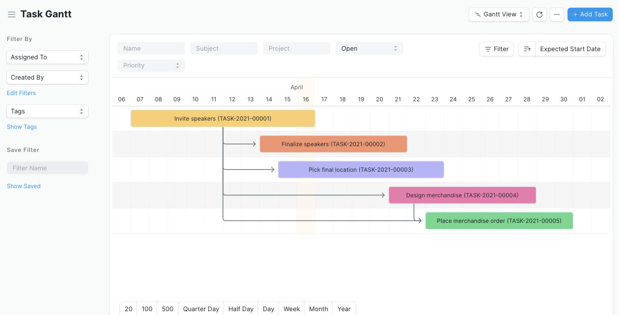
7. Projects
All-in-one PM
Agile projects / Kanban
To-dos & Chats
Document linking
Emails & notifications
Project costing
Profitability
Time-tracking
Billing
Customer access

Slide 12
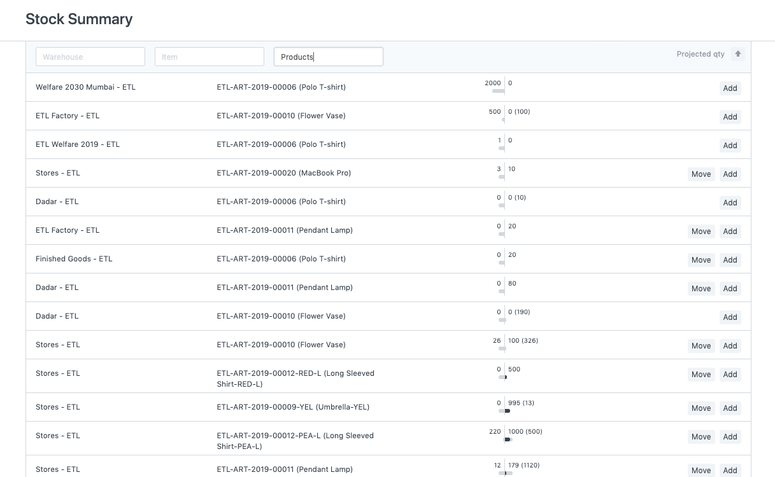
8. Inventory & Warehouses
Stock reports
Multi-warehousing
Multi-store
Item variants
Promotional schemes
Automated replenishment
Multi-currency accounting
Billing & pricing
Credits & receivables

Slide 13
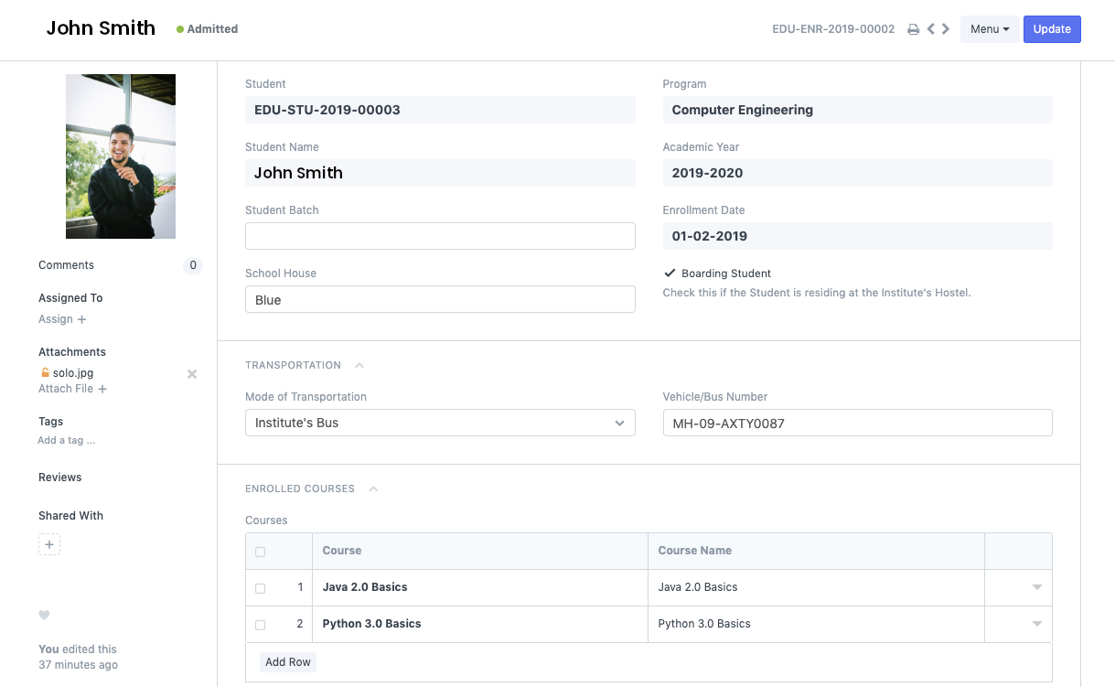
9. Education & Learning
Application
Student information
Course documents
Instructors
Program enrollment
Program & Courses
Attendance
Fees – if applicable
Assessments
Role integration

Slide 14
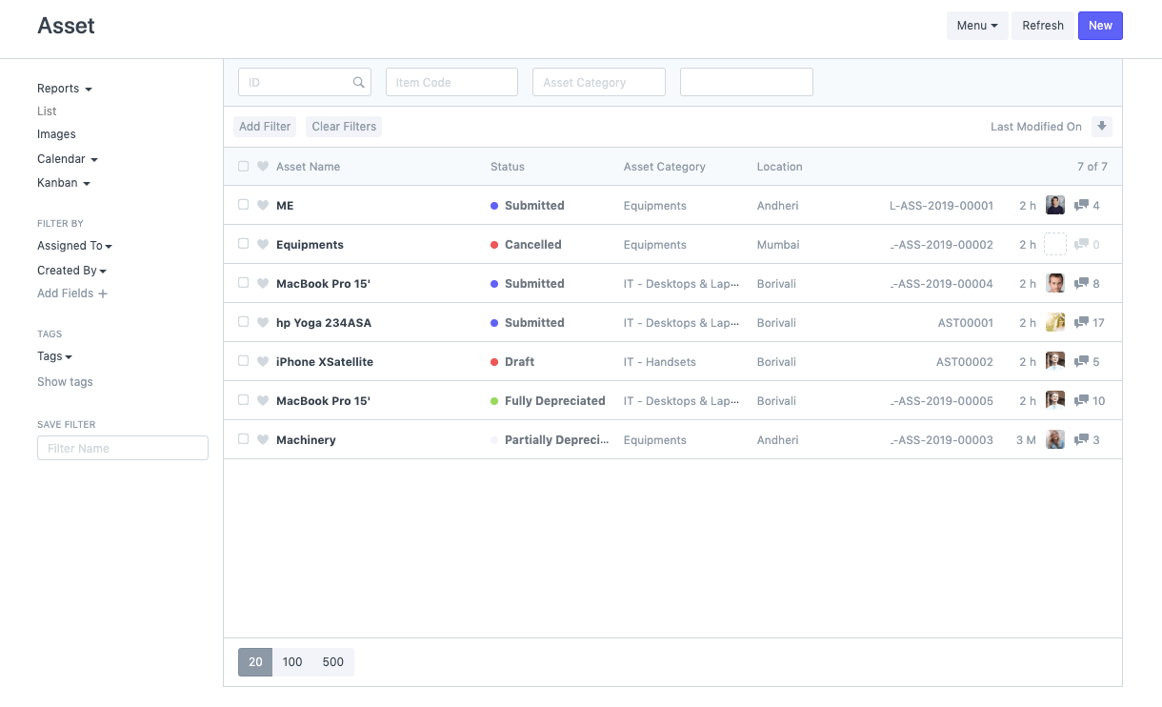
10. Asset Management
Asset lifecycle
Asset inventory
Purchasing
Selling / Disposal
Auto depreciation
Scrapping
Value adjustment
Reporting

Slide 15
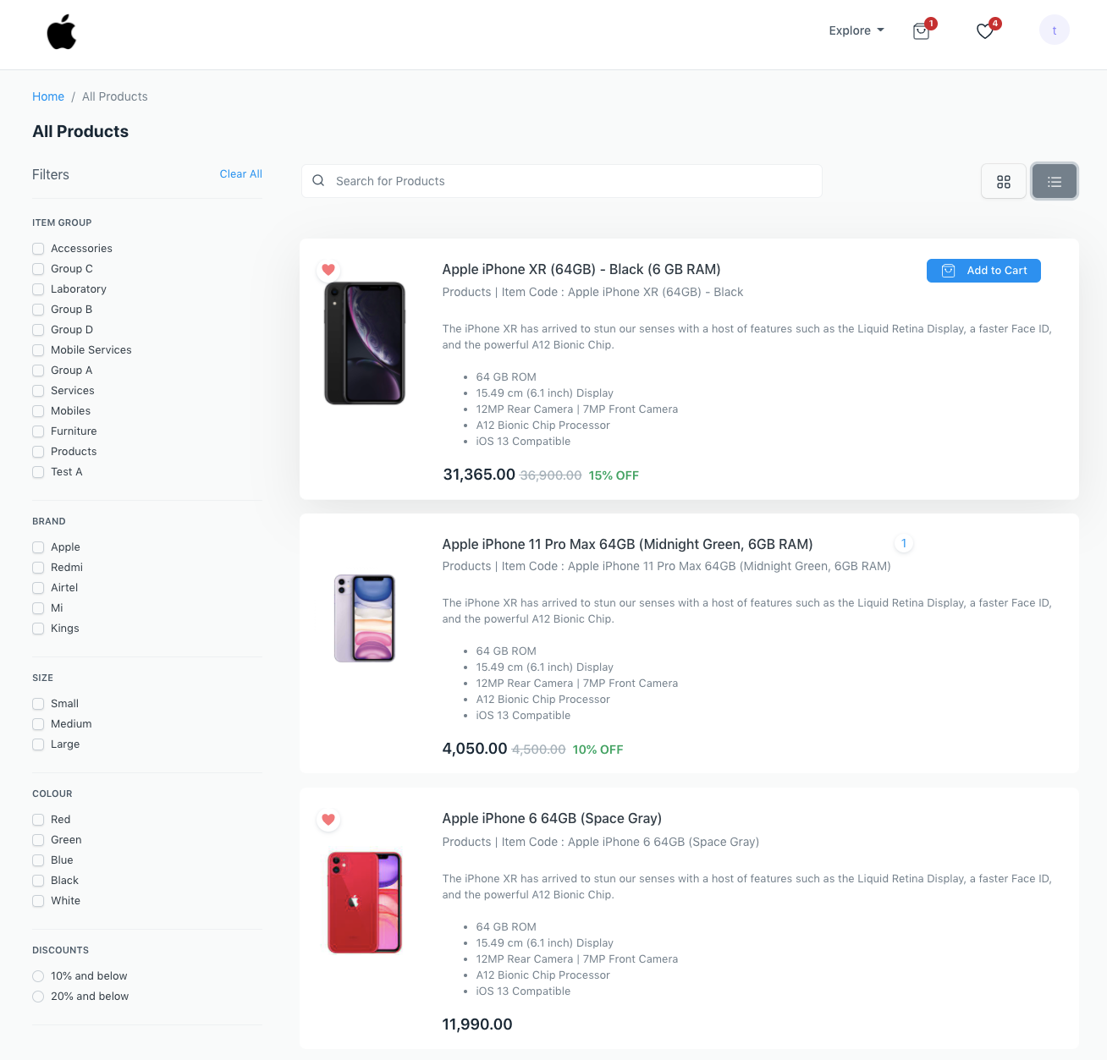
11. E-Commerce
Product lists
Advanced search
Real-time inventory
Promotions
Price lists
Discounts
Shipping
Wishlist
Multi-currency
Note: Apple logos and trademarks are the property of Apple Inc.

Slide 16
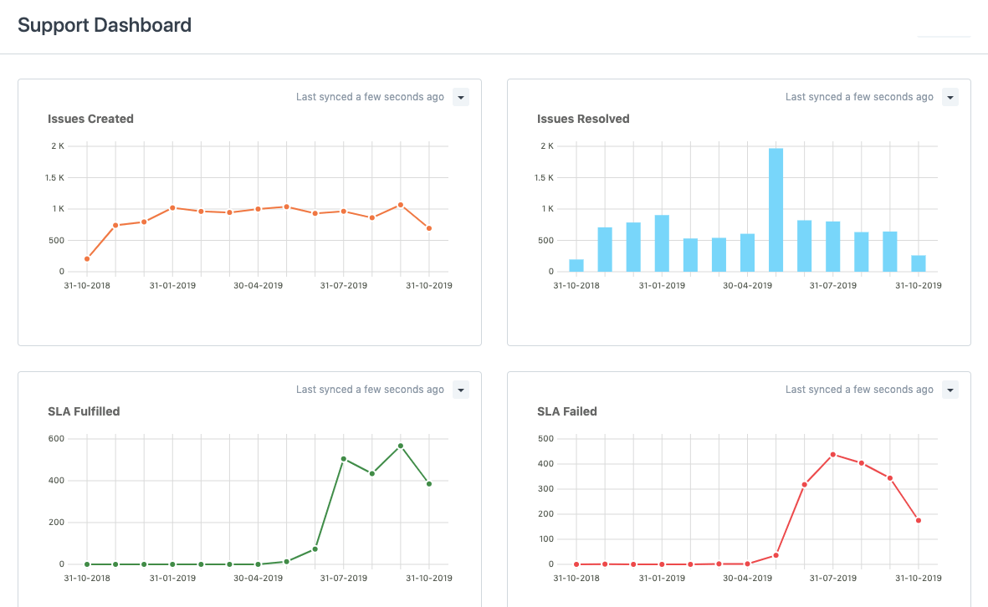
12. Helpdesk & Support
Omnichannel interactions
Customer tickets
Automate ticket assignments
Team performance
SLAs
Knowledge base
Scheduling Maintenance Visits
Warranty support
Note: Apple products and trademarks are the property of Apple Inc.

Slide 17

“
Having the right tool for the job is half the battle

Slide 18
Please feel free to contact us
info@oneoffice.ca

