Slide 1
OneOfficeERP
All verticals in one platform

Slide 2
Mission - A simple, complete & secure platform to empower productive teams

Slide 3

Why?
1. Secure
Private local servers, end-end encryption
2. Complete & Easy-to-use
All features in one convenient place
3. Cost Effective
Technology, servers, updates, IT

Slide 4

Re-thought from the ground up

Slide 5
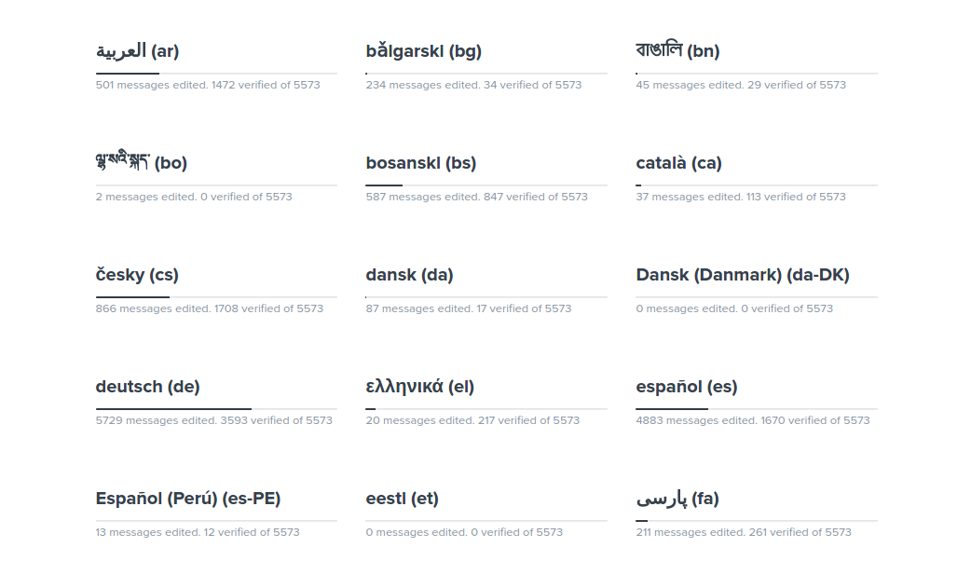
Languages We speak everything ...

Slide 6

Services

Slide 7
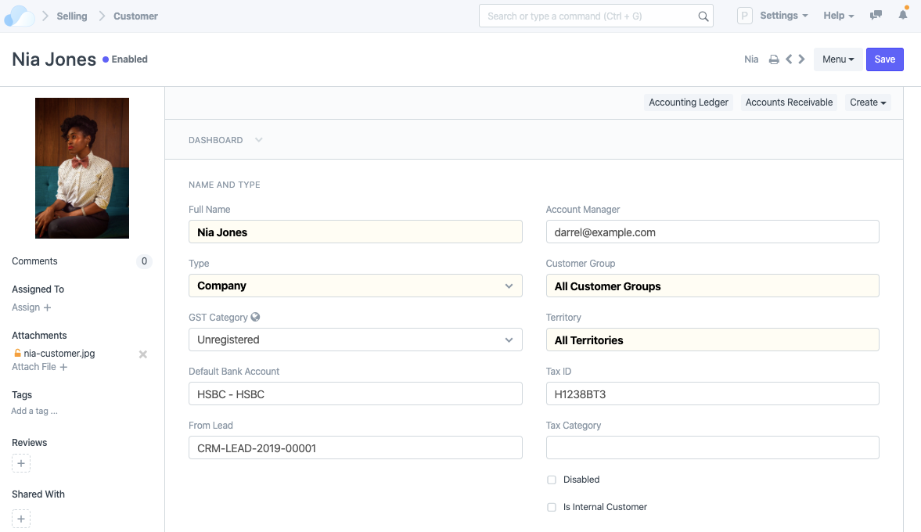
Customers Manage, assign, report ...

Slide 8
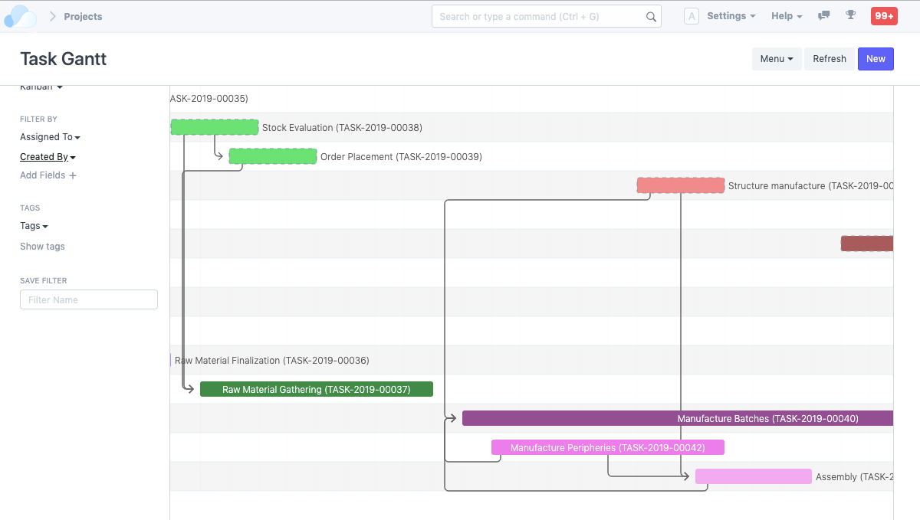
Projects Always on-time, in-scope and on-budget ...

Slide 9
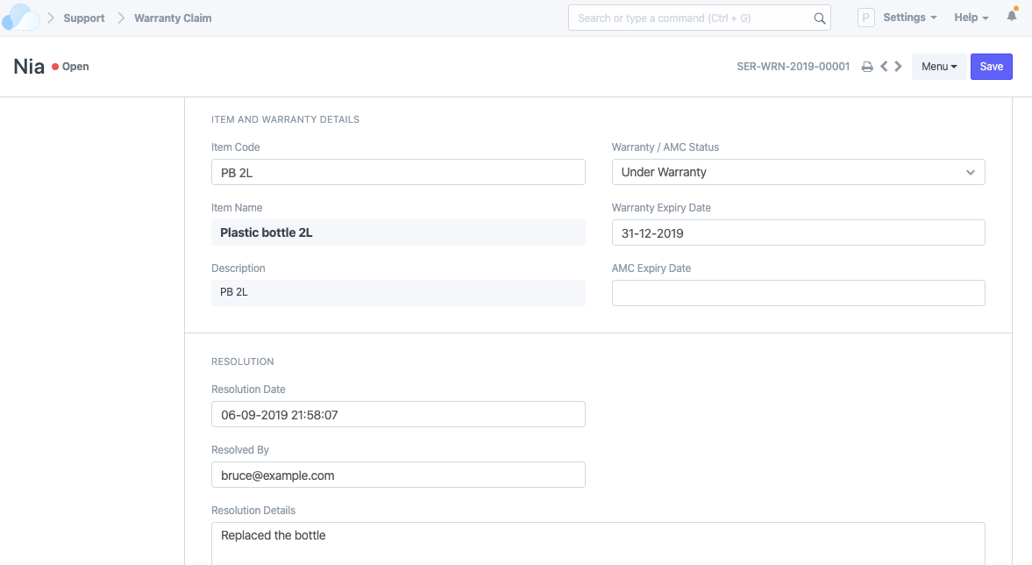
Warranty with built-in reminders

Slide 10
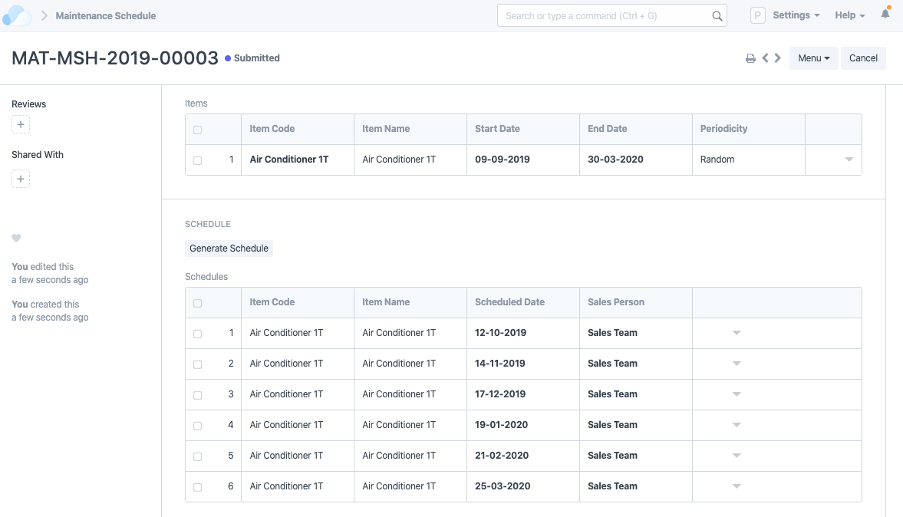
Maintenance Schedule, manage, assign, report ...

Slide 11
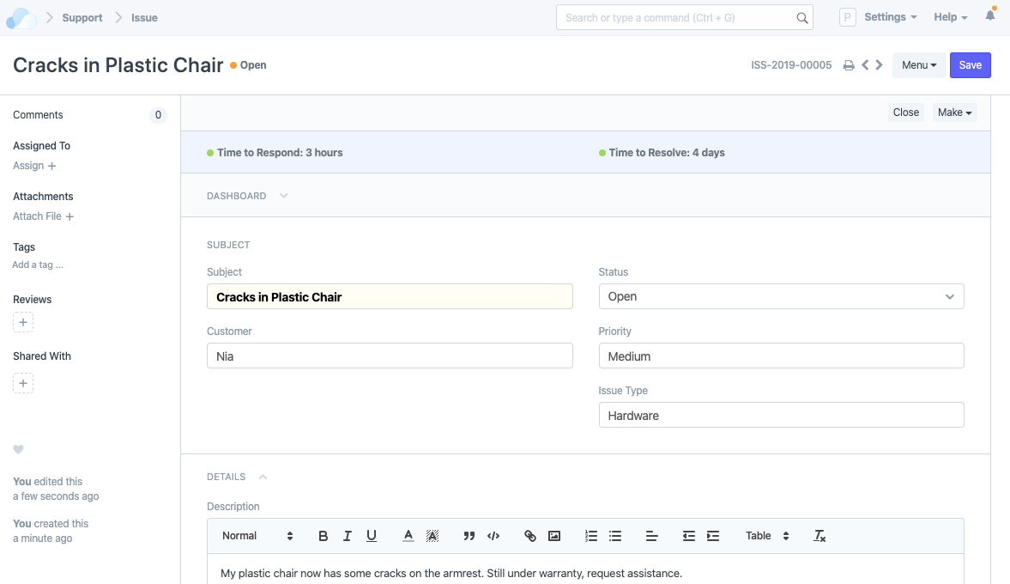
Issues & Tickets A relationship is worth nurturing ...

Slide 12
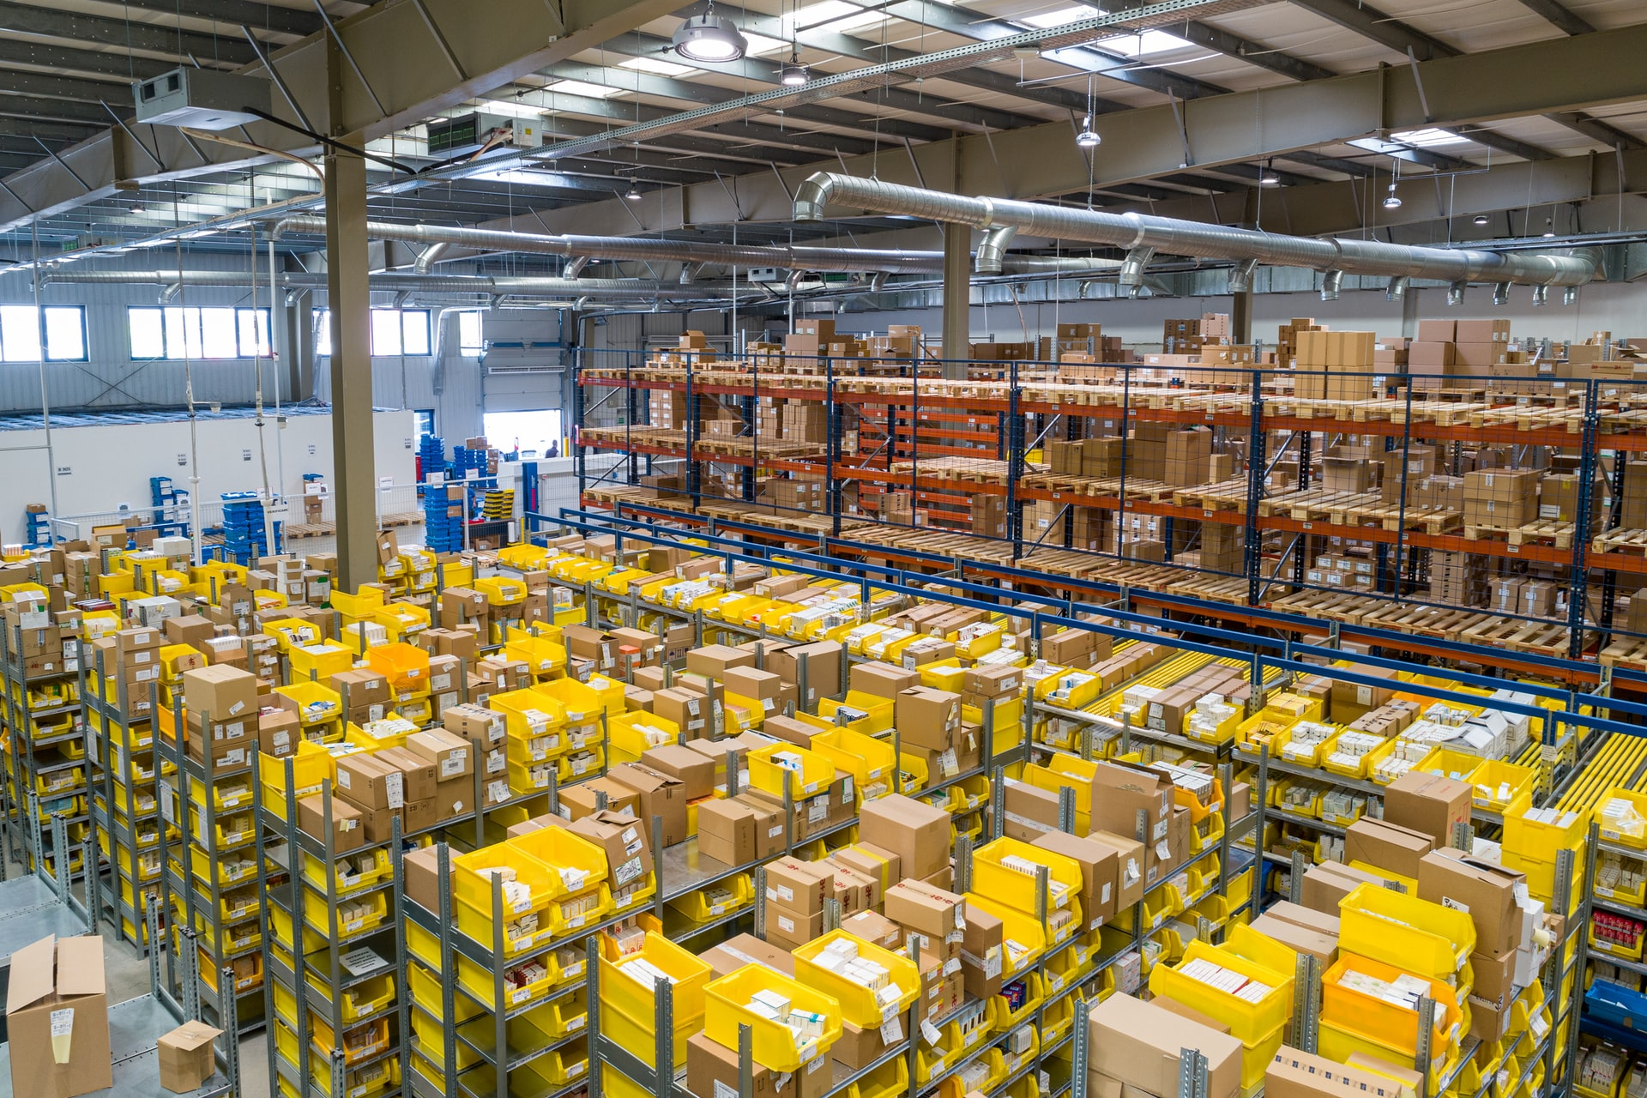
Distribution

Slide 13
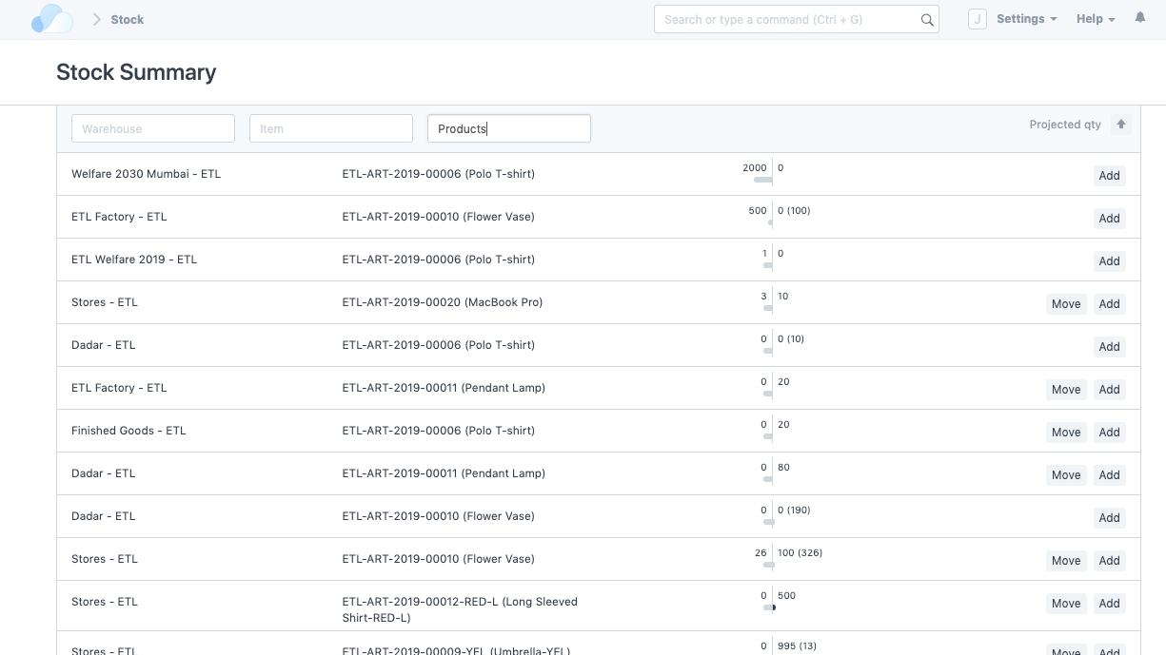
Real-time Inventory No more blindspots

Slide 14
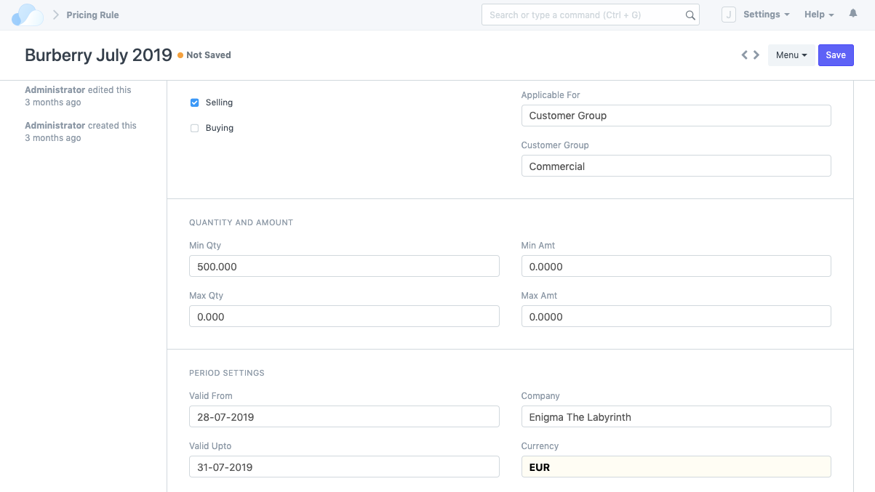
Promotions Create complex pricing rules

Slide 15
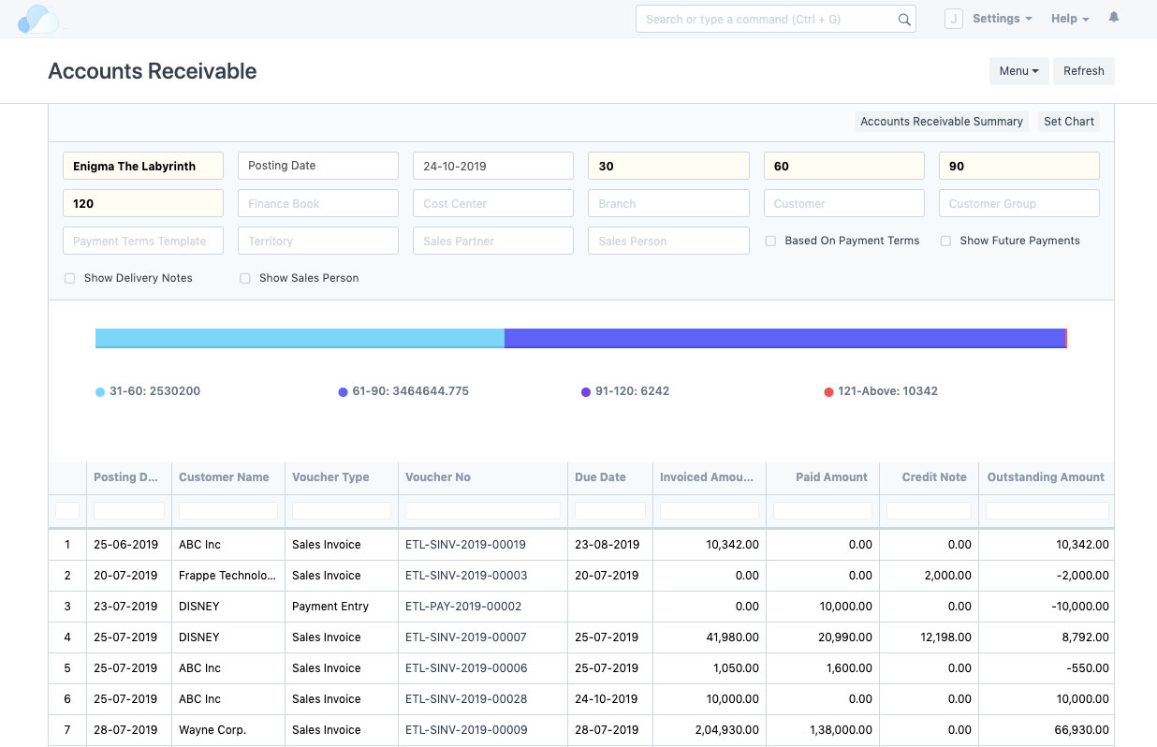
Account Receivables So you never run out of $

Slide 16
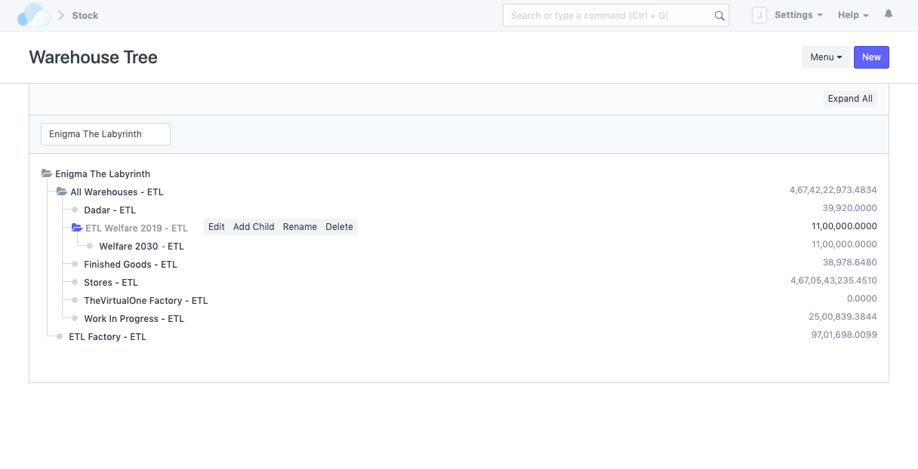
Warehouses Optimised distribution chain

Slide 17
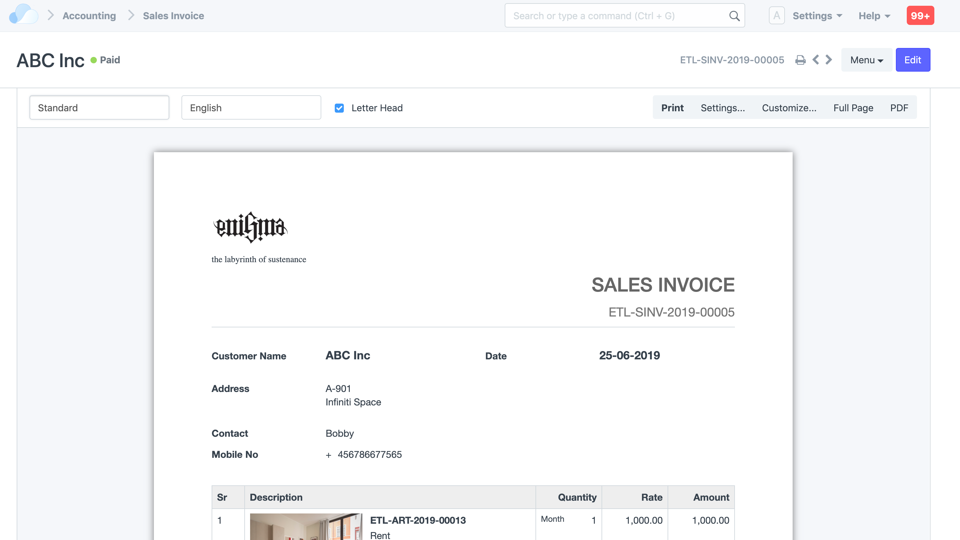
Invoice And get paid in heartbeat

Slide 18
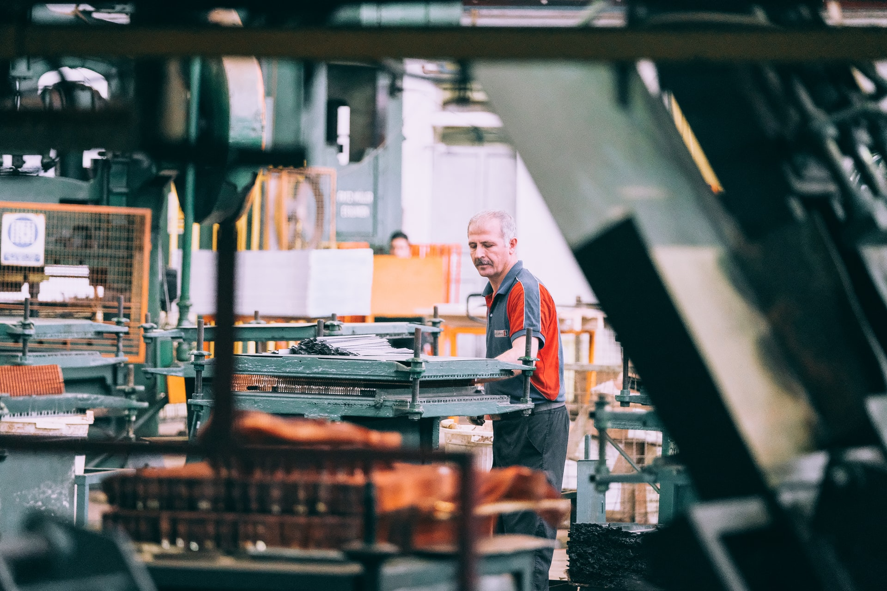
Manufacturing

Slide 19
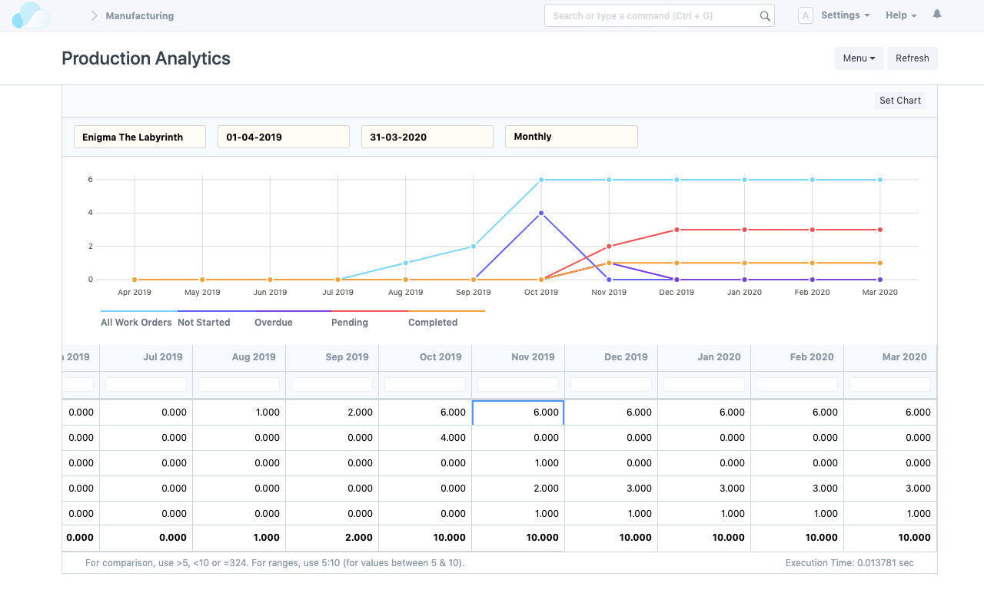
Production Analytics Detailed real-time reports

Slide 20
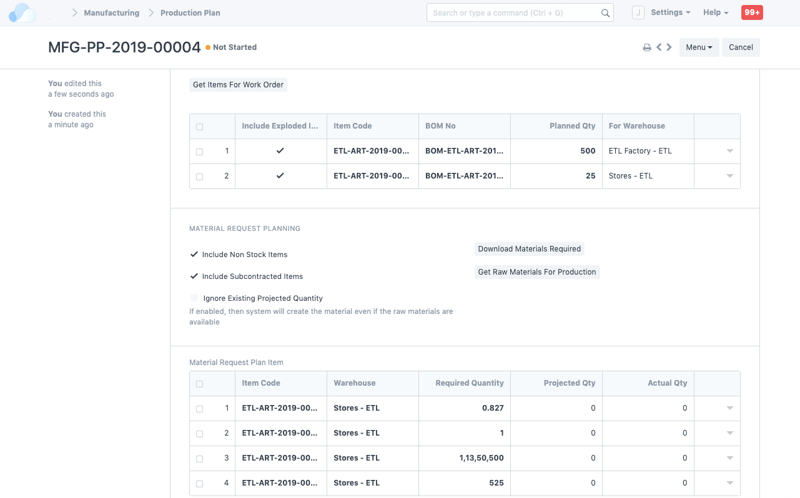
Production Plans Stay on top of your orders

Slide 21
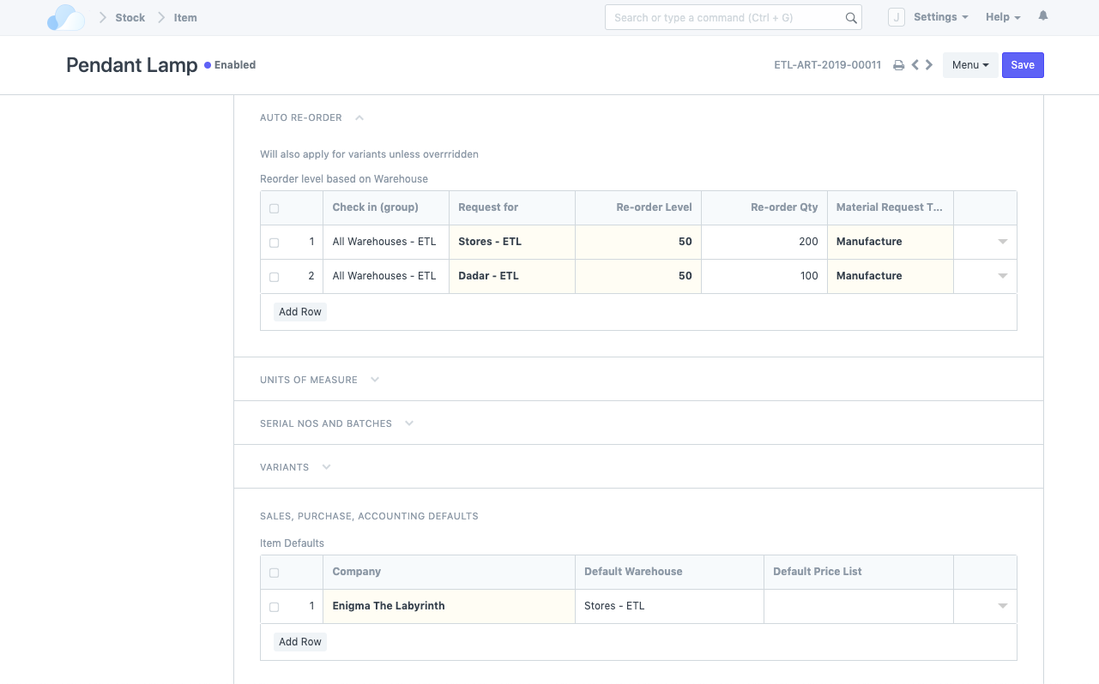
Auto Stock Replenishments So your work never stops

Slide 22
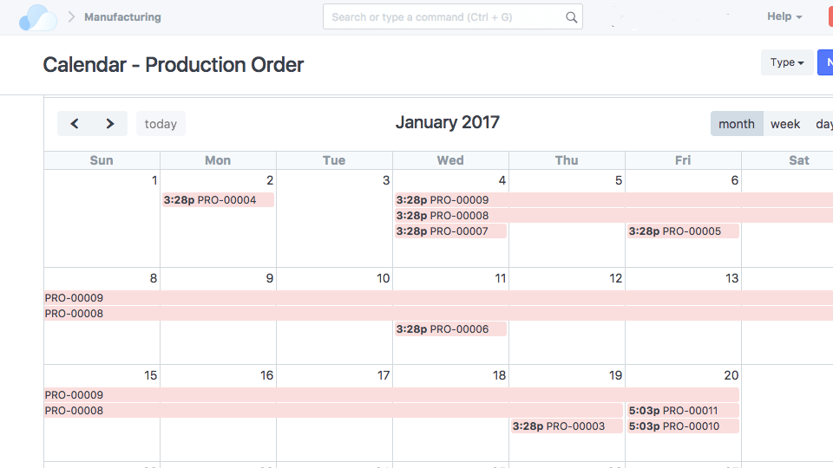
Capacity Planning Optimise your resources

Slide 23
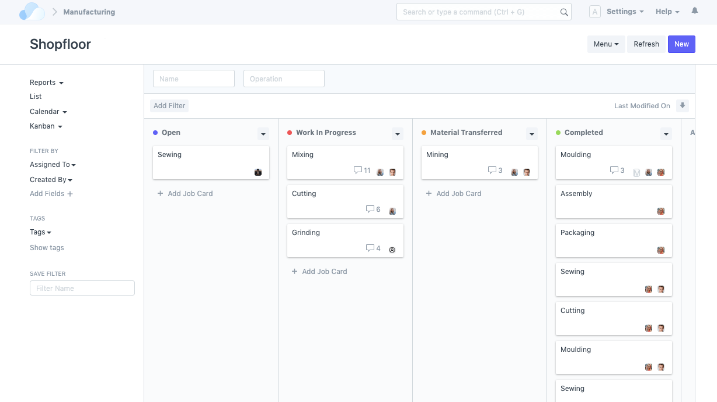
Shopfloor Management Your shop work at a glance

Slide 24
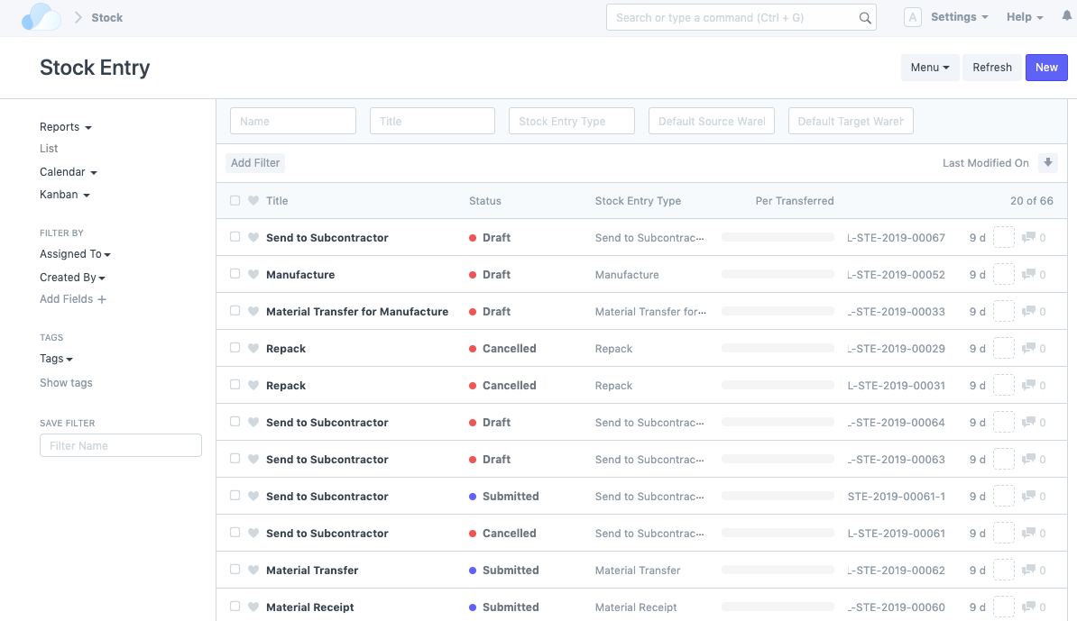
Subcontractors ... integrated into your process

Slide 25

Retail

Slide 26
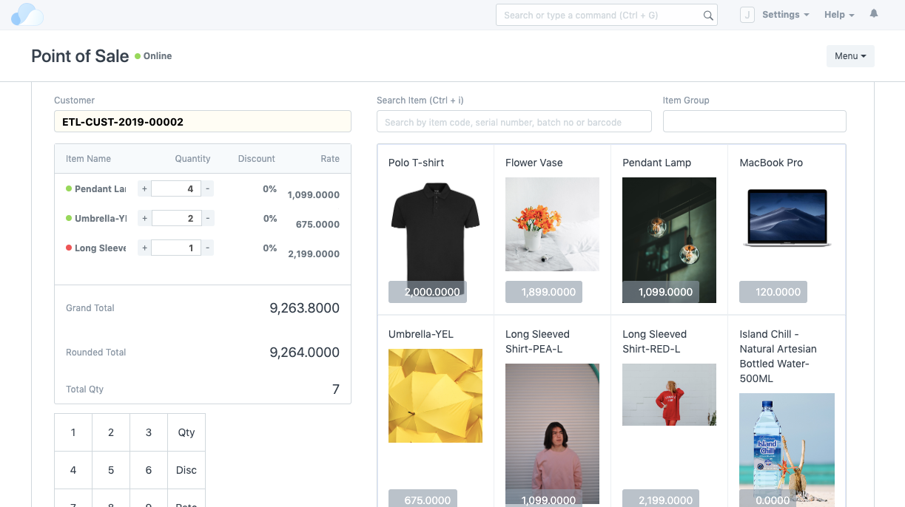
POS ... or integrate current one

Slide 27
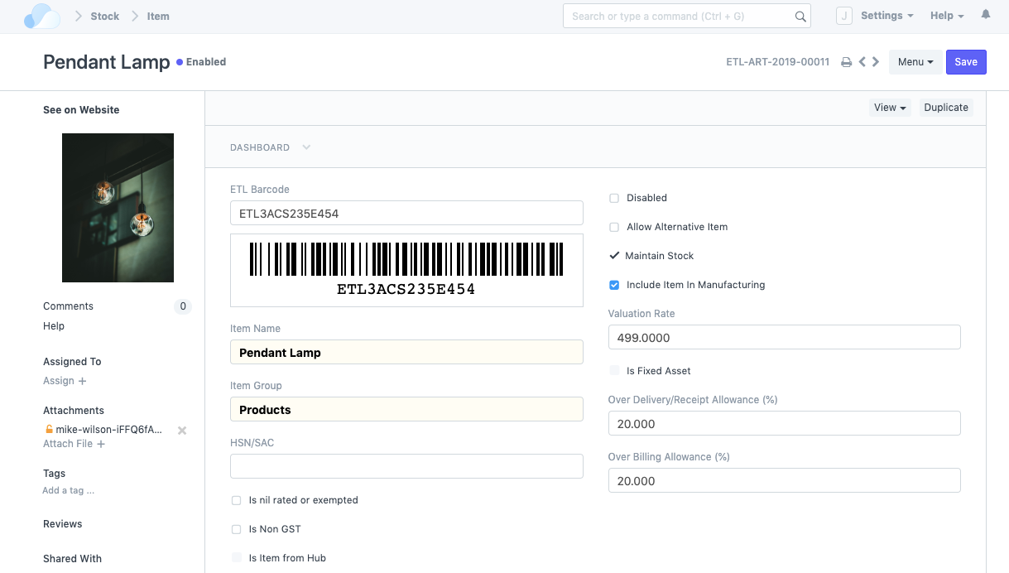
Real-time Inventory No more blindspots

Slide 28
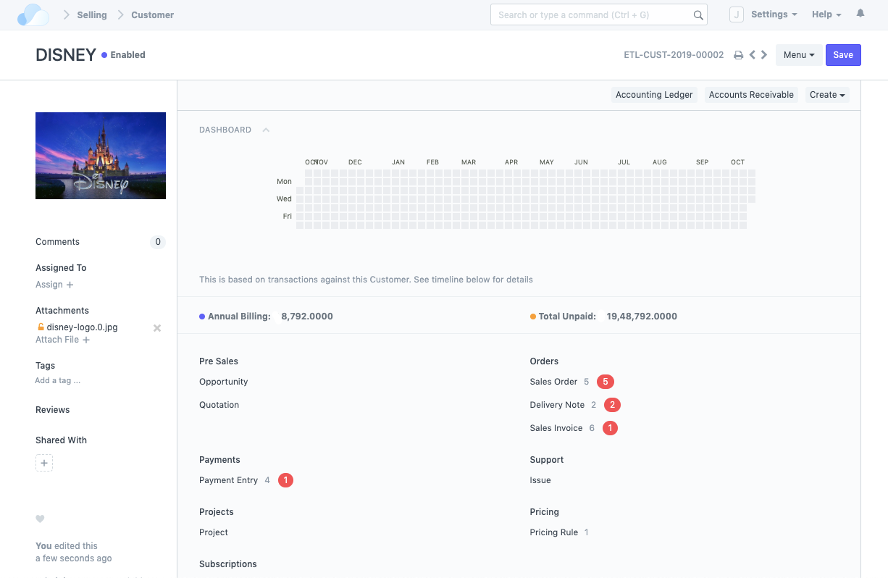
Customers ... the lifeline of every business

Slide 29
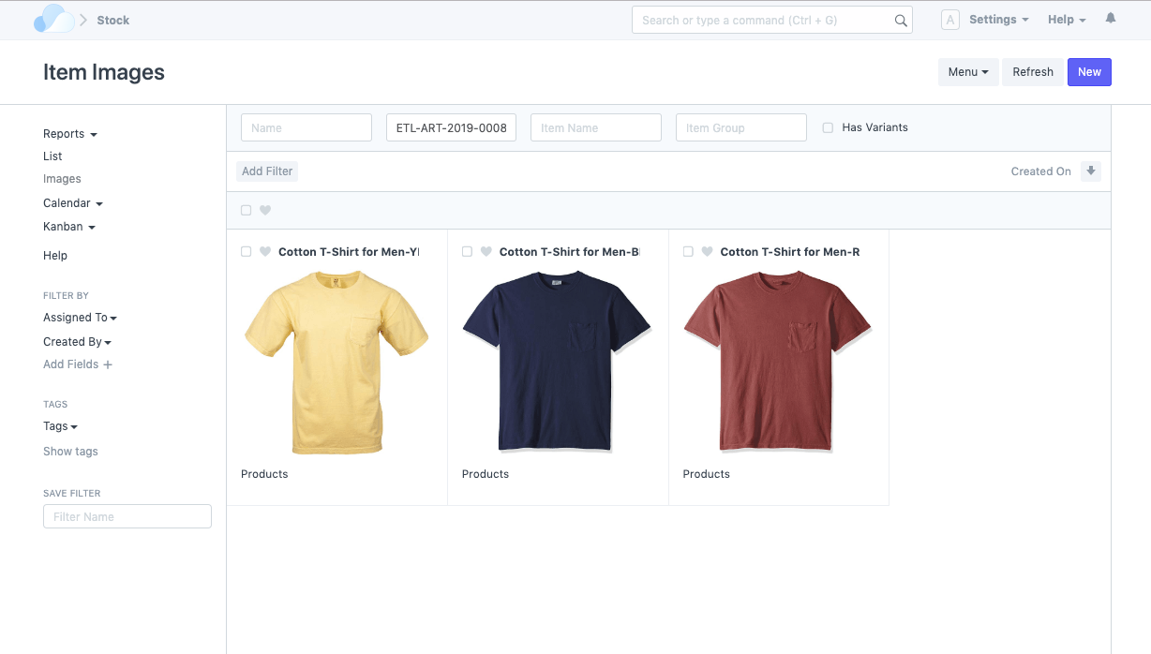
Item Variants No more confusion

Slide 30
Please feel free to contact us
info@oneoffice.ca

