Slide 1
HealthCare
The complete technology solution for today’s hospitals & clinics

Slide 2
Mission - A simple, complete & secure platform to empower productive clinics

Slide 3

Why?
1. Complete & Easy-to-use
All features in one convenient place
2. Secure
Private servers, end-end encryption
3. Cost Effective
Technology, servers, updates, IT

Slide 4
Introduction
The modern healthcare institution needs two main platforms to operate effectively
  Productivity & Collaboration – Files, Emails, Video
  Healthcare Management - ERP
OneOffice provides a single comprehensive integrated solution

Slide 5
OneOffice Productivity

Slide 6

Features
Full productivity – Word, PPT, XLS, Visio
Real collaboration
Email, Calendar, Contacts
Files & Storage
Secure Video & Chat
Projects
Forms
Appointments
Notes
Hybrid
Military-grade Security

Slide 7
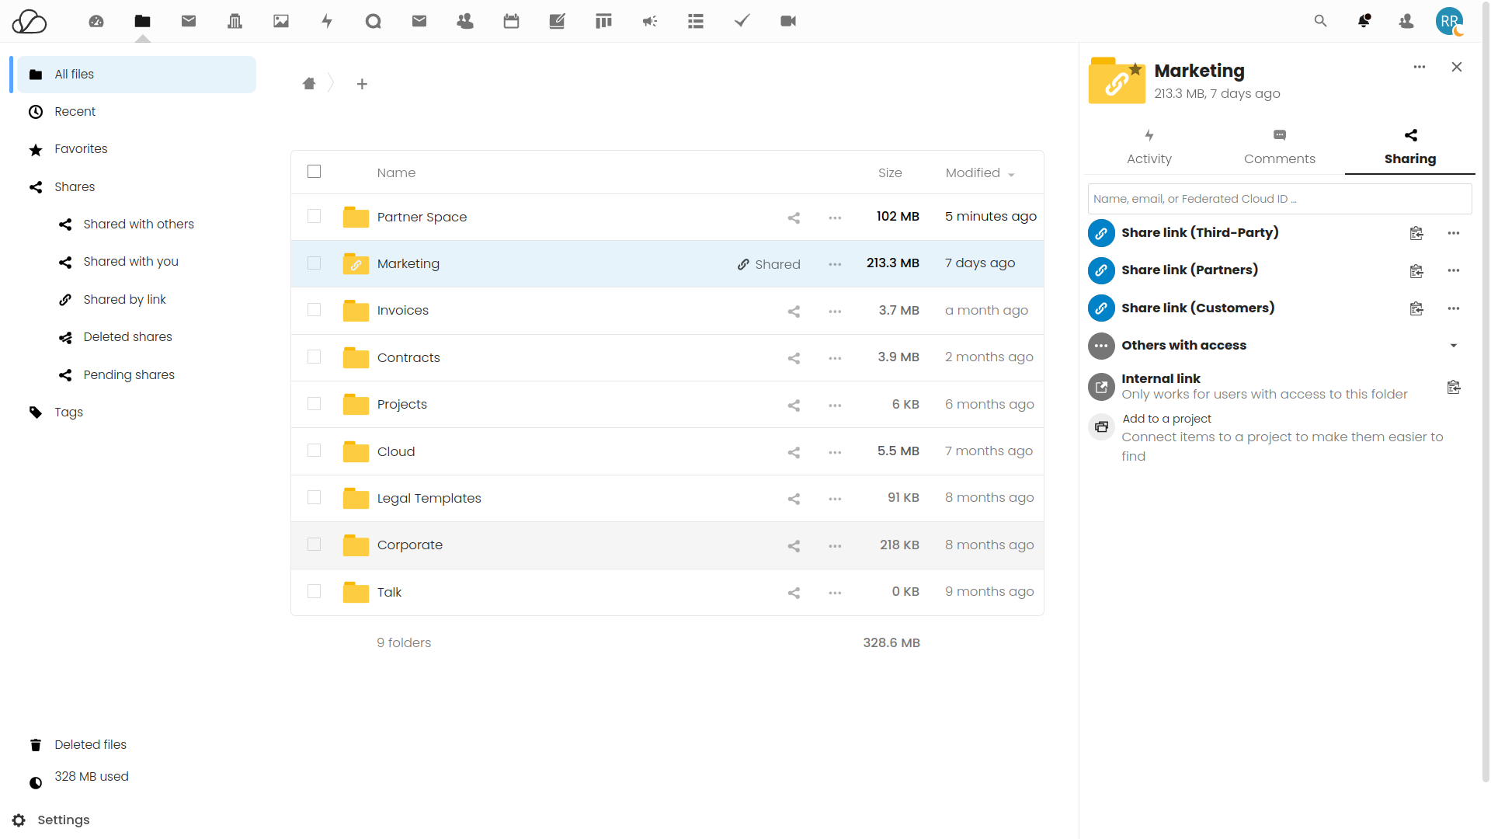
Files & Sharing
Folders & Files
Desktop sync
Live-chat
Internal share
External share
w/different permissions
Version control
Audit
Comments
Tags

Slide 8
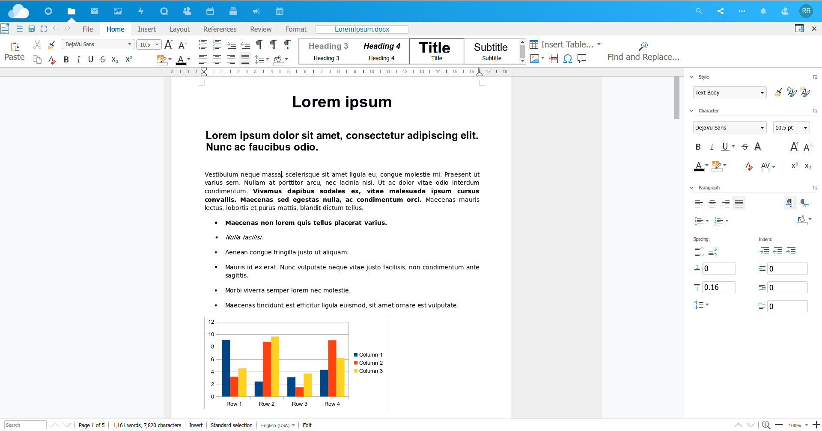
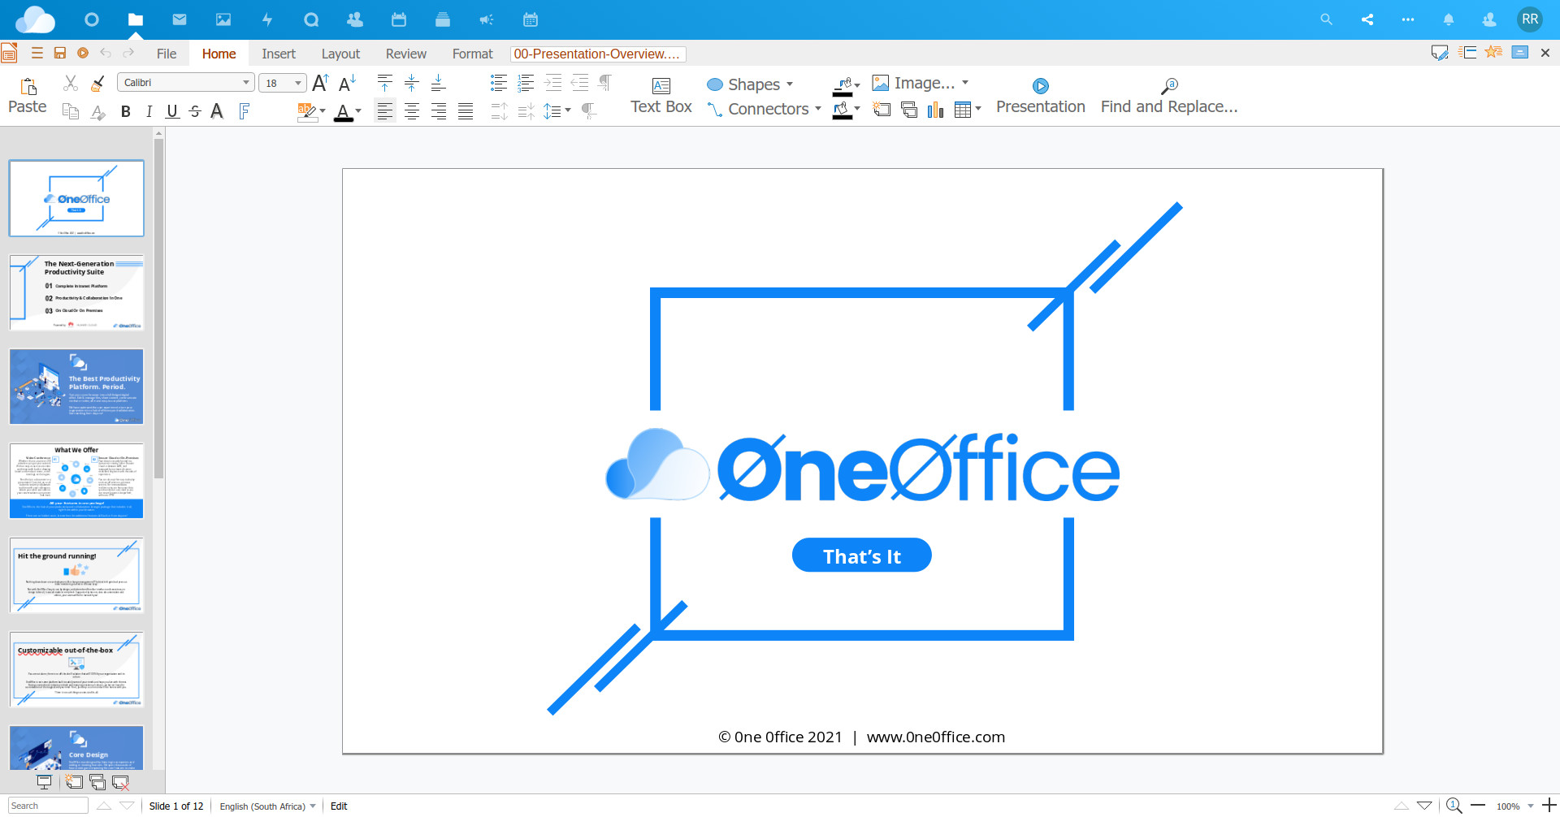
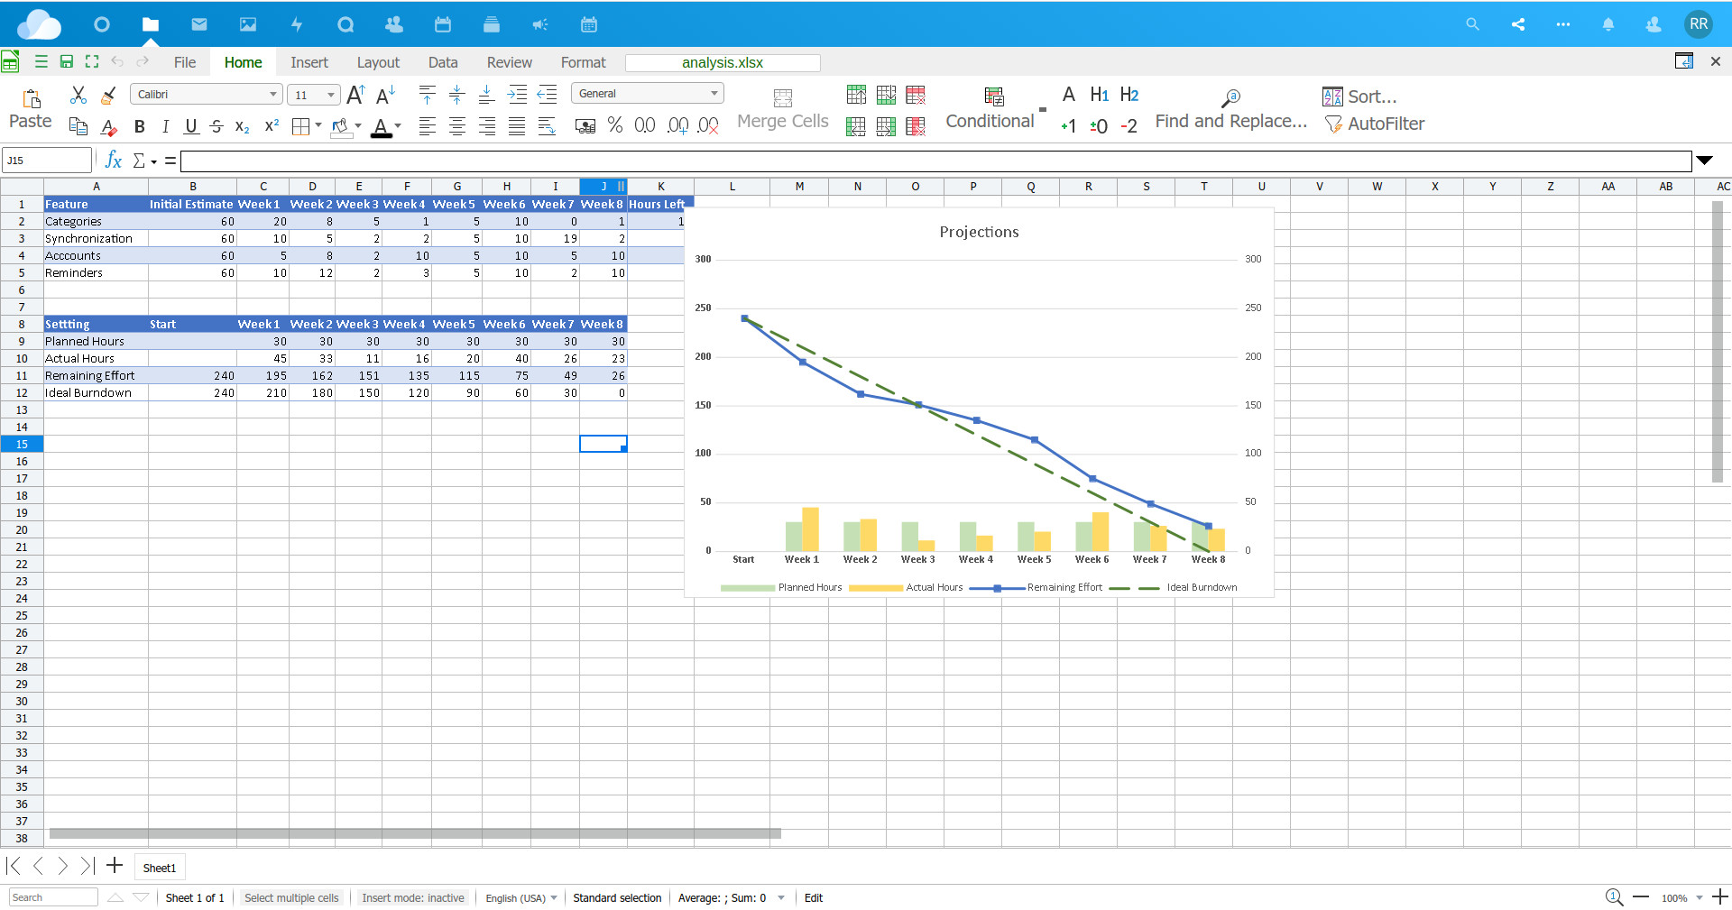
Documents
z
Full Online Editor
Lightning fast
Word, PPT, Excel, Visio
Live-collaboration
Comments
Track changes
PDF / format conversion
Live presentation
Live chats & calls

Slide 9
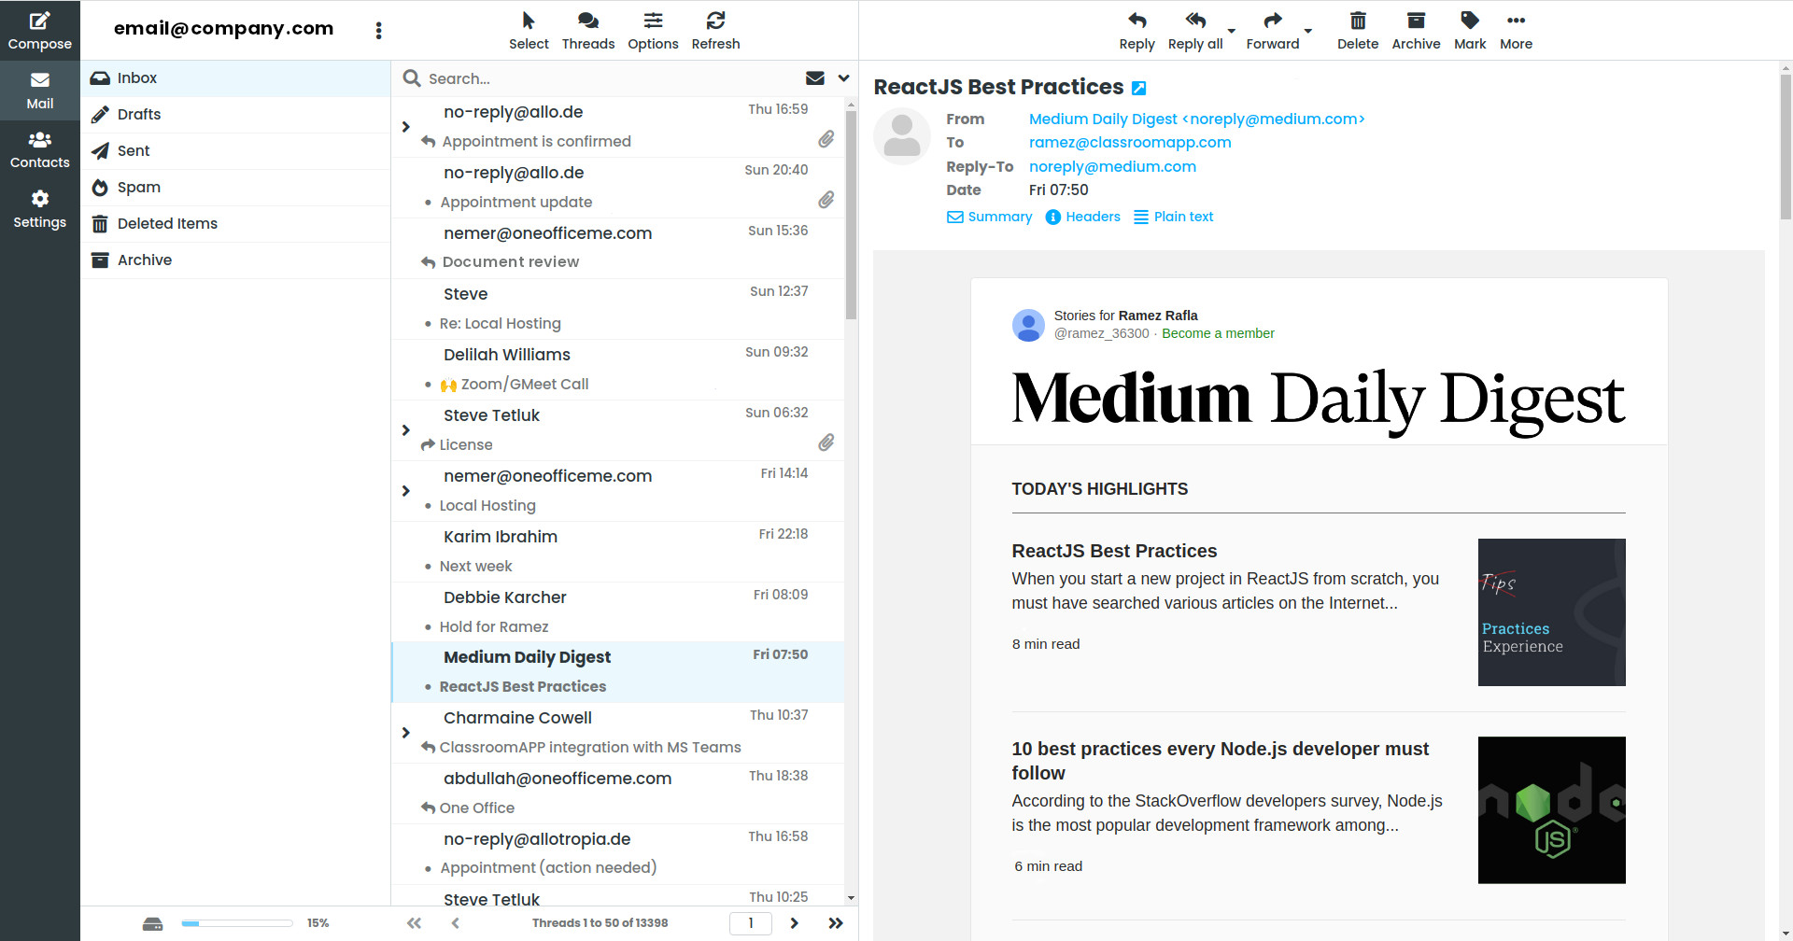
Emails
Secure email server
Lightning fast
Mobile sync
Out of office
Filters
Files integration

Slide 10
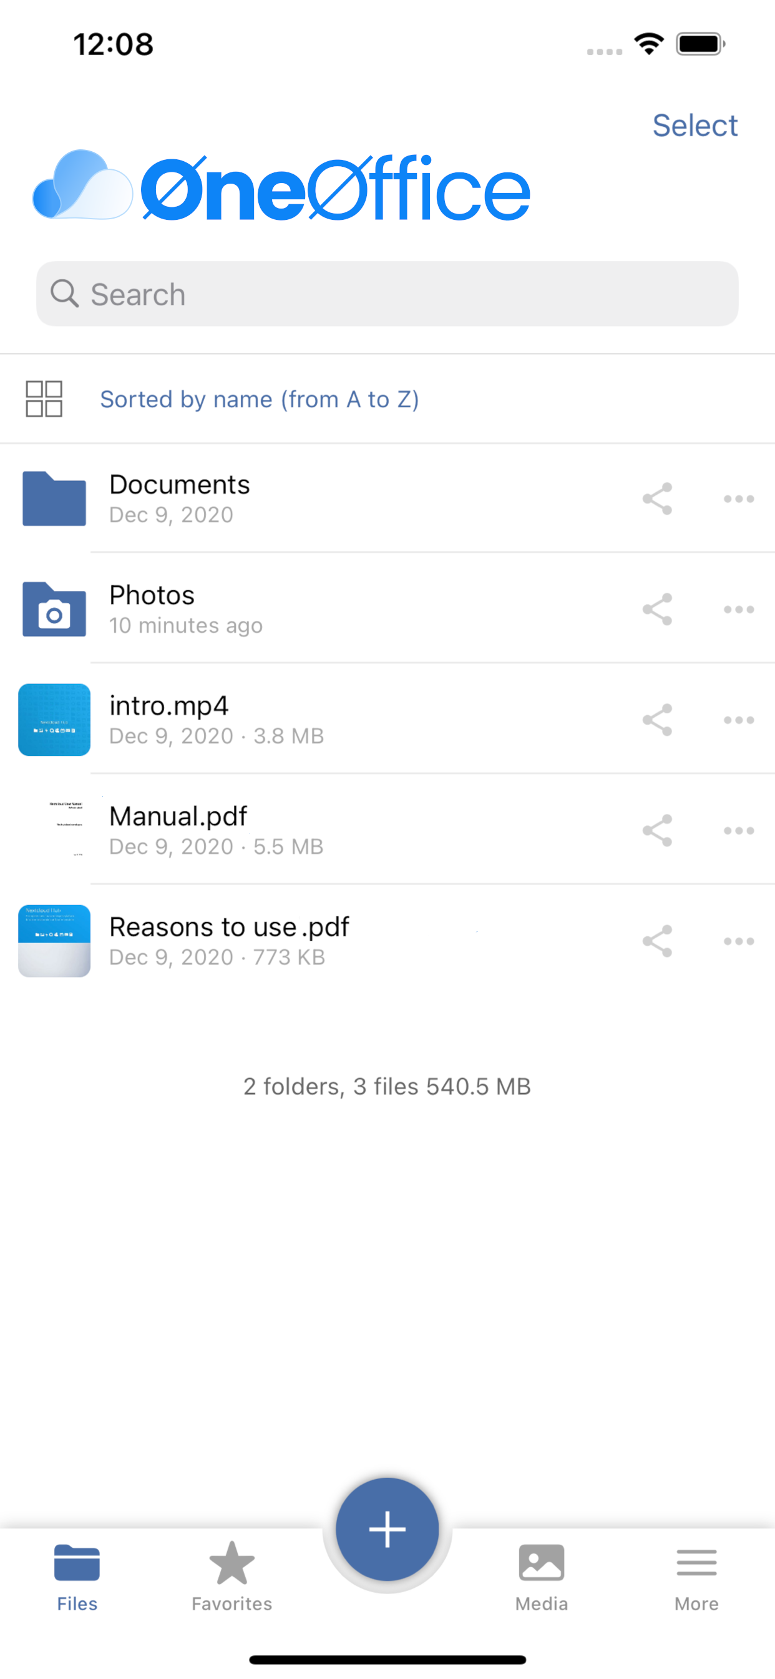

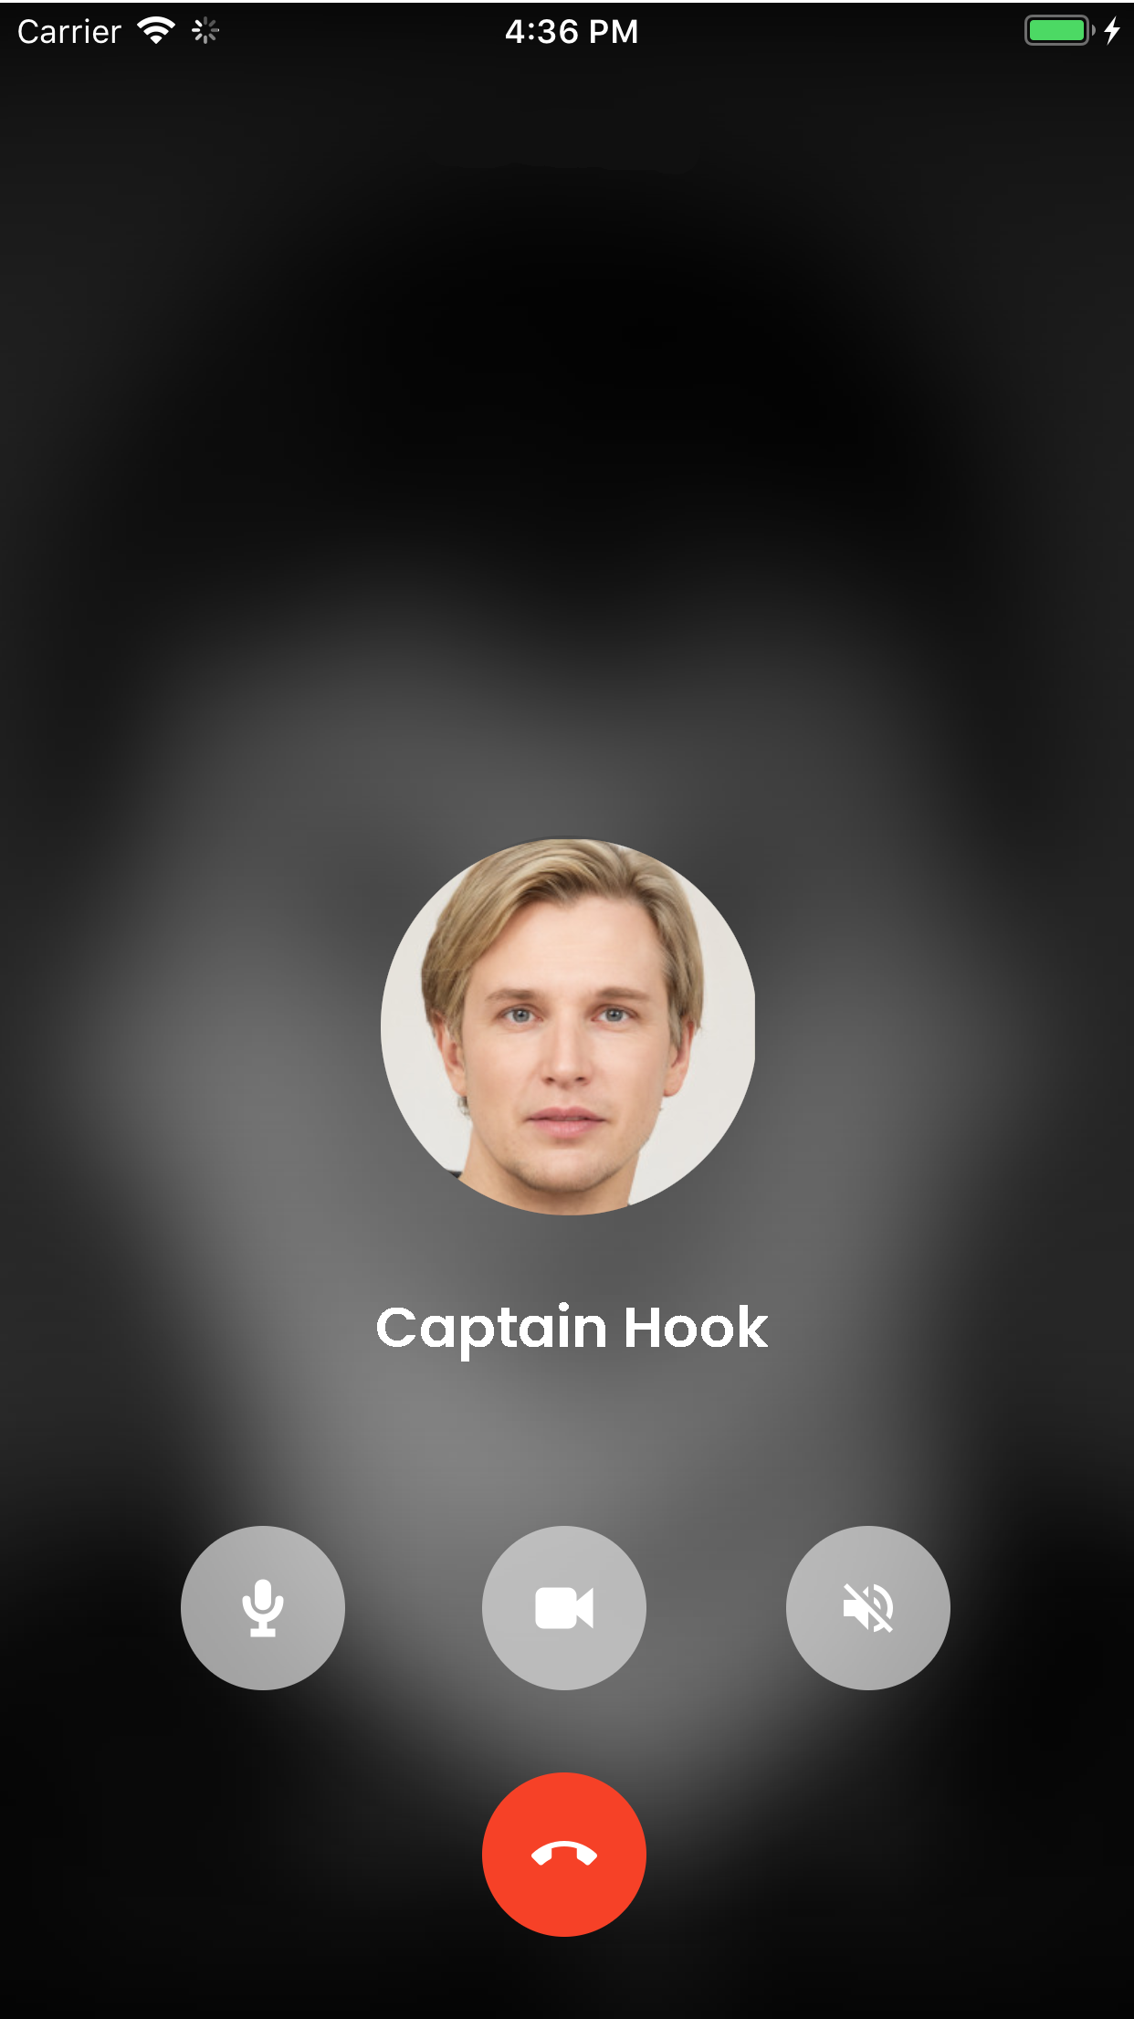
Apps
Drive for Mobile
Meet for Mobile
Authentication Mobile
Desktop editor
Desktop email
Desktop sync / backup

Slide 11

Chats / Calls
End-to-end encrypted
Mobile app
Permanent chat / call links
Background blur
Integrates w/docs & projects

Slide 12
OneOfficeERP – for healthcare

Slide 13
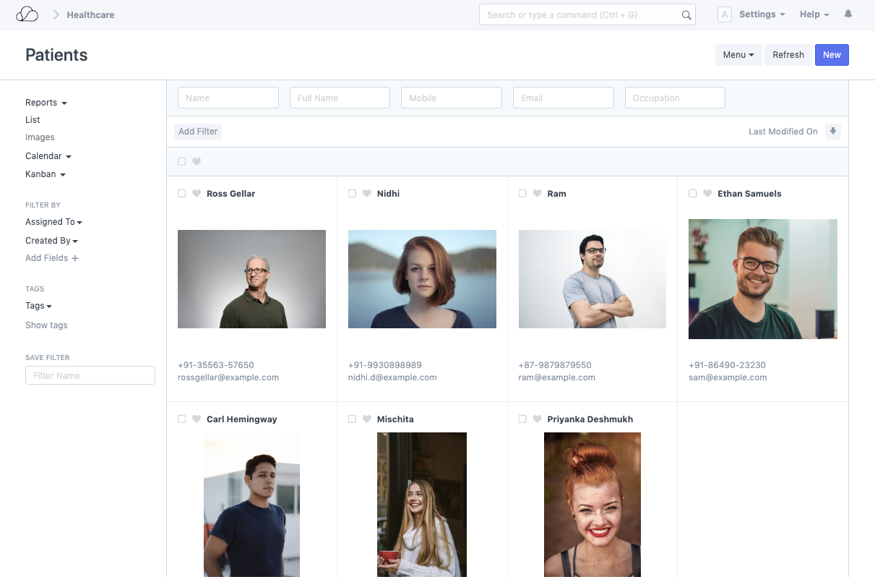
Patient Records
Full patient records
History
Visits
Medication history
Diagnosis history
Doctor & nurse
comments
Additional fields
(next of kin, allergies, etc.)

Slide 14
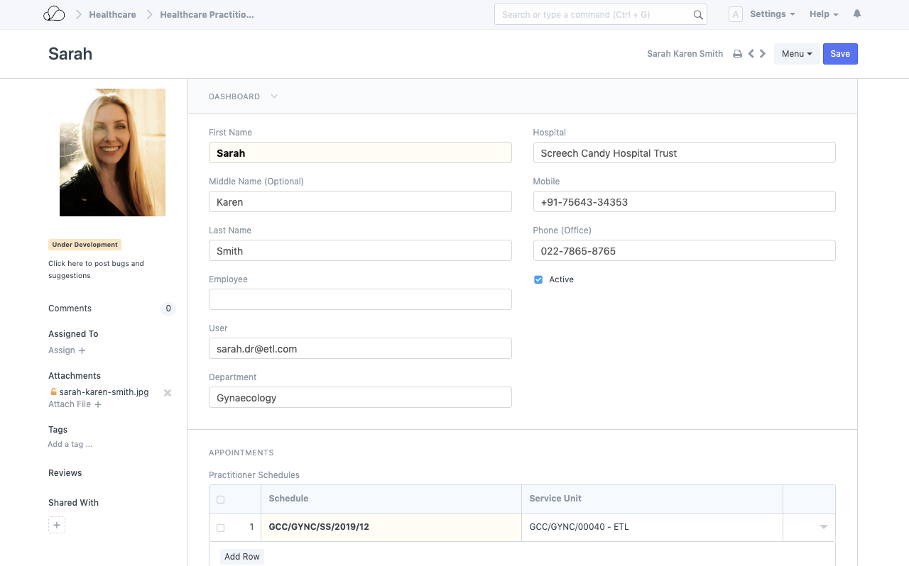
Practitioners
Different profiles
(doctors, nurses etc.)
Access permissions
Employee documents
HR management
Specializations
Schedules
Additional fields
(certifictions, etc.)

Slide 15
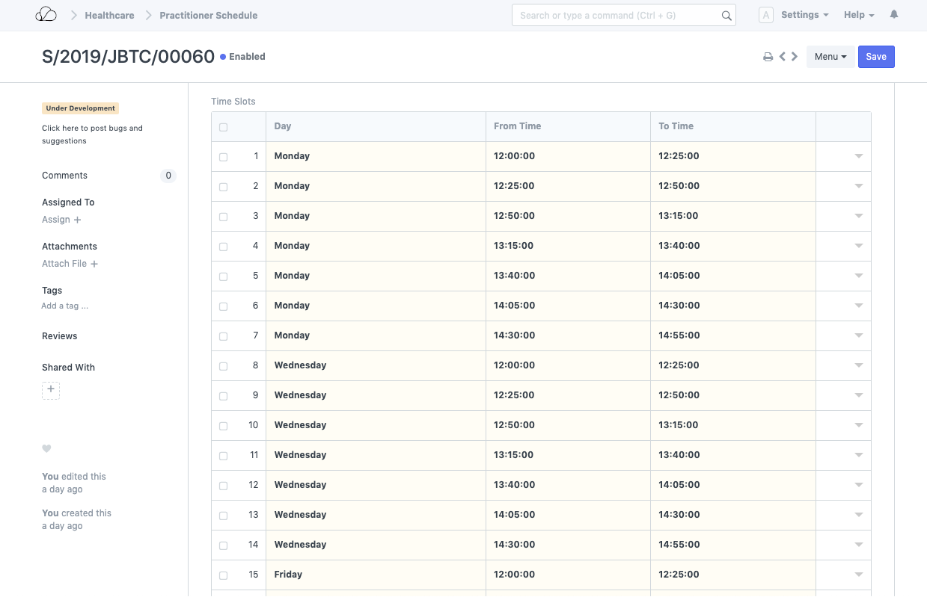
Practitioner Schedule
Availability of practitioners
Time / day blocking
Managing multiple clinics
Real-time booking of appointments

Slide 16
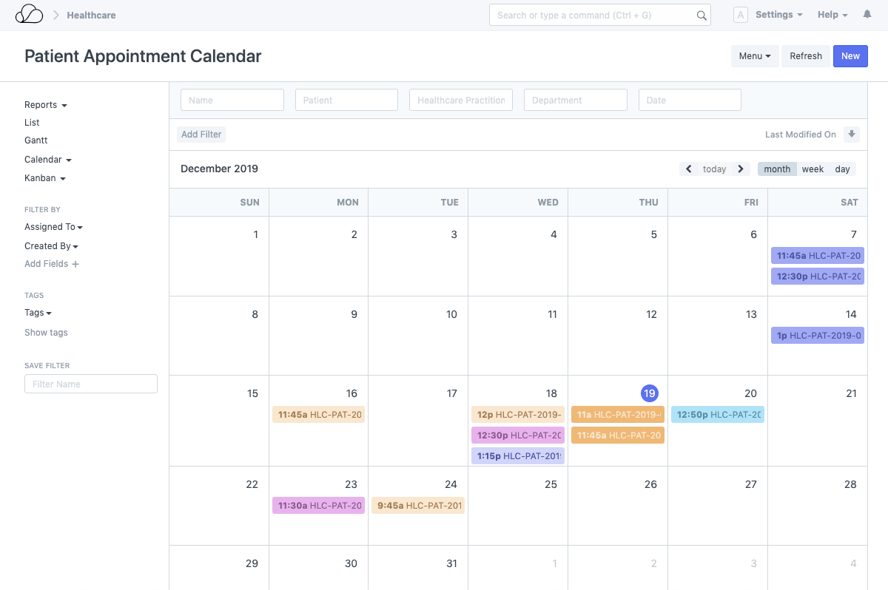
Patient Appointments
Real-time patient booking
Patient reminders and notifications
Real-time changes and cancellations

Slide 17
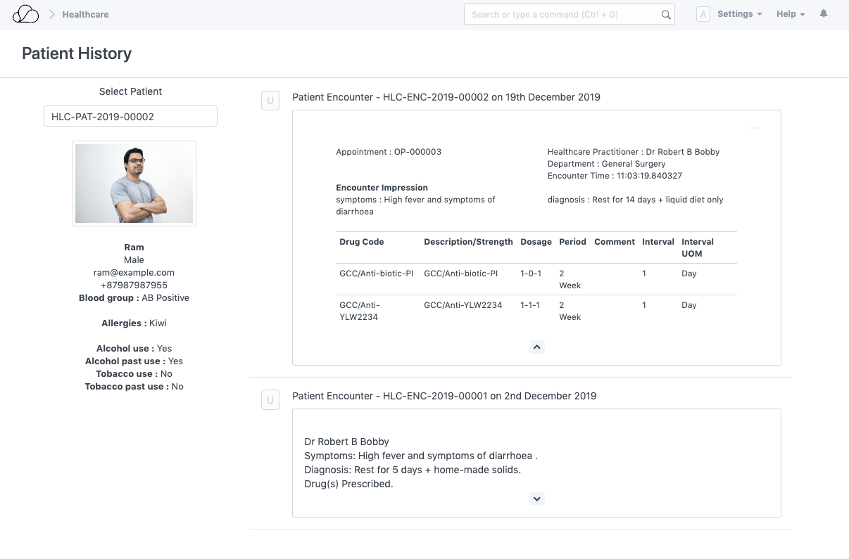
Patient History
Full patient history
Patient conditions
Medications
Allergies
Practitioners
Encounters / visits
Billing

Slide 18
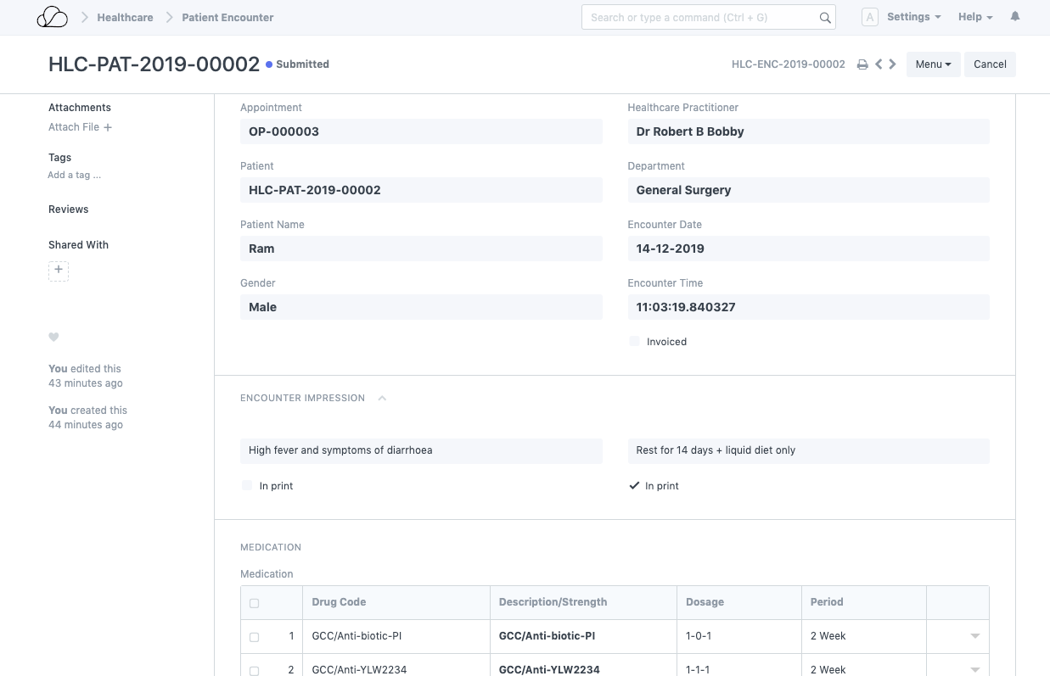
Patient Visits
Patient visit records
Full details
Searchable
Linked to patient profile
Linked to practitioner

Slide 19
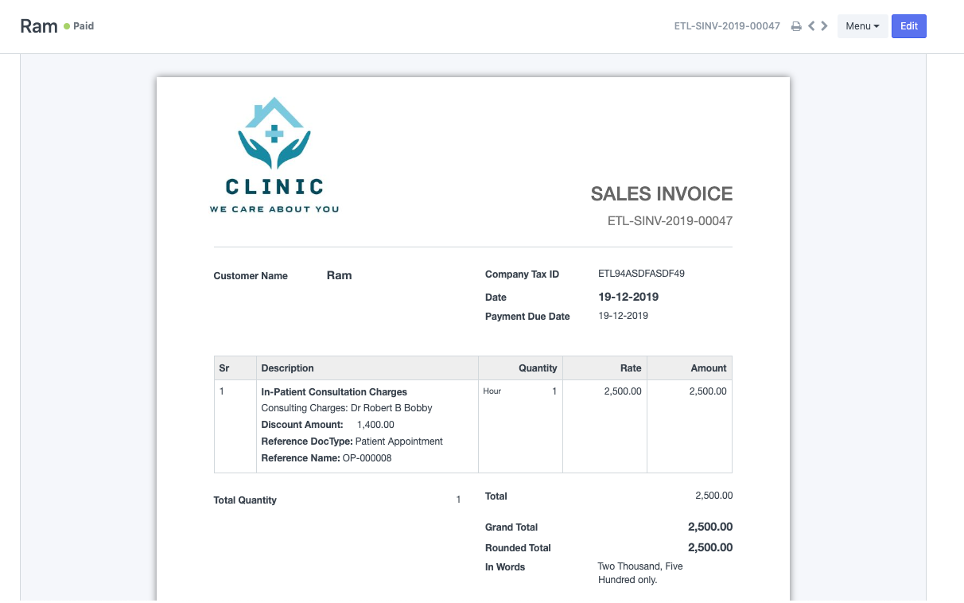
Billing
Automated billing
Customizable
templates
Payment reminders
Linked to patient
financials

Slide 20
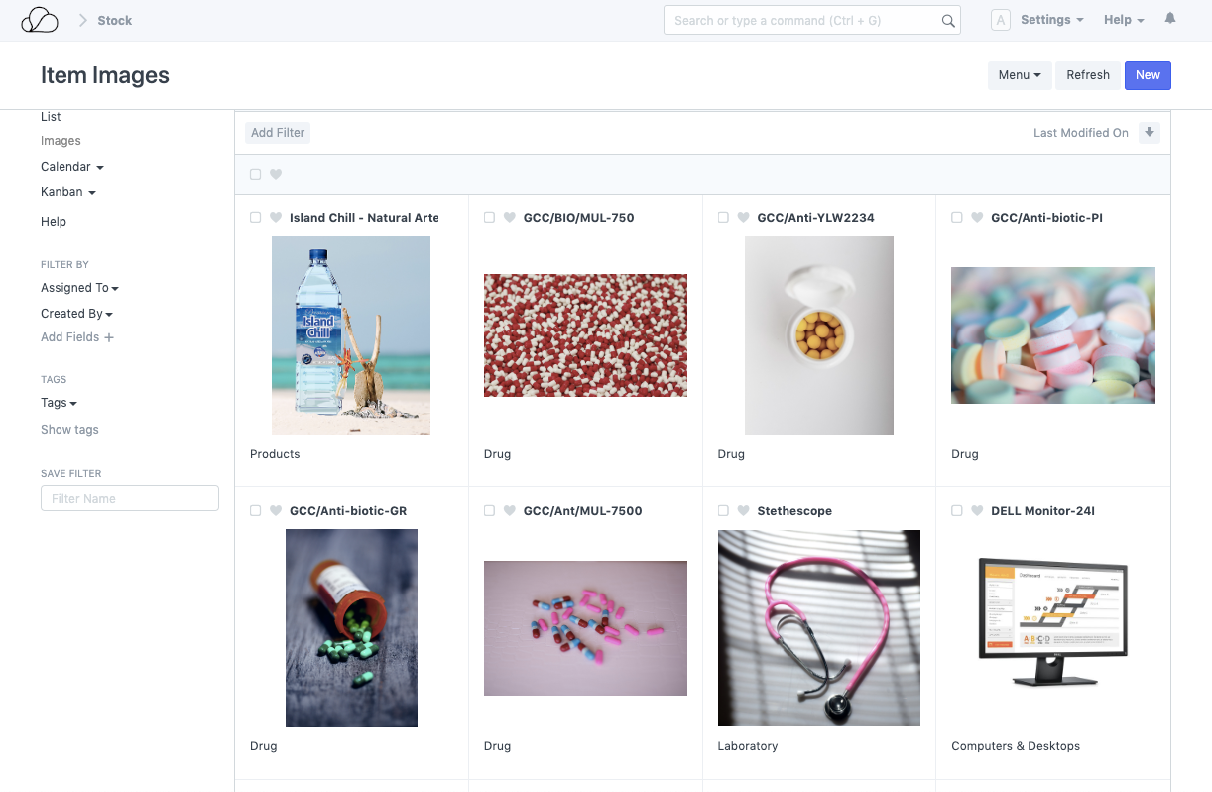
Inventory
Full medical
equipment inventory
Separation based
on toxicity, radioactivity
etc.
Auto-replenishment
Live reports
Multi-locations
Transfers

Slide 21
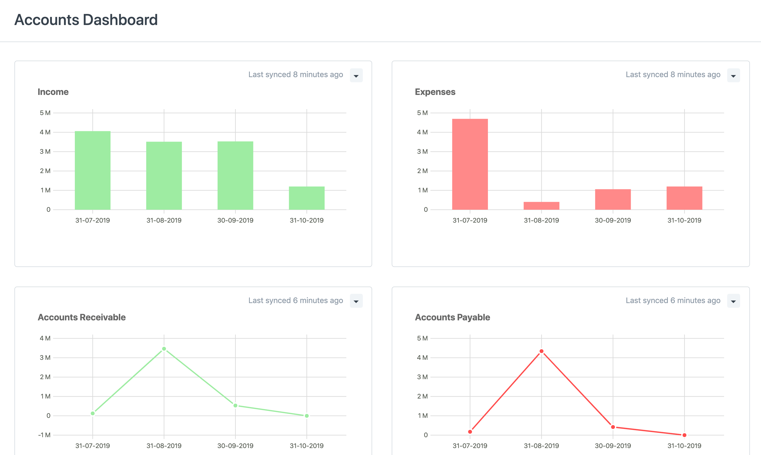
Finances & Accounting
Dashboards
Real-time books
Chart of accounts
Journals & payments
Billing & pricing
Multi-currency
Auto-invoicing
Banking

Slide 22
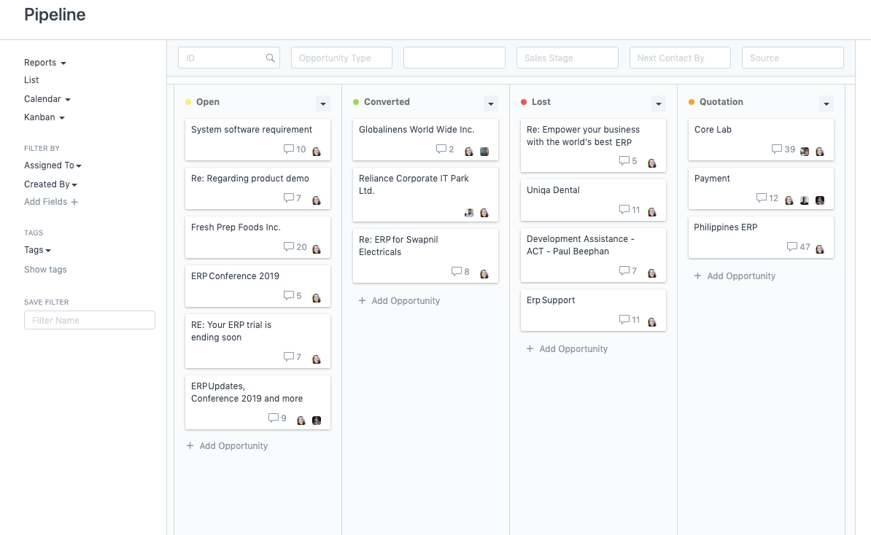
Customer Relationships
Omnichannel
Automated
Sales efficiency
360 visibility
Quotations
Digital marketing
Social Media
Notifications
Meetings & follow ups

Slide 23
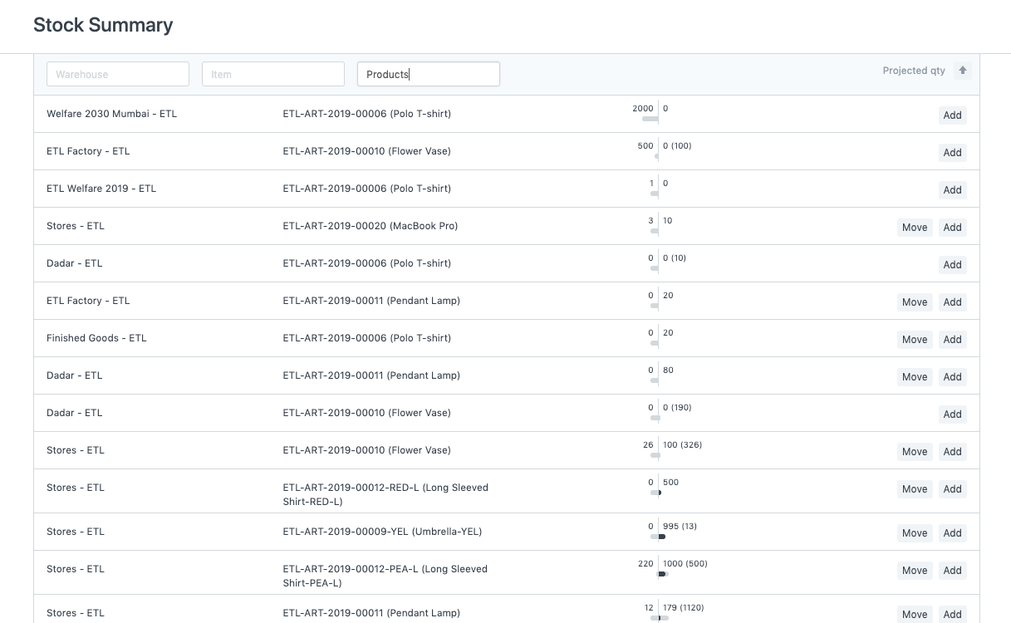
Inventory & Warehouses
Stock reports
Multi-warehousing
Item variants
Promotional schemes
Automated replenishment
Multi-currency accounting
Billing & pricing
Credits & receivables

Slide 24
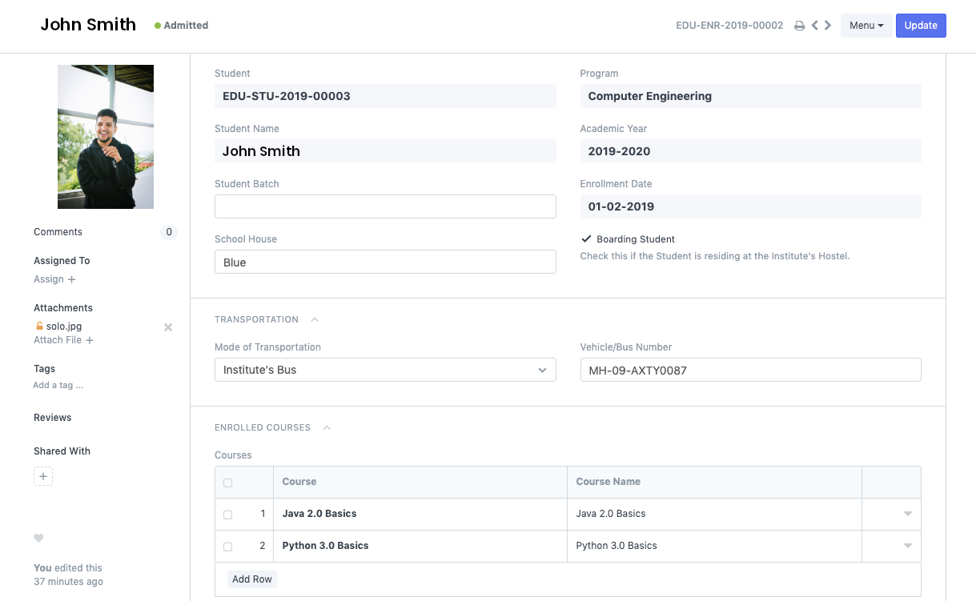
Education & Learning
Course documents
Instructors
Program enrollment
Program & Courses
Attendance
Assessments
Role integration

Slide 25
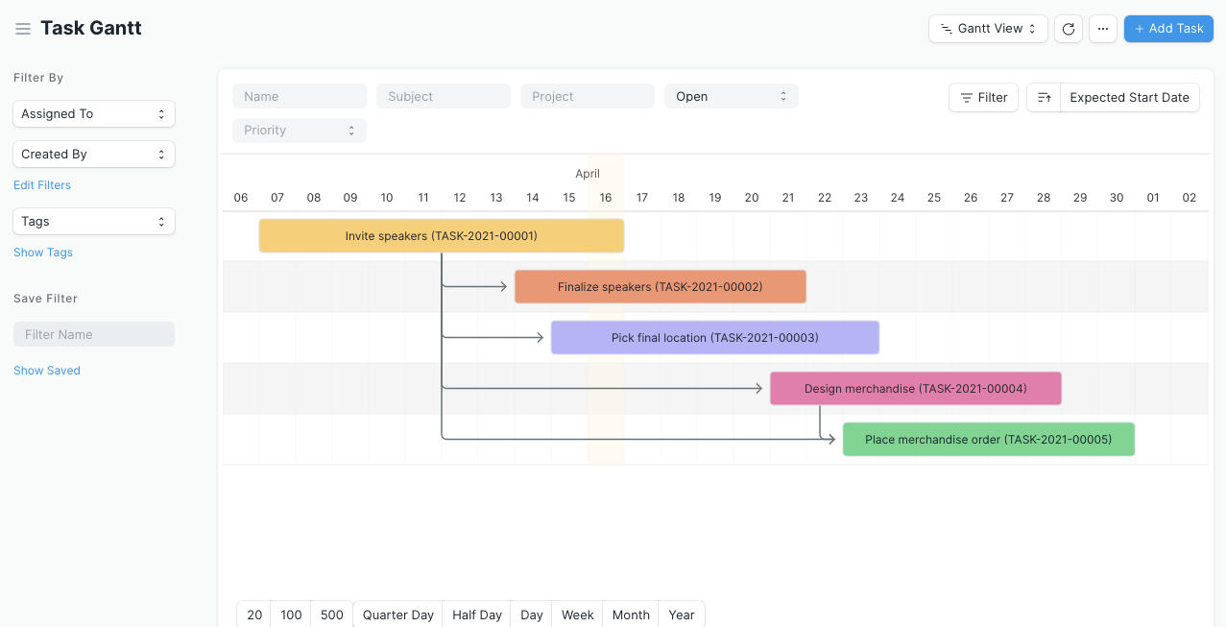
Projects
All-in-one PM
Agile projects / Kanban
To-dos & Chats
Document linking
Emails & notifications
Project costing
Profitability
Time-tracking
Billing
Customer access

Slide 26
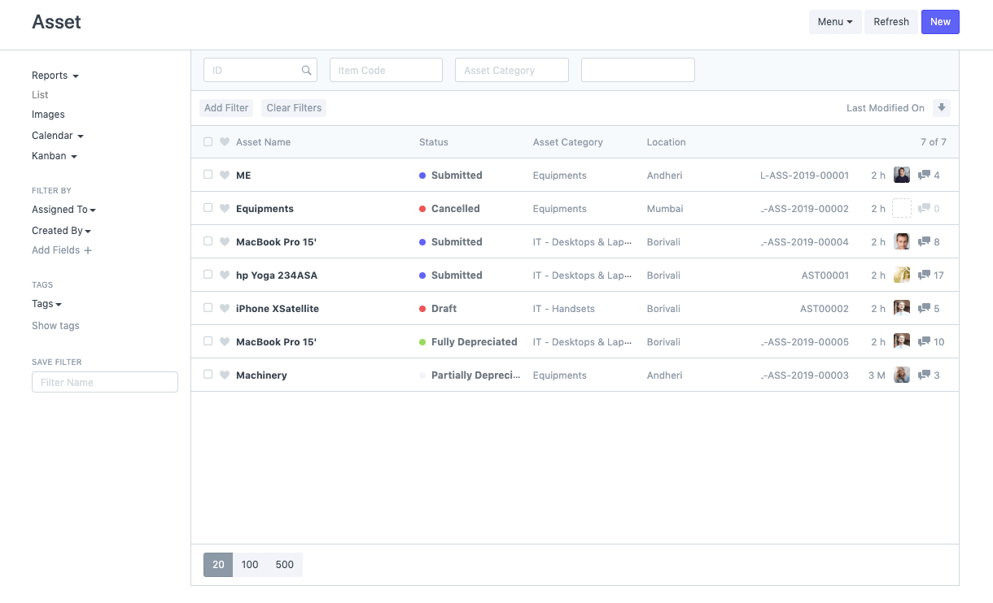
Asset Management
Asset lifecycle
Asset inventory
Purchasing
Selling / Disposal
Auto depreciation
Scrapping
Value adjustment
Reporting

Slide 27
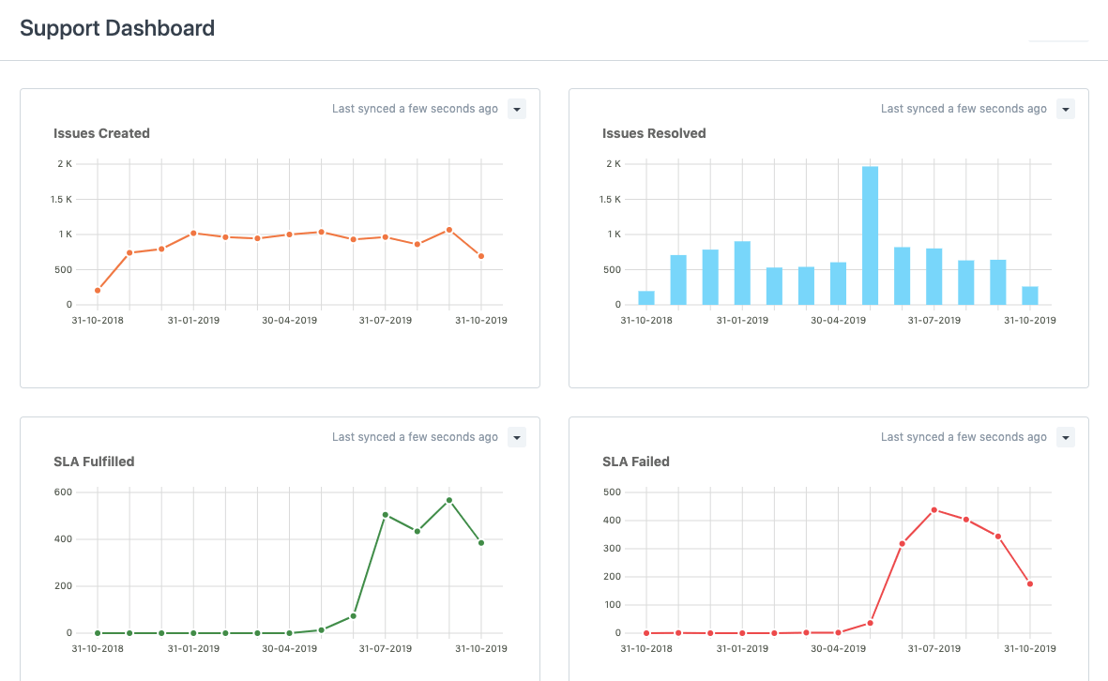
Helpdesk & Support
Omnichannel
interactions
Customer tickets
Automate ticket
assignments
Team performance
SLAs
Knowledge base
Scheduling Maintenance
Visits

Slide 28
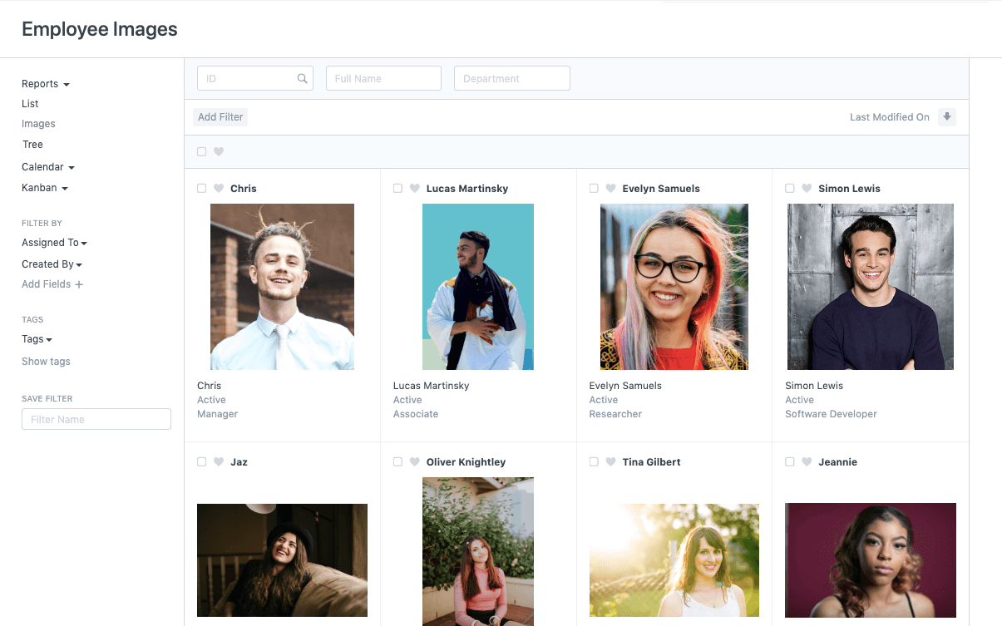
Human Resources
Talent acquisition
Employees
Training
KPIs
Expenses
Attendance
Leaves
Payroll & taxes
Salary structures
Timesheets
Variable pay

Slide 29

Productive ...
Patient-centric healthcare

Slide 30

“
Having the right tool for the job is half the battle

Slide 31
Please feel free to contact us
info@oneoffice.ca

