Slide 1

Modern HigherEd
Only on
The complete technology solution for today’s universities & colleges

Slide 2
Mission - A simple, complete & secure platform to empower productive institutions

Slide 3

Why?
1. Complete & Easy-to-use
All features in one convenient place
2. Secure
Private servers, end-end encryption
3. Cost Effective
Technology, servers, updates, IT

Slide 4
Introduction
The modern university needs three main platforms to operate effectively
Productivity & Collaboration – Files, Emails, Video
Learning Management System
Campus Management System
OneOffice provides a single comprehensive integrated solution

Slide 5
OneOffice Productivity

Slide 6

Features
Full productivity – Word, PPT, XLS, Visio
Real collaboration
Email, Calendar, Contacts
Files & Storage
Secure Video & Chat
Projects
Forms
Appointments
Notes
Hybrid
Military-grade Security

Slide 7
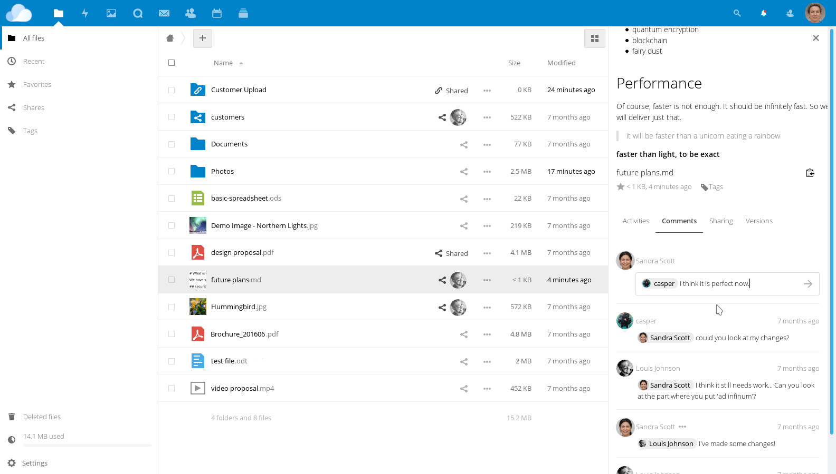
Files & Sharing
Folders & Files
Desktop sync
Live-chat
Internal share
External share w/ different permissions
Version control
Audit
Comments
Tags

Slide 8
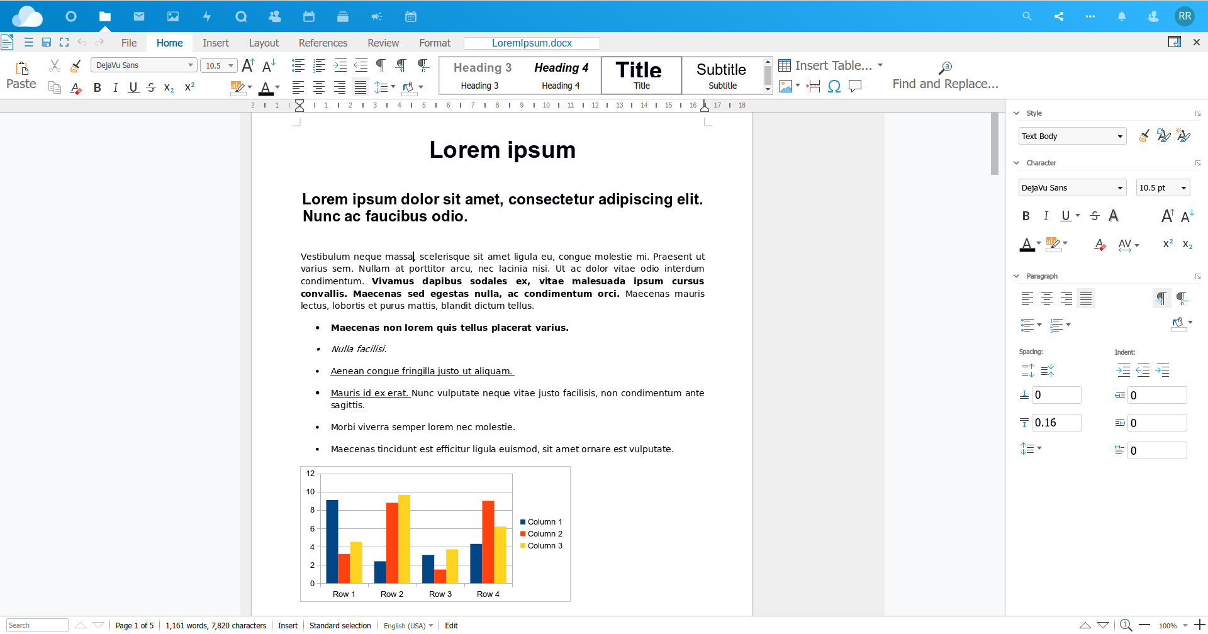
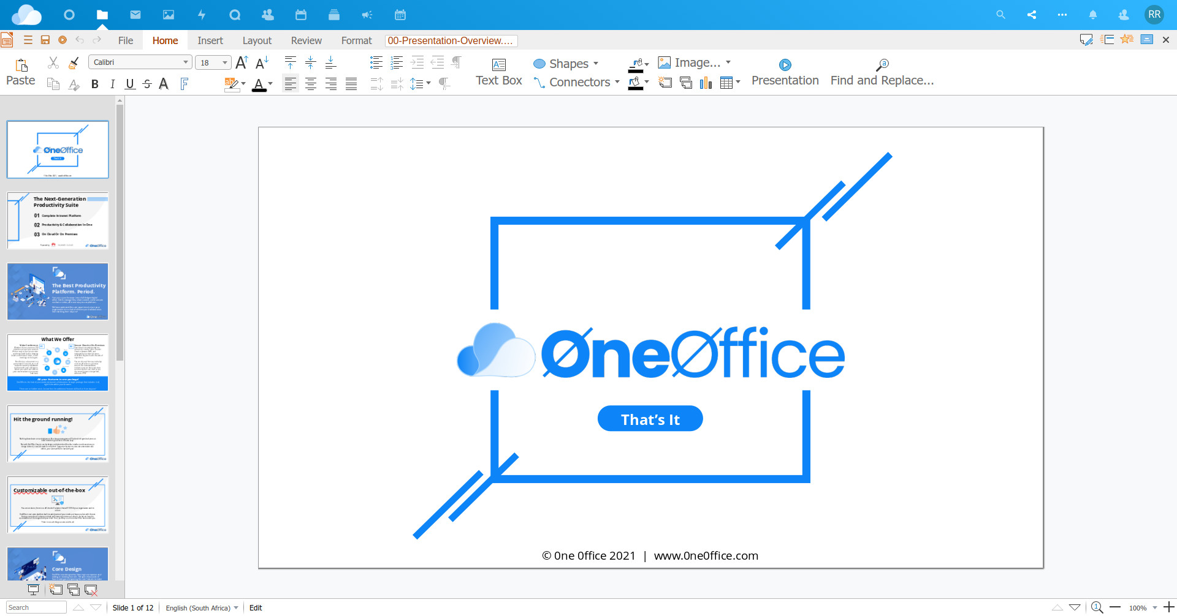
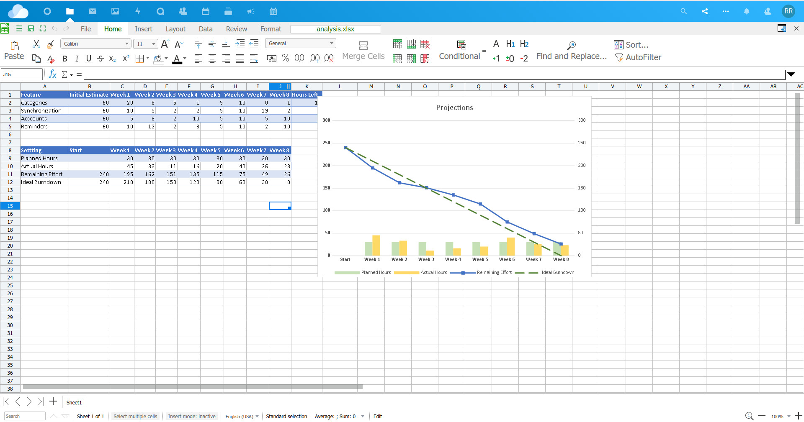
Documents
z
Full Online Editor
Lightning fast
Word, PPT, Excel, Visio
Live-collaboration
Comments
Track changes
PDF / format conversion
Live presentation
Live chats & calls

Slide 9
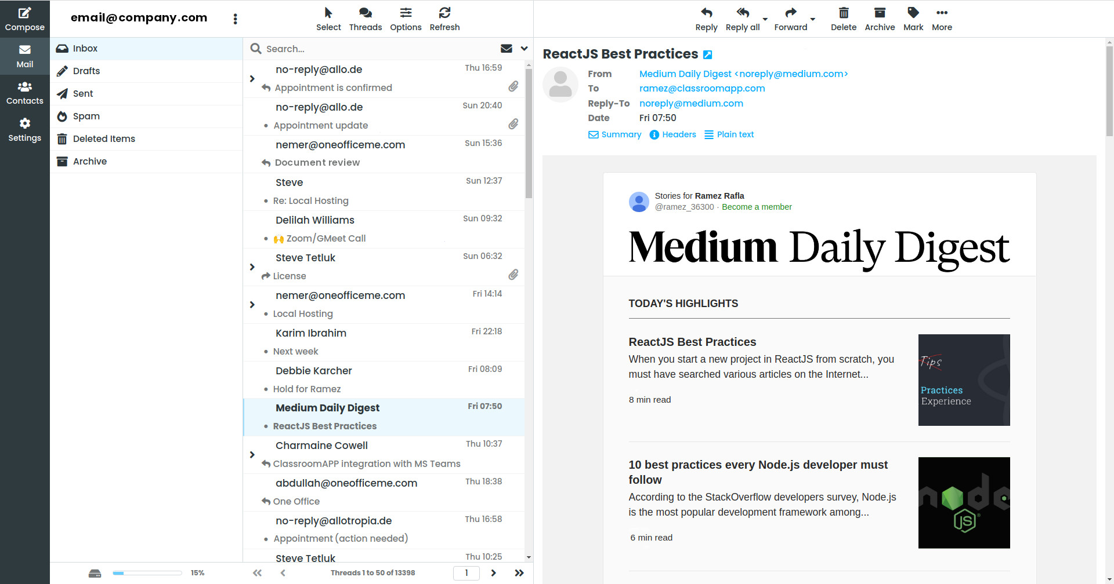
Emails
Secure email server
Lightning fast
Mobile sync
Out of office
Filters
Files integration

Slide 10
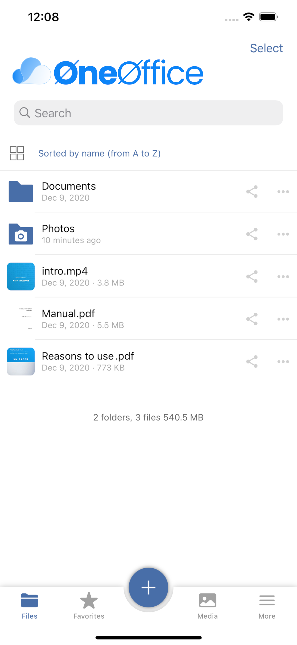
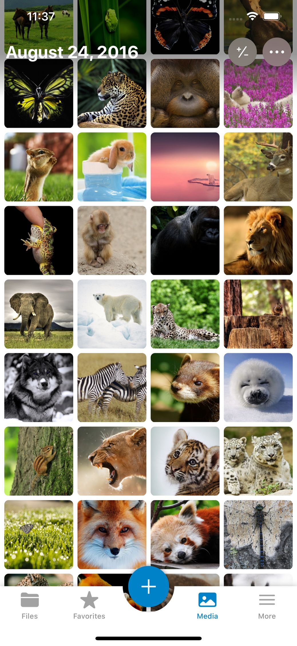
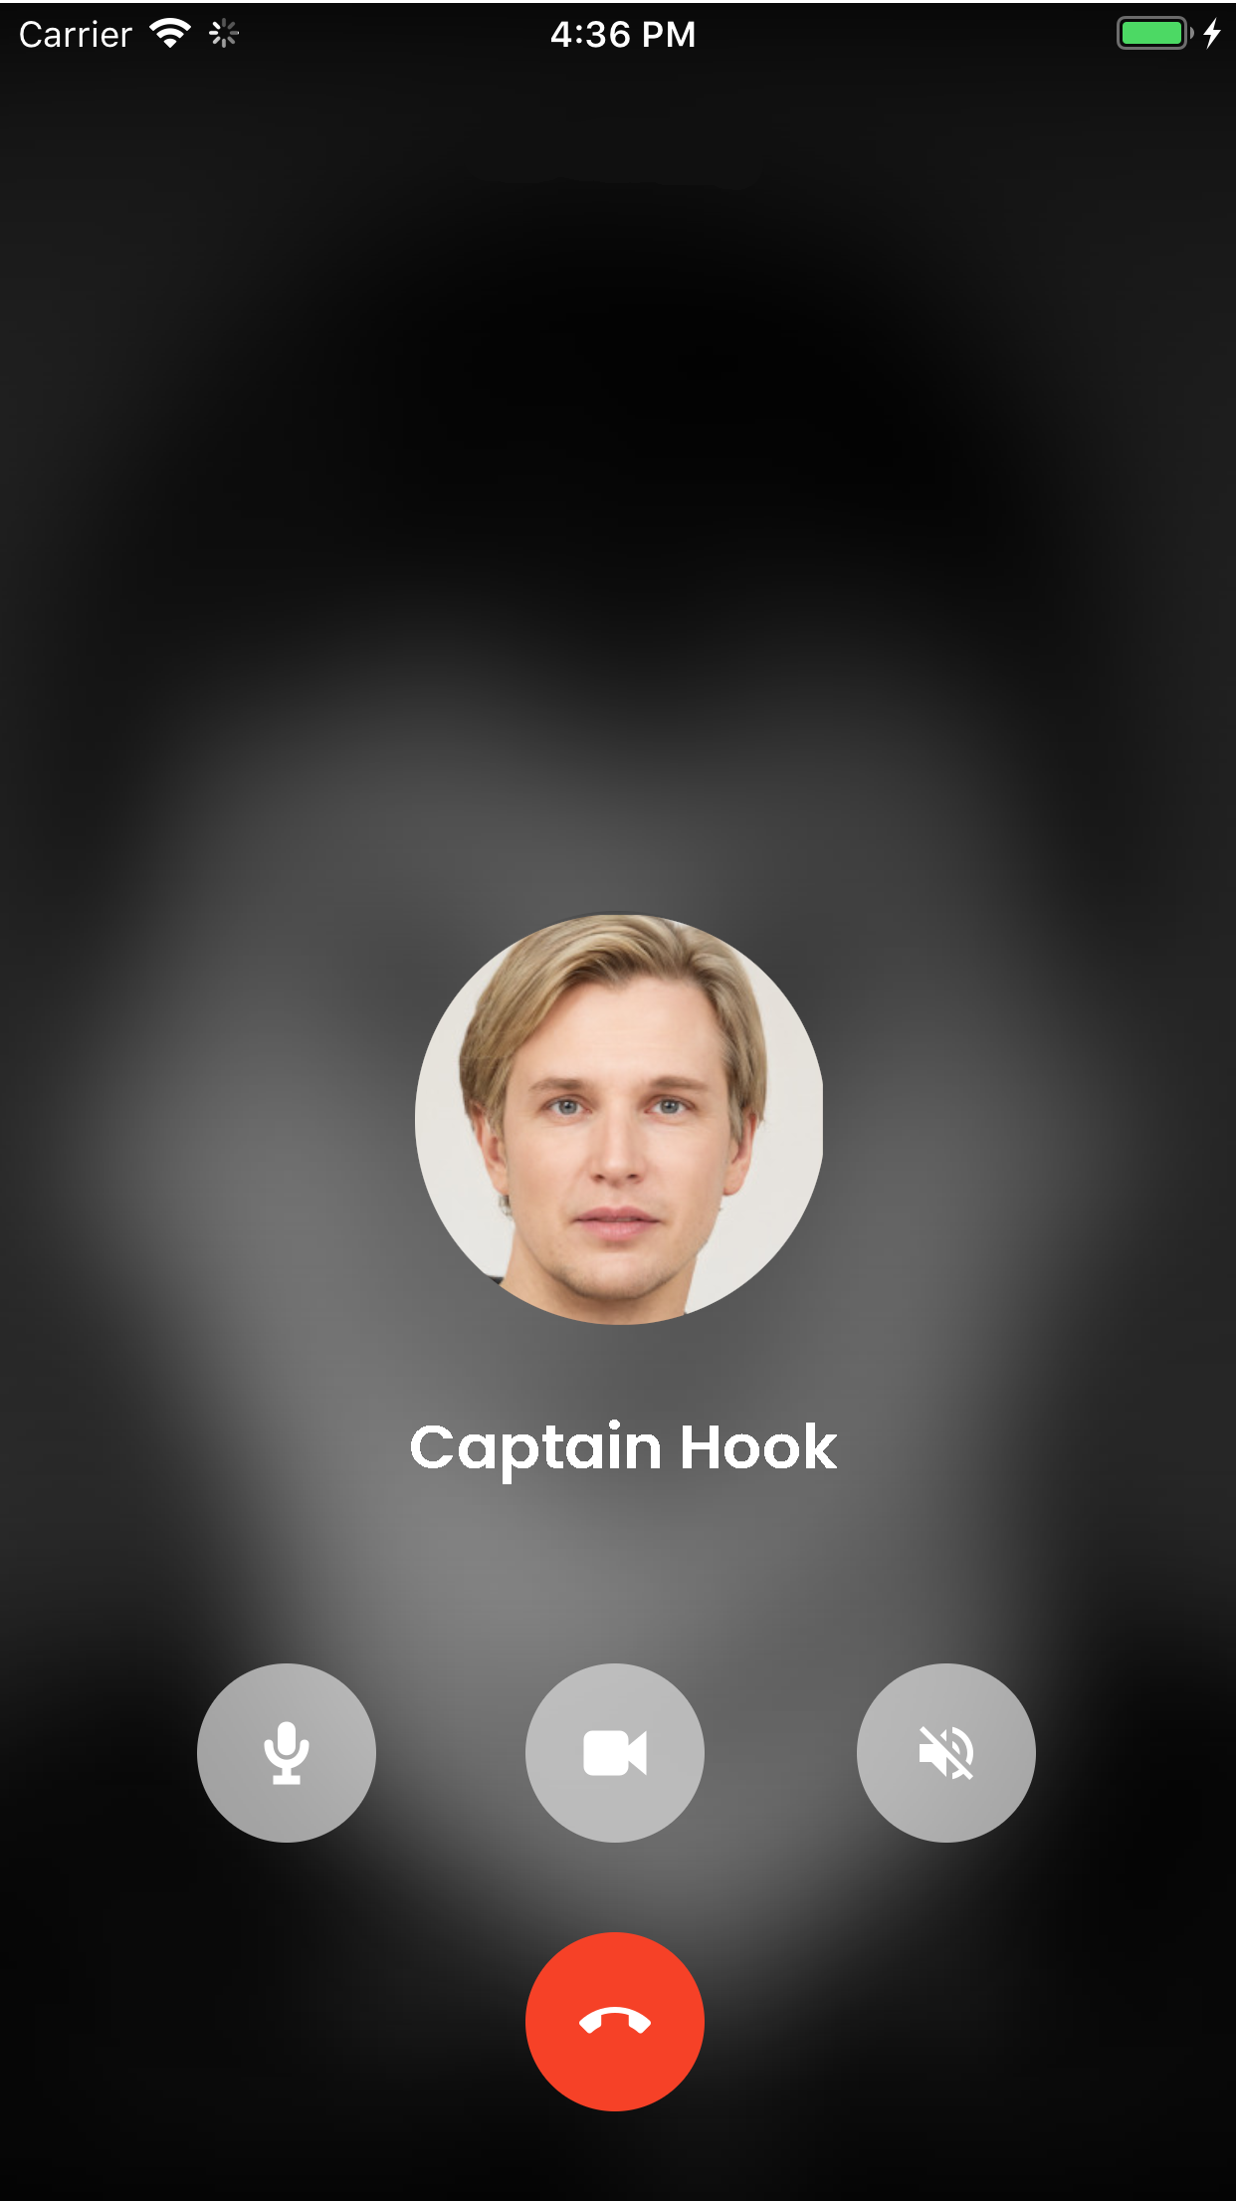
Apps
Drive for Mobile
Meet for Mobile
Authentication Mobile
Desktop editor
Desktop email
Desktop sync / backup

Slide 11
Chats / Calls
End-to-end encrypted
Mobile app
Permanent chat / call links
Background blur
Integrates w/ docs & projects

Slide 12
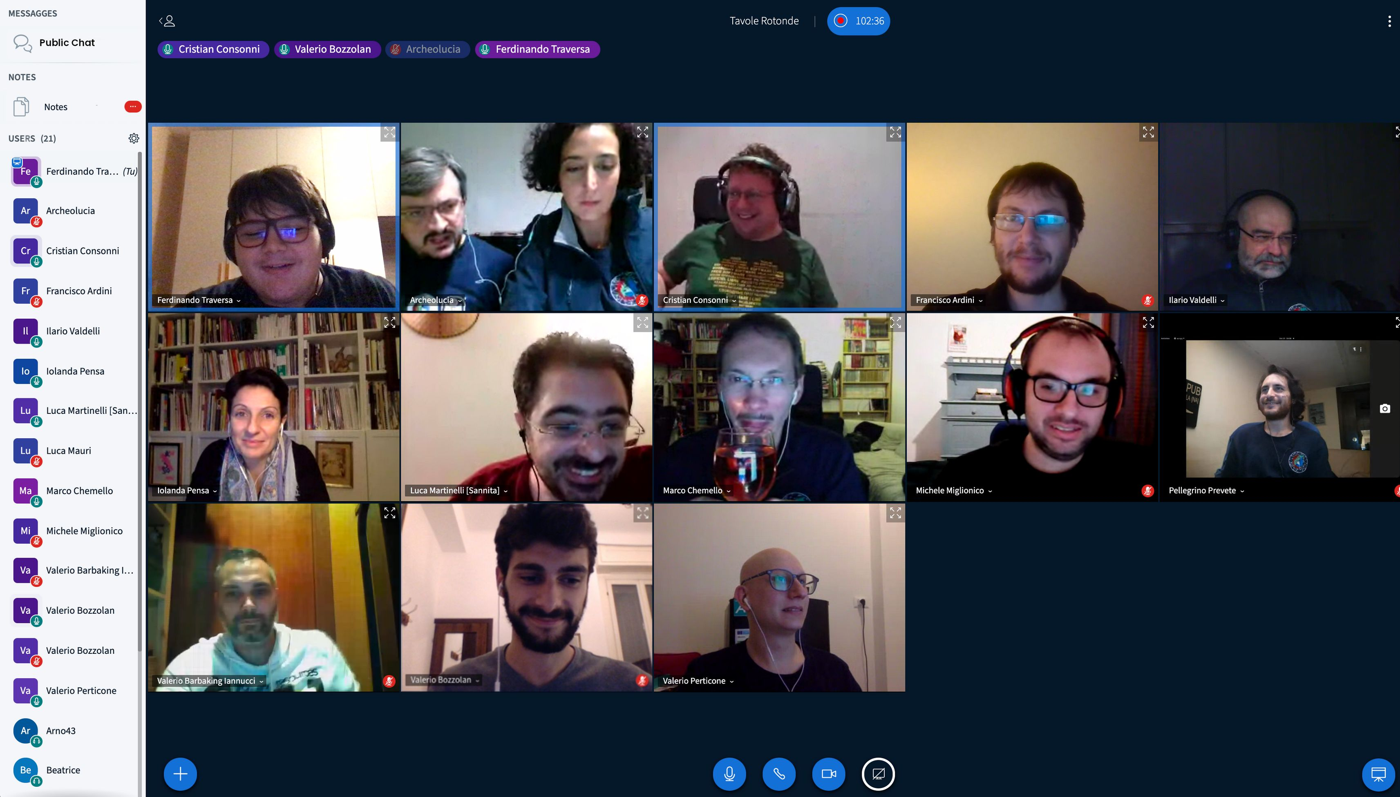
Webinar
Up to 1000 users
Recording
Lighting fast
Low bandwidth
Smart audio check
Document sharing
External video sync
Secure chat
Mobile-ready

Slide 13
Learning Management System – based on Ilias

Slide 14
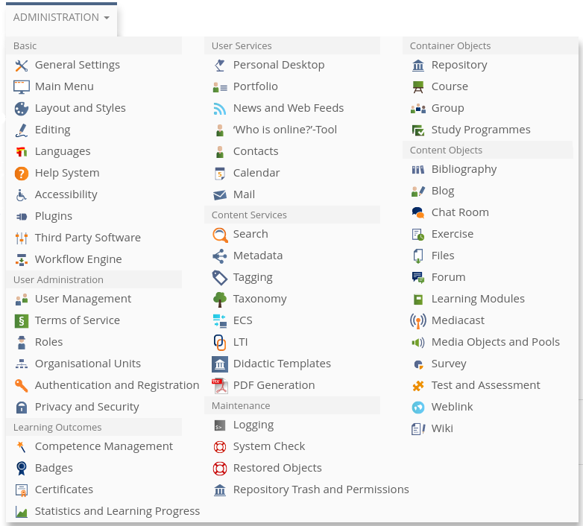
Complete Feature-Set
Testing & Question banks
Content & Learning Objects
Portfolios
Gradebook
Advanced user permissions
Reports
Social - Blog, forum, chat, wiki
Multimedia
Calendar
Certificates
Video conferencing
Media
Integration & Single Sign on

Slide 15






In Great Company!
Universität zu Köln - Germany
(2004) 105,000 users
Universität Bern - Swiss
(2006) 70,000 users
Copernicus Languages - Italy / EU (2004) 50,000 users
Toulouse III - France
(2012) 35,000 users
University of Jaén - Spain
(2003) 25,000 users
Altai State Technical Univ - Russia
(2012) 20,000 users

Slide 16
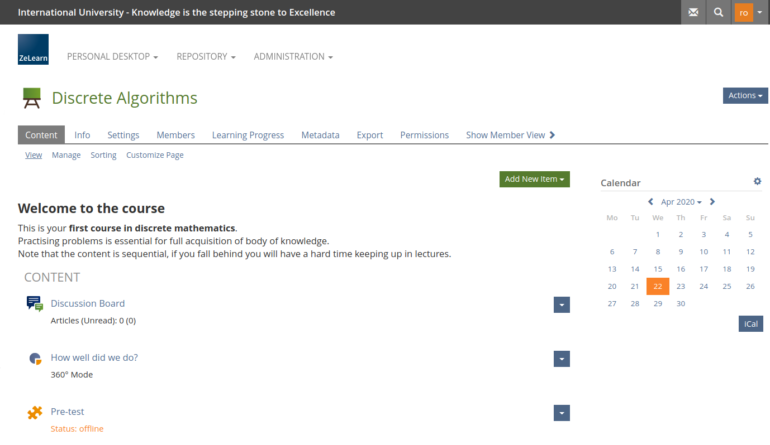
Intuitive User Interface

Slide 17
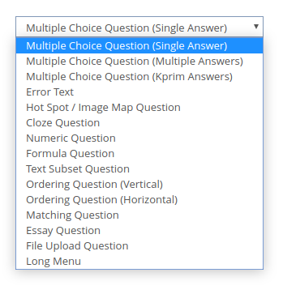
Best-in-Class Testing Engine
Common question types
Automated test generation
Random order to avoid cheating
Kiosk mode to lock students
Advanced reports
Automated remediation
Timed tests

Slide 18
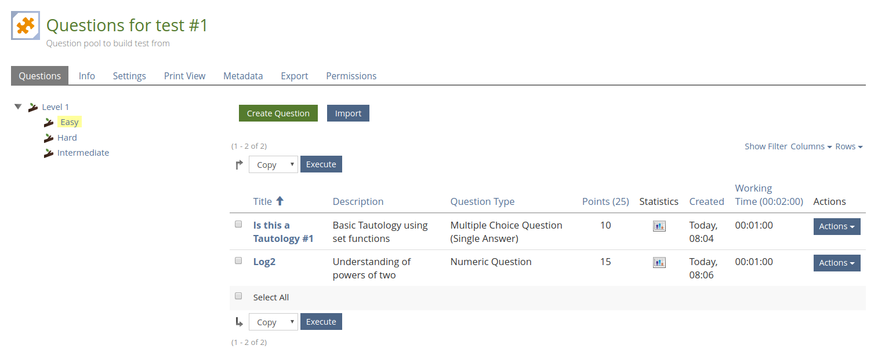
Question Banks
Easy creation of questions
Advanced taxonomies
Intelligent auto-correction
Import / export
Sharing of question banks
Statistics per question / taxonomy

Slide 19
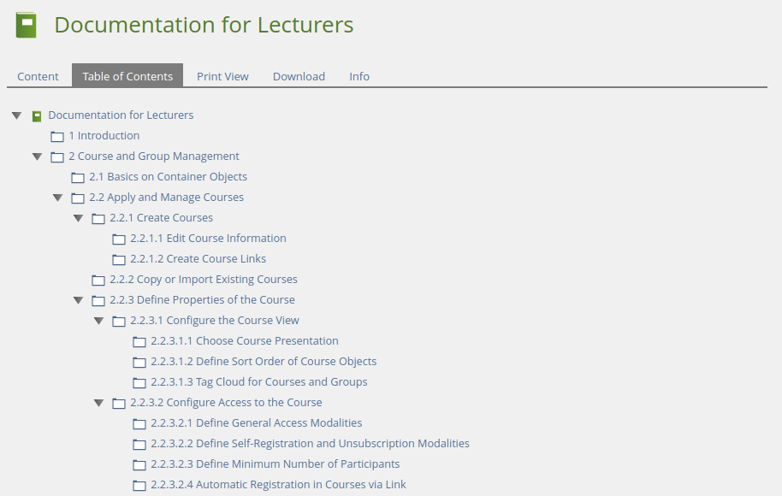
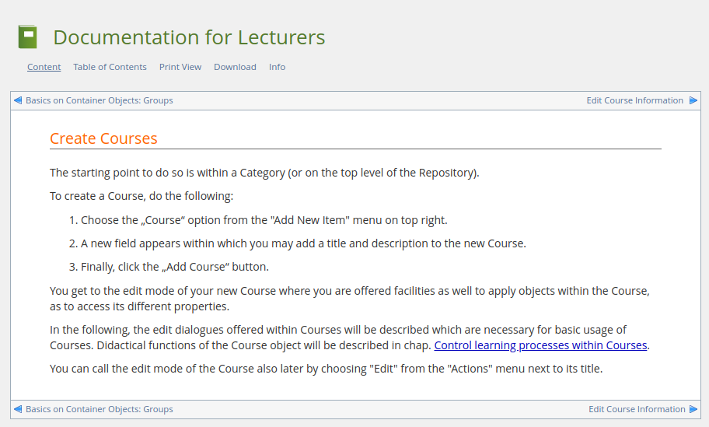
Ebook / Content Creation

Slide 20
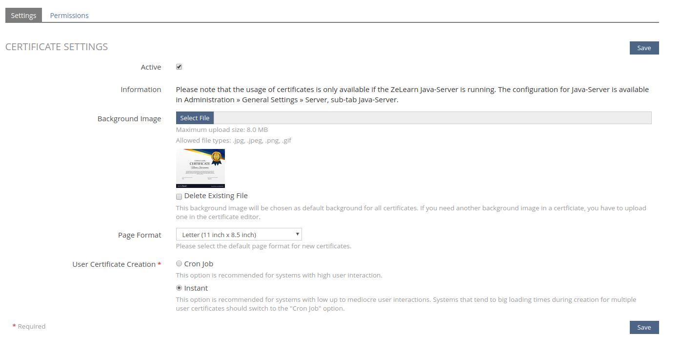
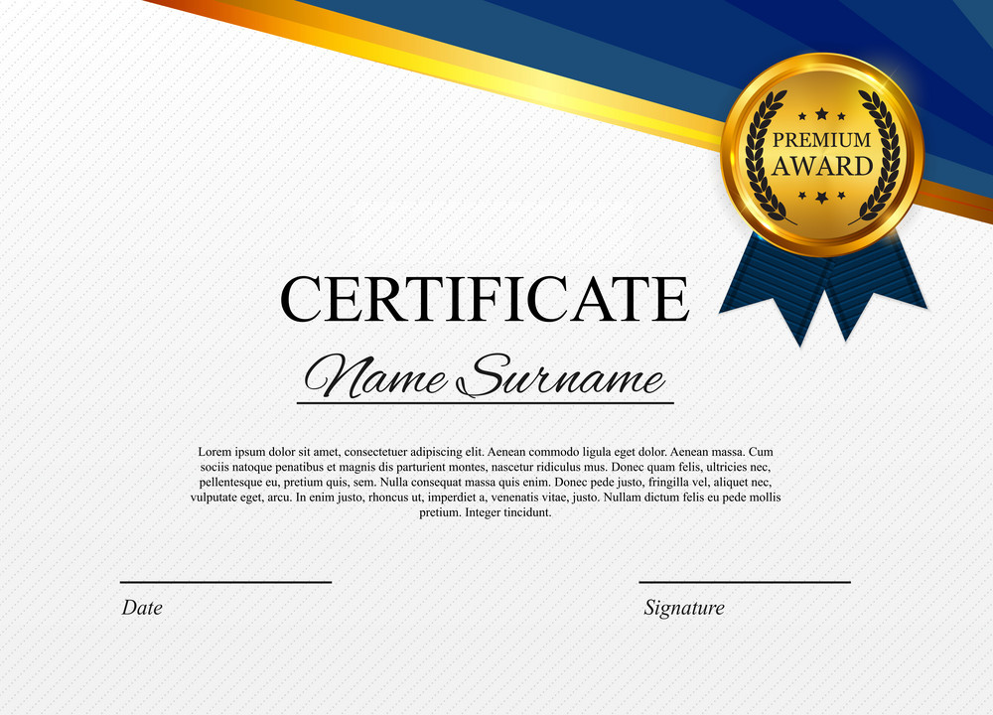
Certificates & Badges
Automated certificate generation
Link to student progress / completion
Customization

Slide 21
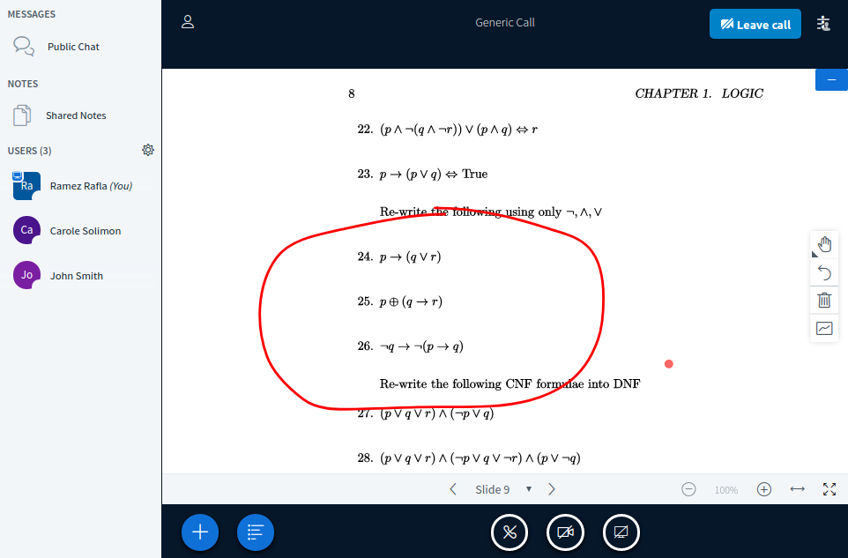
Distance Learning
Real-time video / audio
White board
Session recording
Real-time collaboration
Polls
Synchronized Slides
Synchronized Videos
Public / private chat
Breakout rooms
1000 users per session

Slide 22
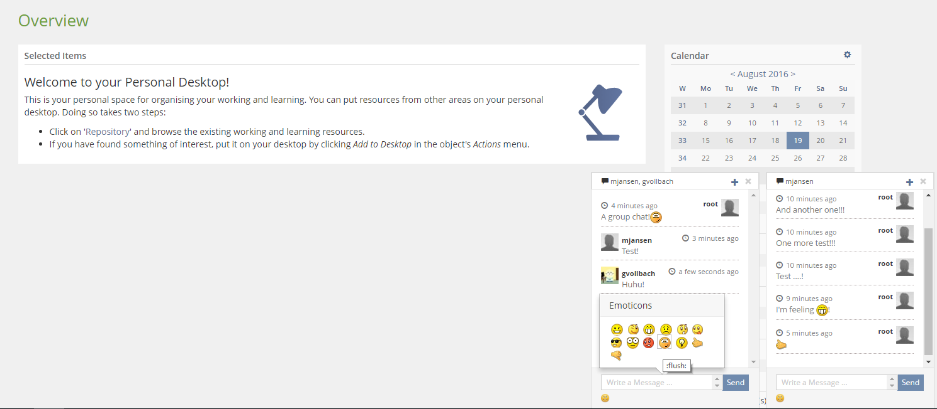
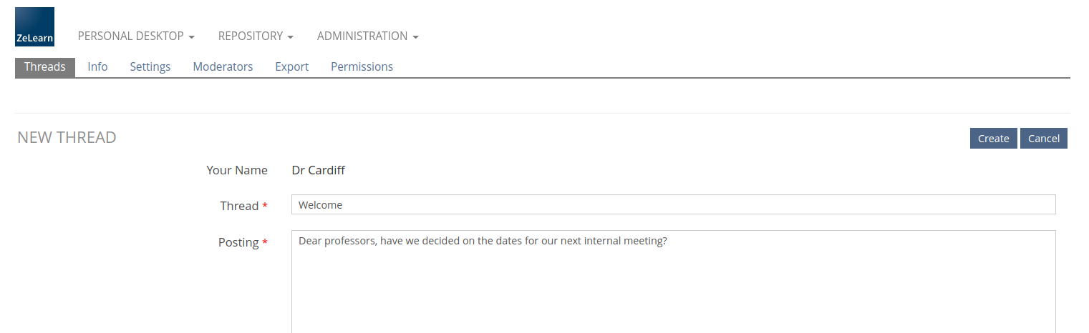
Collaboration & Communication
Real-time chats
Moderated forums
Content sharing
Shared workspaces

Slide 23
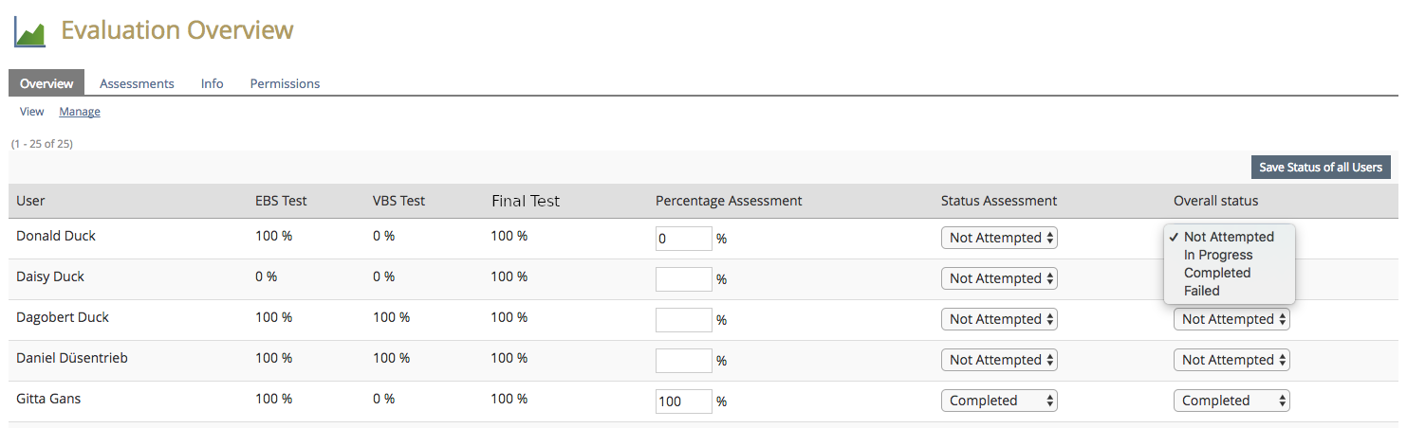
Gradebook
Automated course results
Weighted tests
Manual & automated tests
Import paper tests
Export as XLSX
Push to SMS / Backend

Slide 24
Campus Management

Slide 25
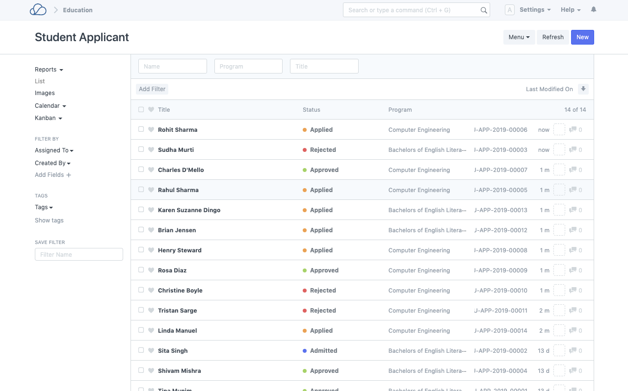
Student Applications

Slide 26
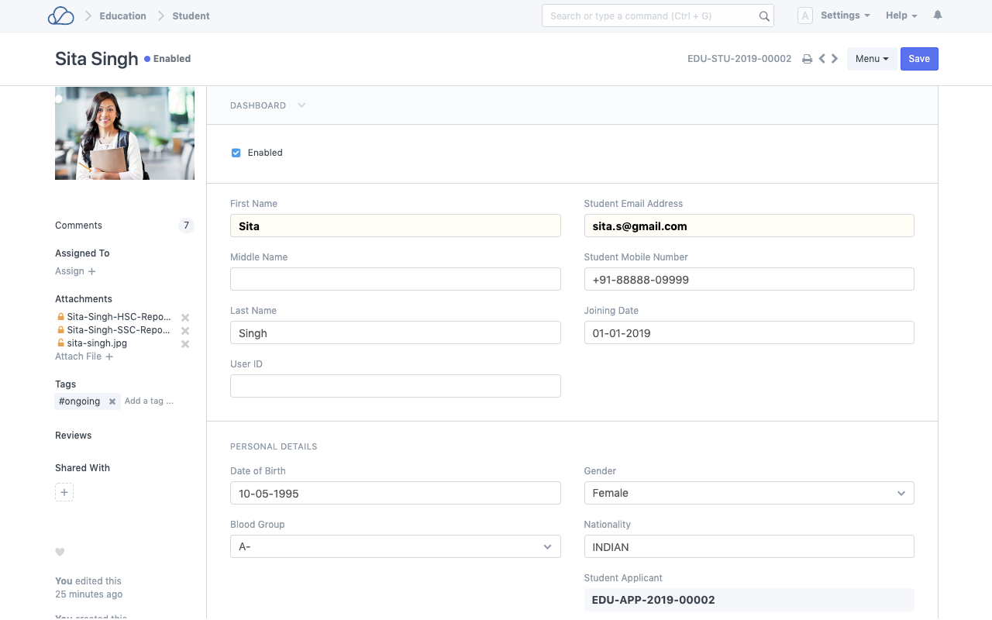
Student Information System

Slide 27
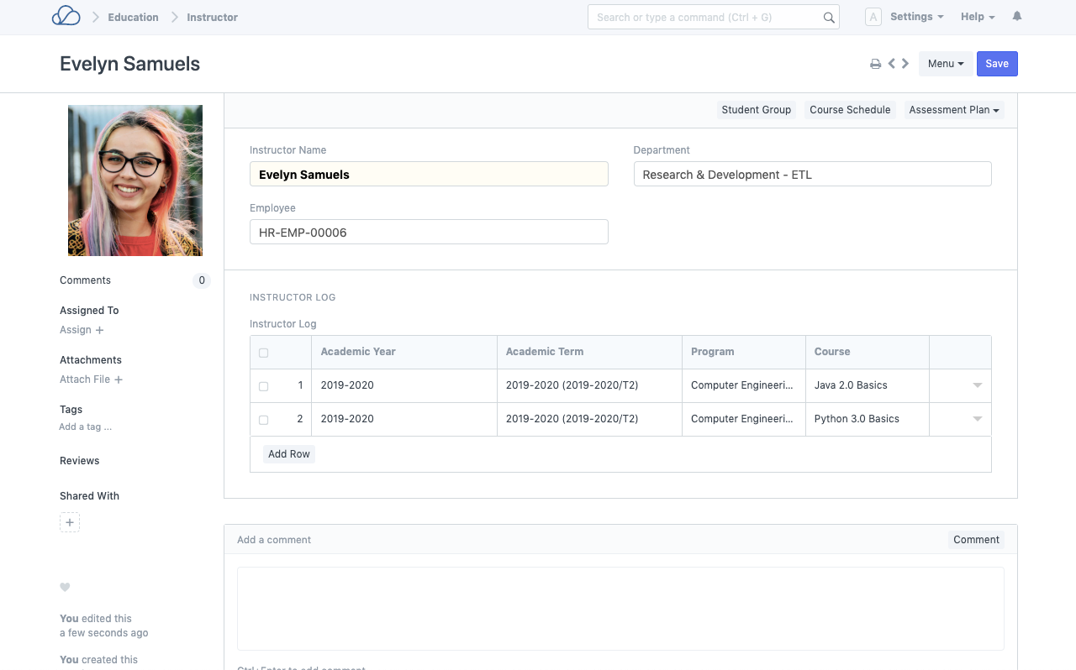
Professors / Academic Staff

Slide 28
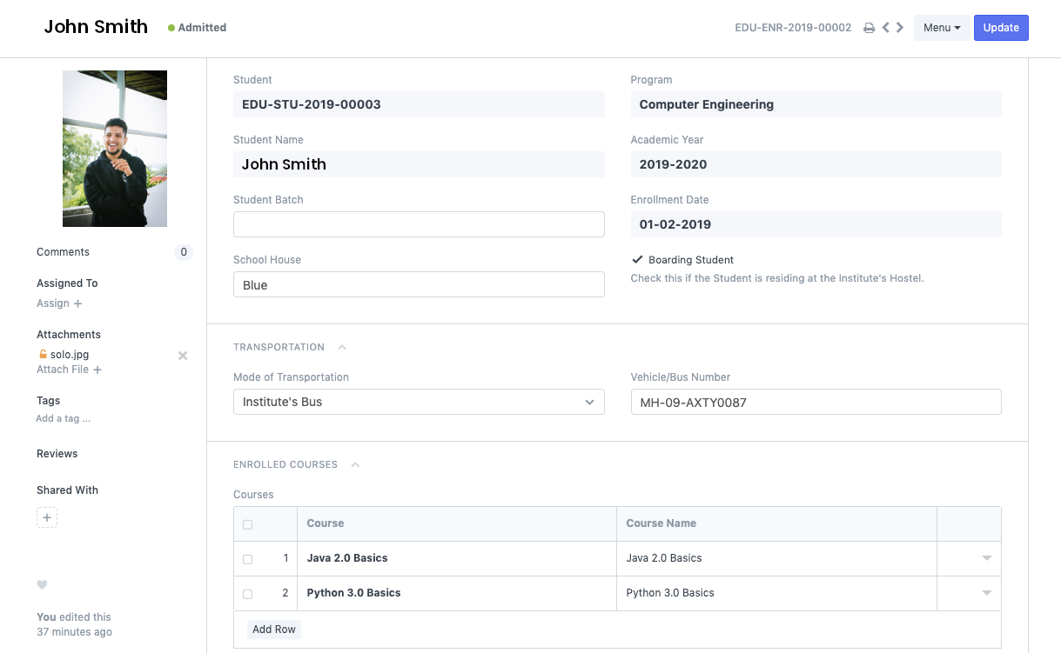
Enrollment

Slide 29
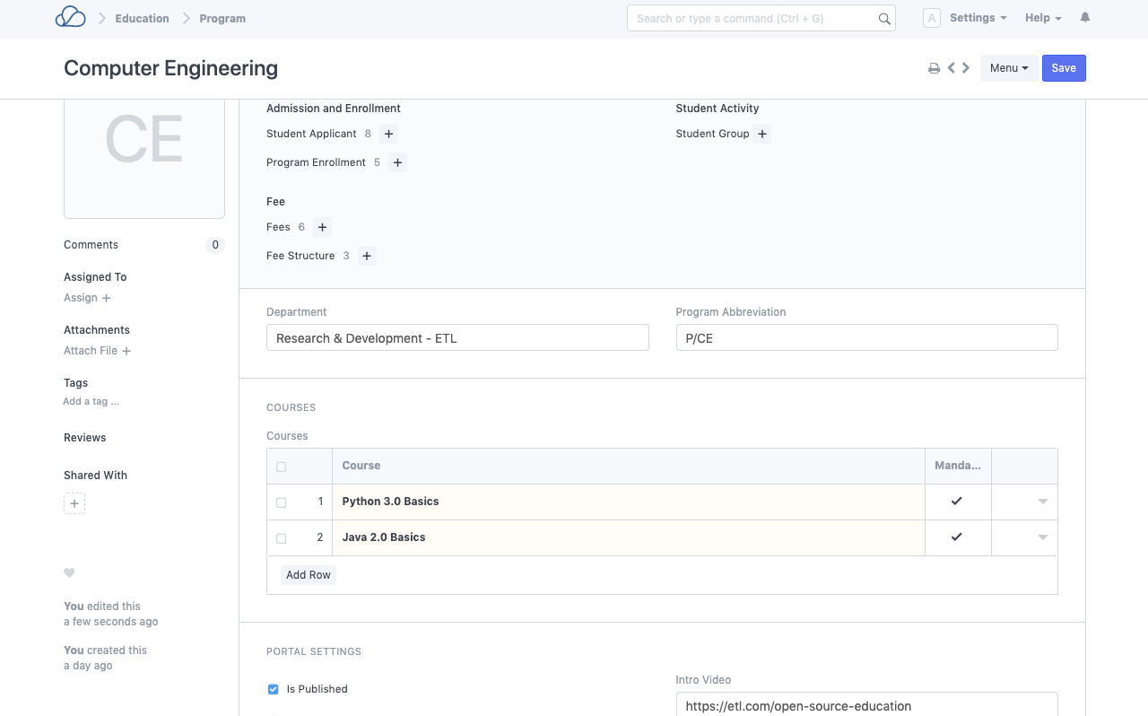
Programs / Learning Paths

Slide 30
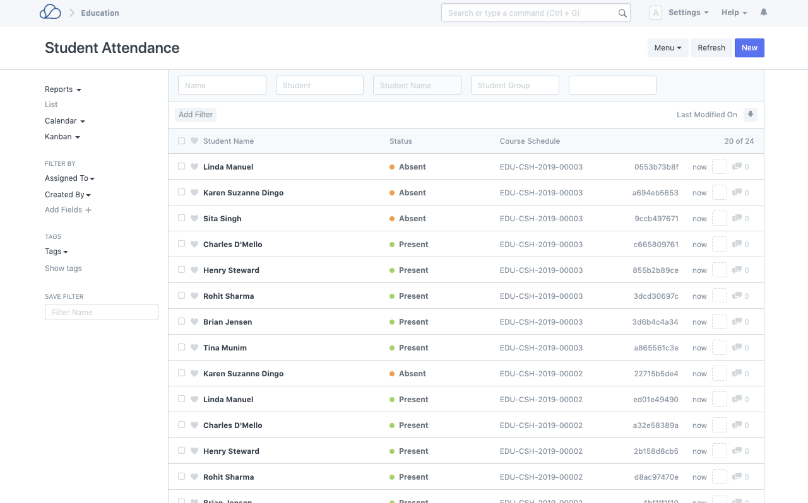
Student Attendance

Slide 31
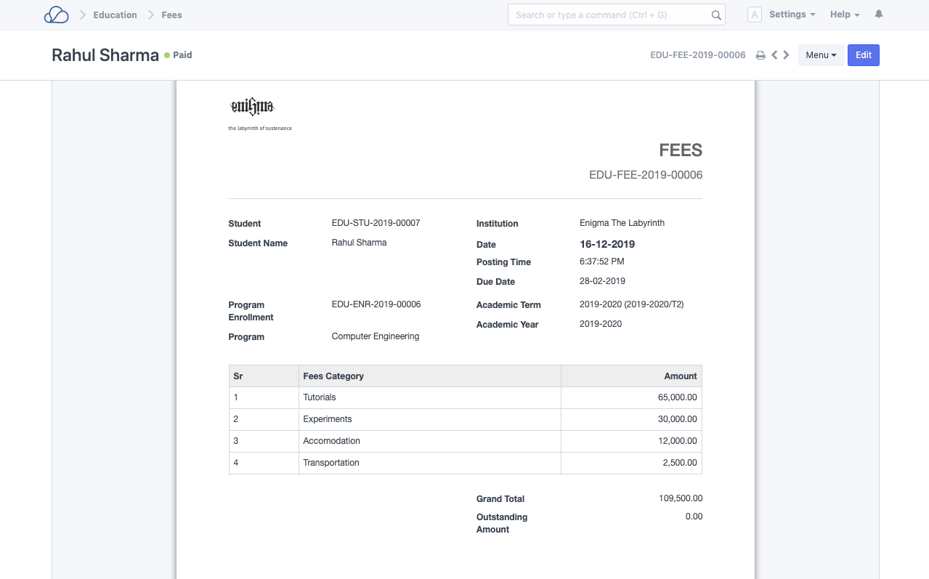
Fees

Slide 32
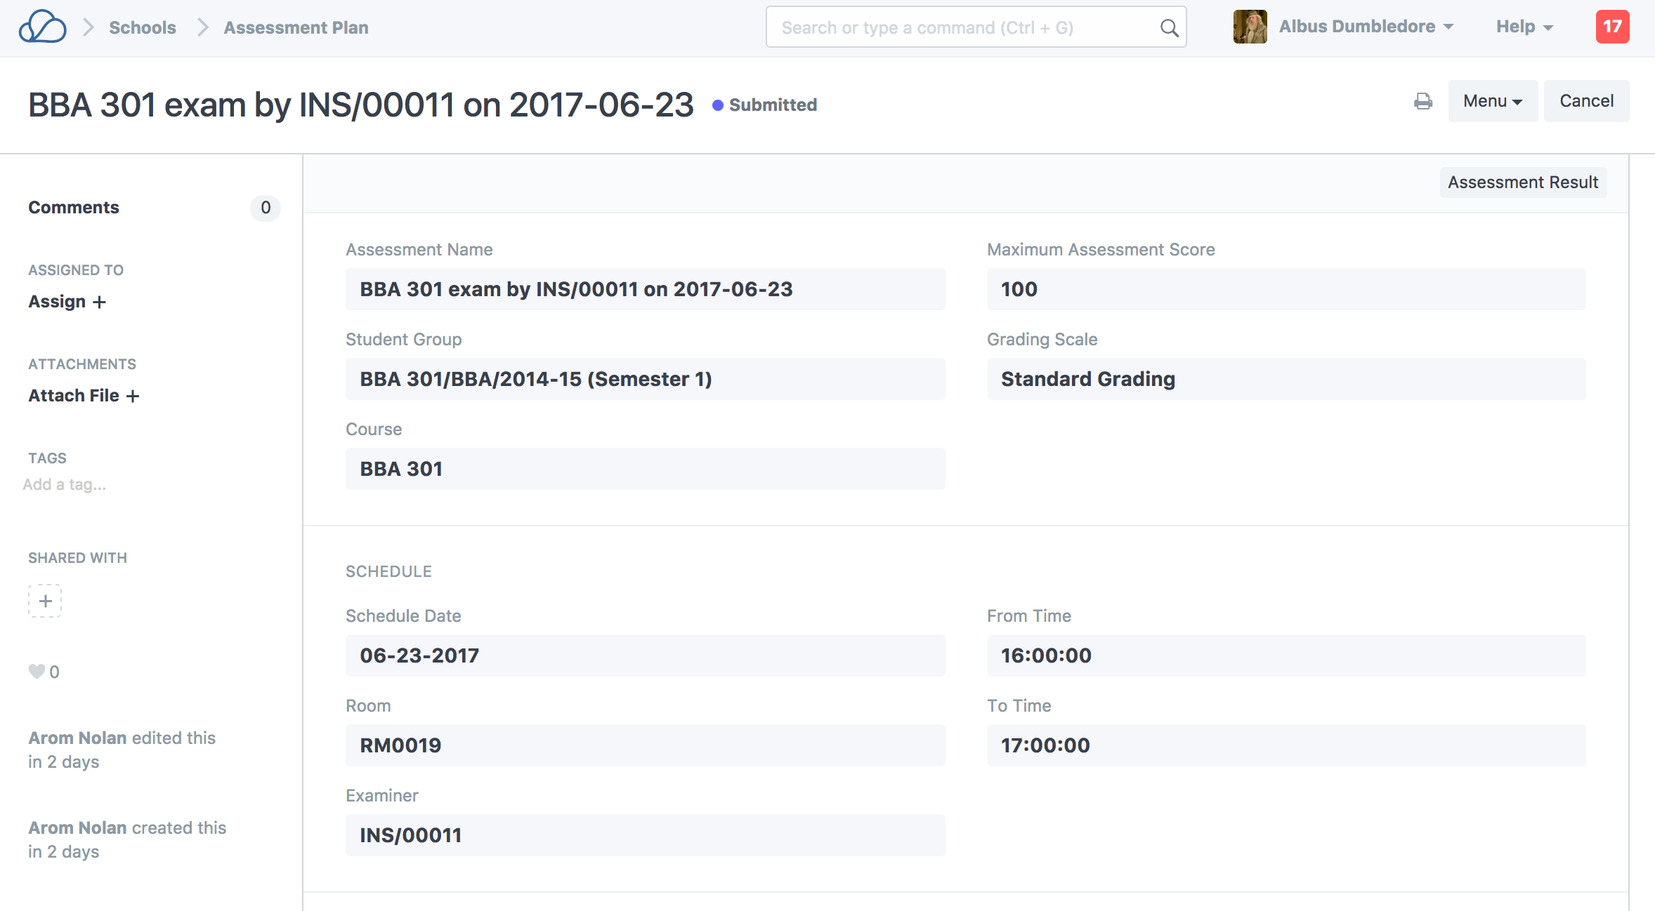
Finals / Midterms

Slide 33
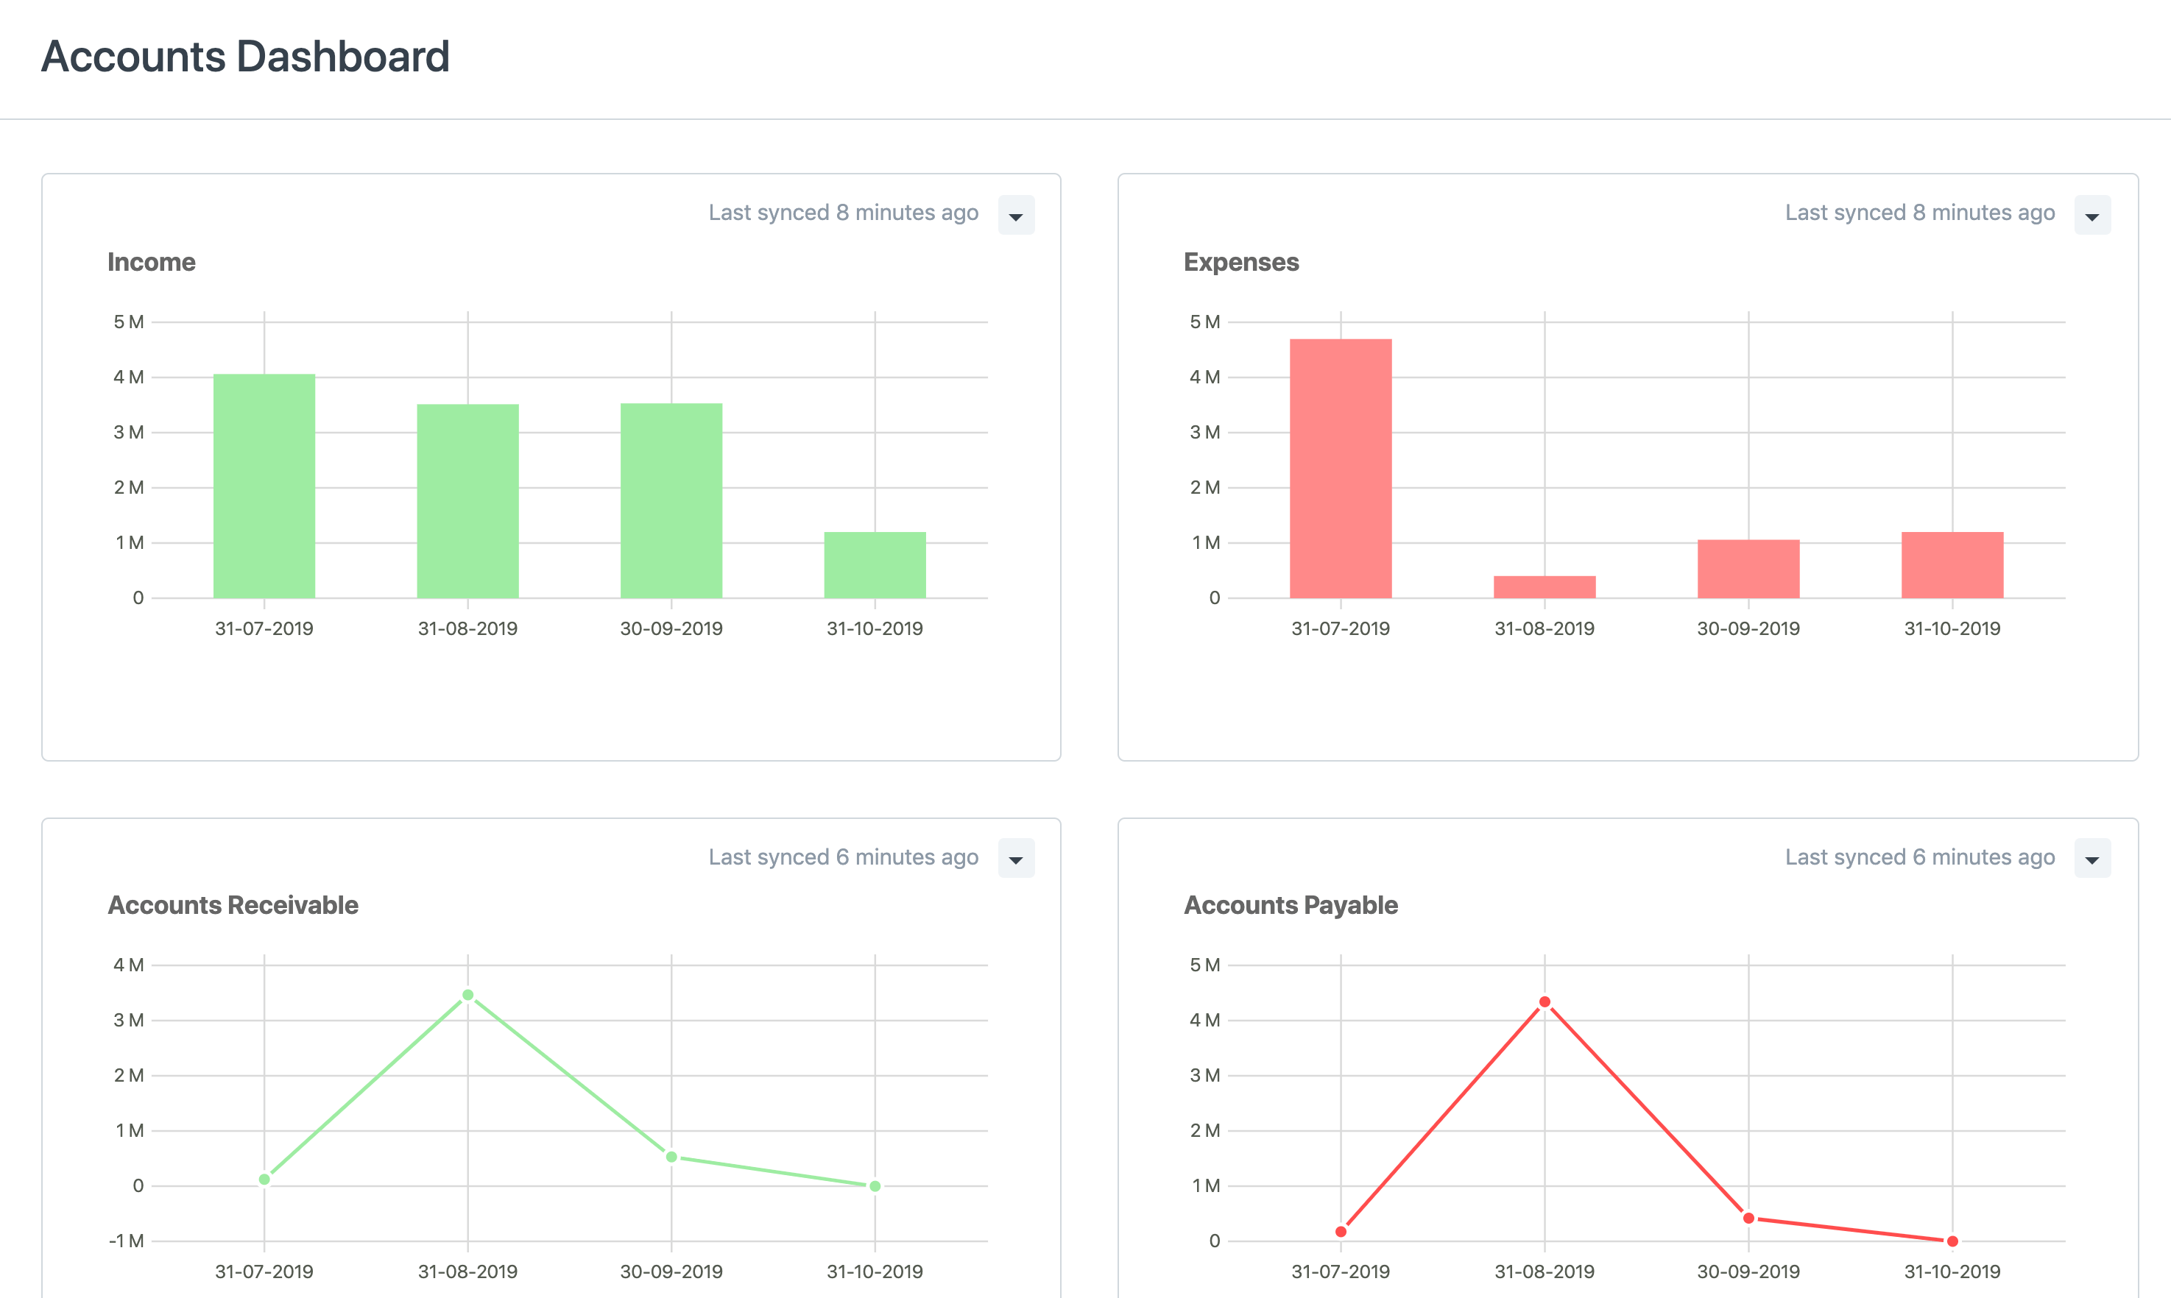
Finances & Accounting
Dashboards
Real-time books
Chart of accounts
Journals & payments
Billing & pricing
Multi-currency
Auto-invoicing
Banking

Slide 34
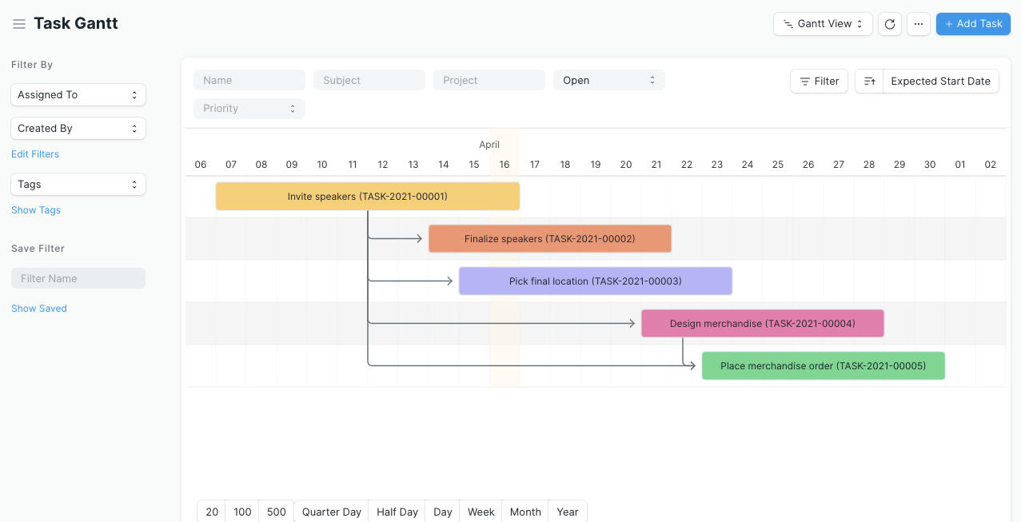
Projects
All-in-one PM
Agile projects / Kanban
To-dos & Chats
Document linking
Emails & notifications
Project costing
Profitability
Time-tracking
Billing
Customer access

Slide 35
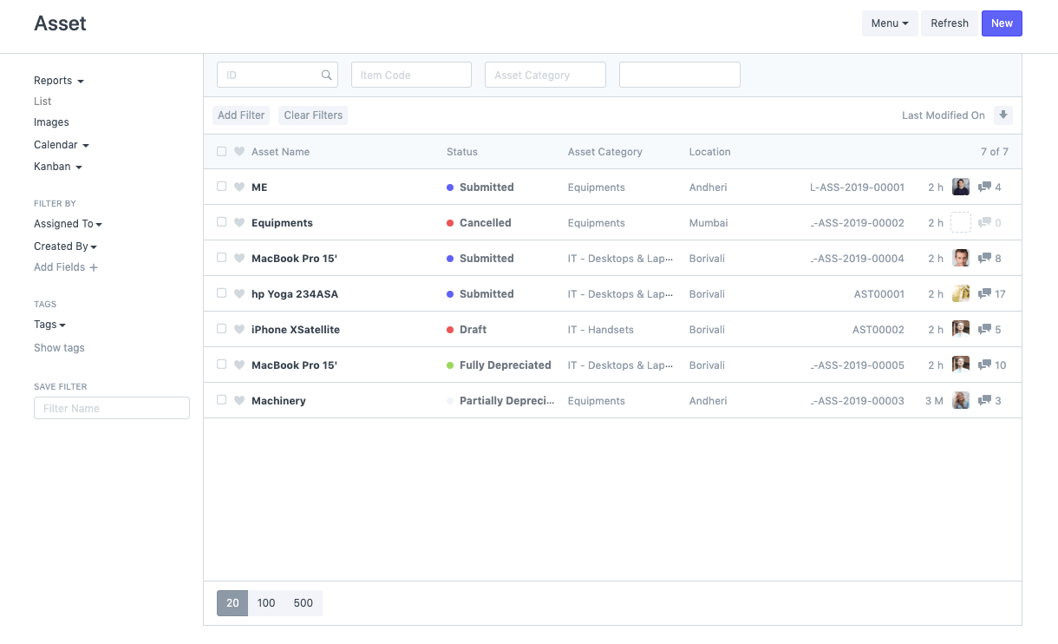
Asset Management
Asset lifecycle
Asset inventory
Purchasing
Selling / Disposal
Auto depreciation
Scrapping
Value adjustment
Reporting

Slide 36
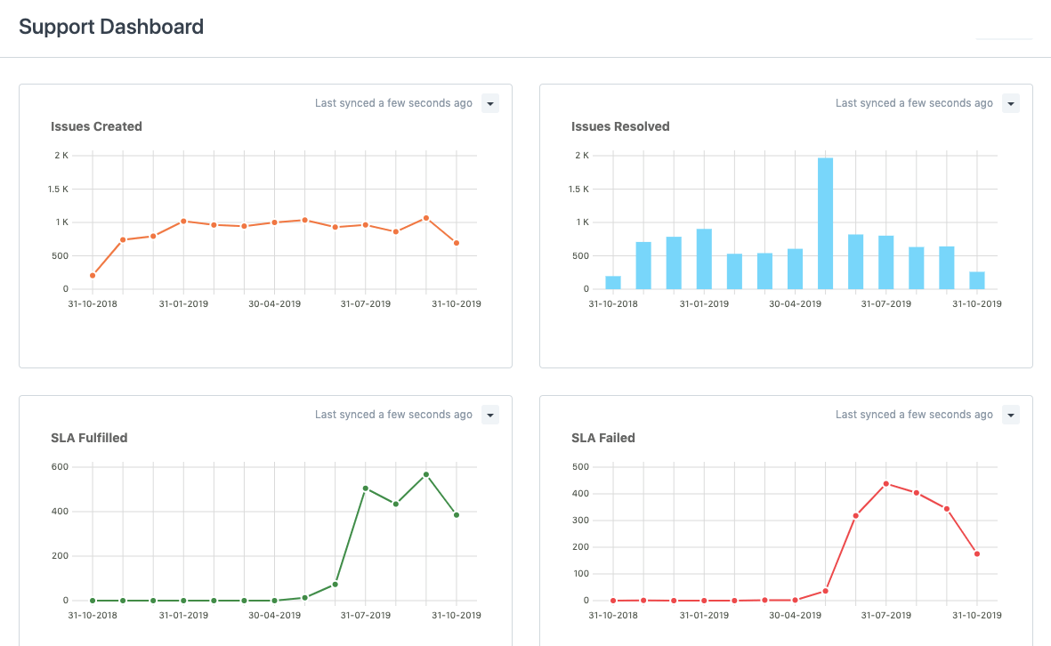
Helpdesk & Support
Omnichannel interactions
Customer tickets
Automate ticket assignments
Team performance
SLAs
Knowledge base
Scheduling Maintenance Visits
Note: Apple products and trademarks are the property of Apple Inc.

Slide 37
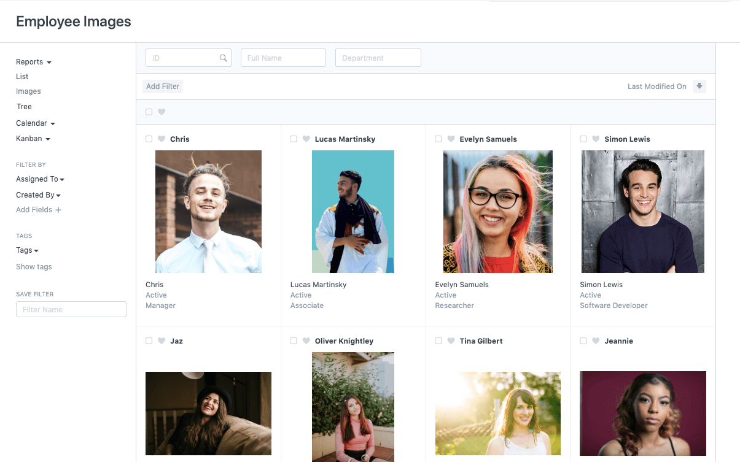
Human Resources
Talent acquisition
Employees
Training
KPIs
Expenses
Attendance
Leaves
Payroll & taxes
Salary structures
Timesheets
Variable pay

Slide 38

Anywhere ...
is your classroom now

Slide 39

“
Having the right tool for the job is half the battle

Slide 40
Please feel free to contact us
info@oneoffice.ca

