Slide 1



Next Generation Instruction
Part of

Slide 2

The Ultimate Toolkit
A single flexible platform --
[Replaces 5 teaching app in one]
Easy to use & complete
Used by top US districts
Built-in remote control
Digital curriculum
Go digital in less than 10 minutes
Supports all devices

Slide 3
The most important thing that schools can do is not to use technology in the curriculum more, but to use it more effectively
- John G Palfrey & Urs Gasser

Slide 4
1
Who are we?
And why are we best-positioned to solve this?

Slide 5

Mission
ClassroomAPP's mission is to be the easy-to-use learning digital platform to cost-effectively solve all our stakeholders (manager / admins, teachers, students, parents) learning needs

Slide 6




About us
US, Canada, Africa, Middle-East, Europe
US / Canadian
~ 12 years
Award-winning
teaching platform
1000s of schools
5M students

Slide 7
The Only Complete
Ed-Tech Stack
Only by solving ALL its problems in ONE solution can instruction be streamlined

Slide 8
Award-winning Innovation
LMS
Parents
Security
Communication
Control
Analytics
AI
Integrations

Slide 9
A hardened
100% uptime infrastructure
using the latest technologies
Real-time
Server

Slide 10
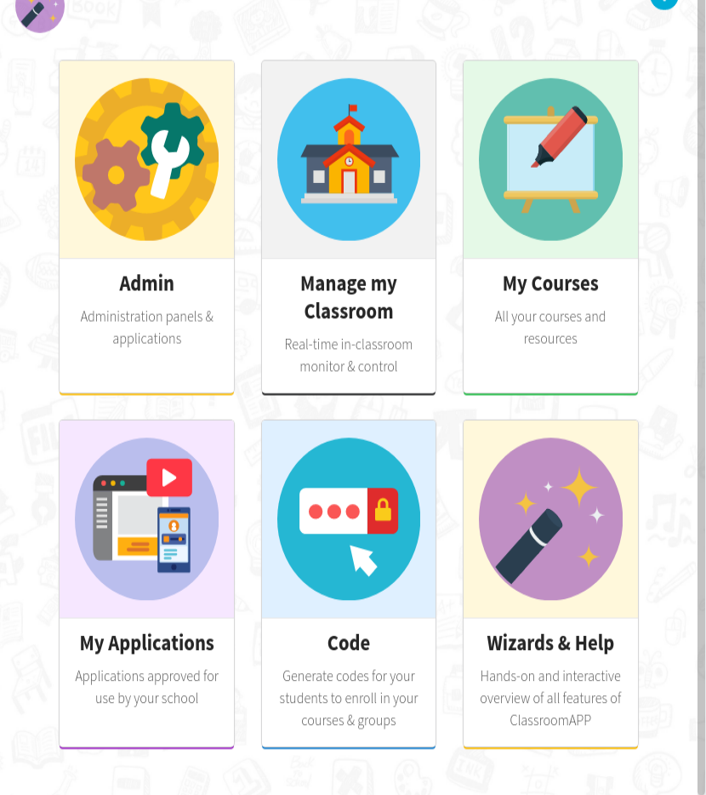
User Interface
Pedagogically-optimized UI, makes teachers and students feel right at home, so they can do more learning and less of … everything else that is wasteful

Slide 11
Use Case
Miami-Dade is the third-largest district in the US. They are using Microsoft for all their tools, but needed a “teaching layer” on top to make it easy to use. As Covid hit, their classrooms faced serious challenges
By integrating ClassroomAPP they now, have
Real-time control
Real-time visibility
Ability to teach in-class and remotely, or hybrid

Slide 12
3
Real-time Learning
The most well-thought out LMS, period!
[The entire design came from teacher feedback]

Slide 13
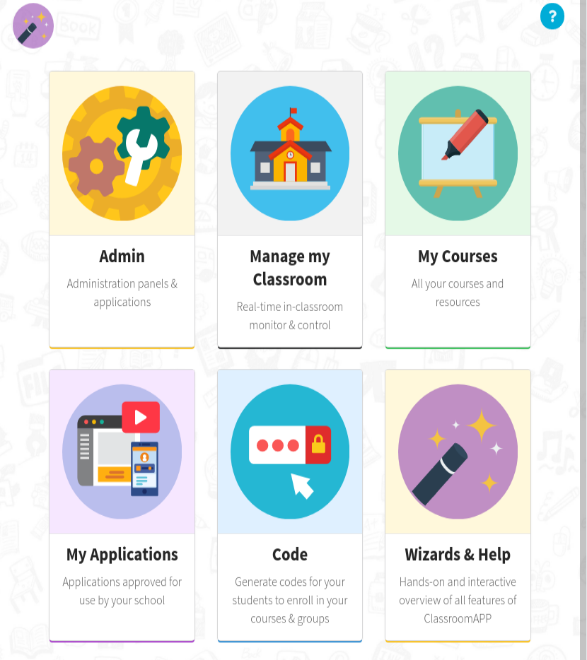
Integrated Real-time LMS
All the tools teachers & students need
Deep integration with Microsoft
Third-party learning-apps
Robotics, coding & next-gen curricula
Tests, assessments, quizzes
Videos, audio, graphics
It’s all there! Literally
The product of years of in-classroom use

Slide 14
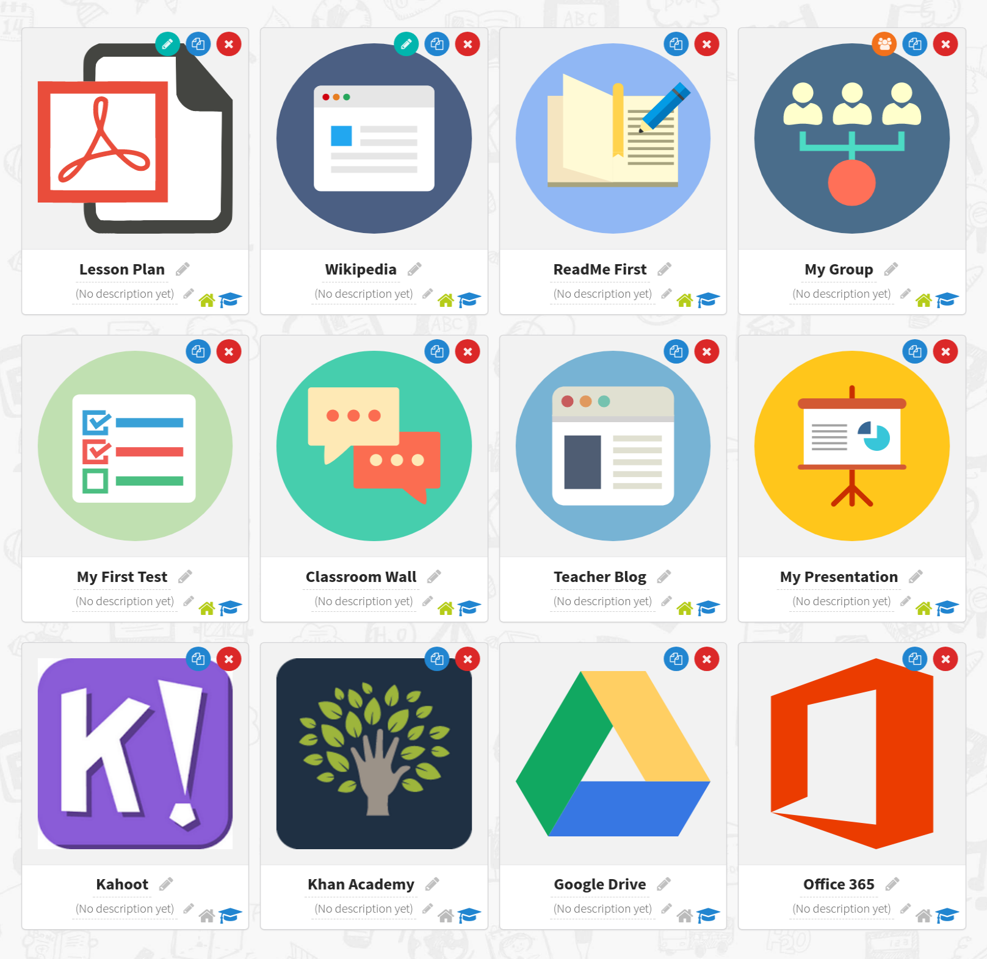
Parents are ..
… first-class citizens
Real-time view of student progress
Real-time communication with staff
Advanced reports & analytics
Control of student browsing at home

Slide 15
4
Control
Complete & Easy-to-use

Slide 16
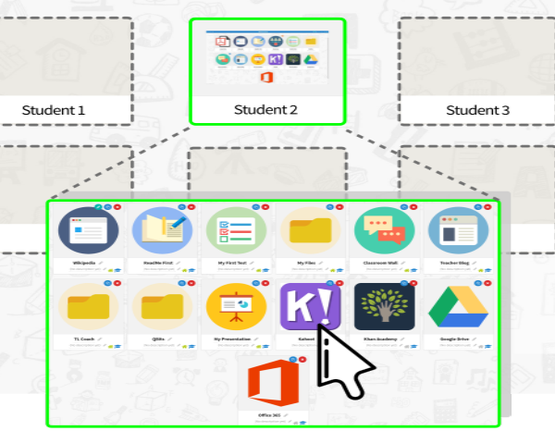
Real-time classroom control
In-classroom or remote
View student screens real-time
Click on student screens
Lock tests
Ensure student focus & awareness

Slide 17
Use case
Eternity School District in Honduras used ClassroomAPP to deploy remote instruction at home. The major challenges were the low-quality of internet bandwidth at home in addition to the different devices students will use.
Control student screens real-time regardless of device
Automatically launch video calls
Record learning sessions
Automate attendance & reporting

Slide 18
5
Data
Big-picture AND granular decision-support tools

Slide 19

Data are becoming the new raw material of business
- Craig Mundie
Sr Advisor to Microsoft CEO

Slide 20

Leave no data behind
ClassroomAPP collects every data point imaginable. As we learn more about student psychology and as AI becomes more accessible, we can run more advanced reports & gain immediate insights
Student browsing & interactions
Teaching methodology
Learning material
Results
Standards
Integration with BI / Azure / Watson

Slide 21
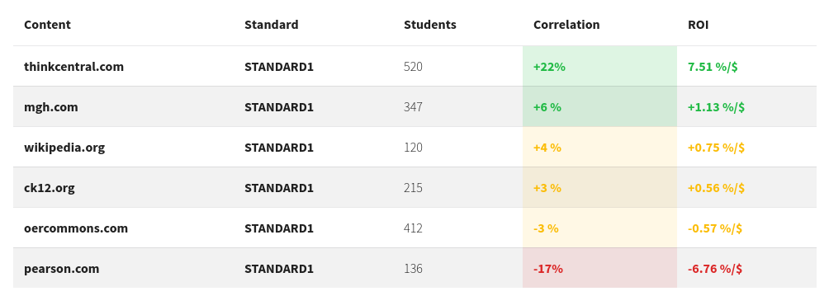
Case in point #1 - Curricula Impact
ClassroomAPP uses big-data to provide insights
Impact of teaching resources on learning
ROI on purchased tools & material
Regional / cultural differences in learning
Opportunities for curricula improvement

Slide 22

Case in point #2 - AI Predictions
ClassroomAPP uses advanced AI to
Build real-time models with a simple UI
Simulate impact of environment changes
Build what-if scenarios
Predict student grades / performance

Slide 23
6
Security & Well-being
The most secure educational App on the planet!

Slide 24
When educating the minds of our youth we must not forget to educate their hearts
- Unkown

Slide 25

In-classroom & At-home security
Secure sandbox
Real-time blocking of malicious sites
Deep integration with video call
platforms to prevent intrusion
Parent controls at home
Real-time parsing of student browsing

Slide 26
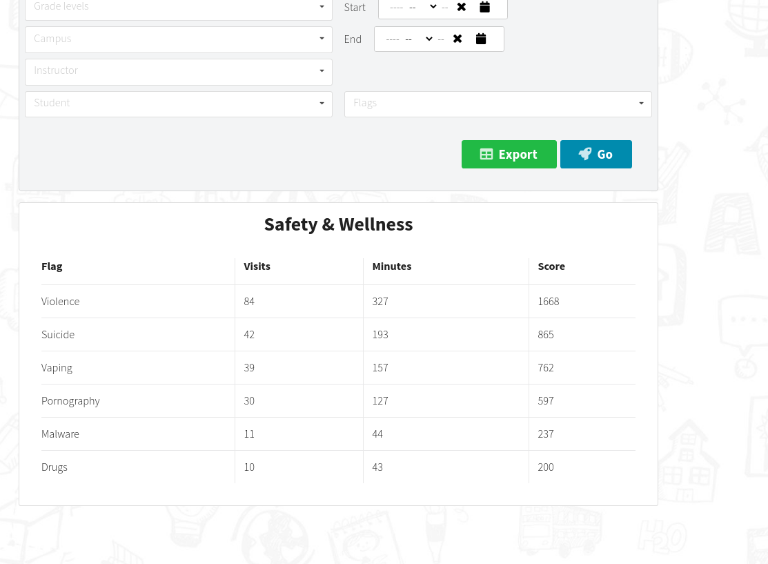

Student Wellness
Source: Helio -- One of the first Covid student mental health studies
Advanced parsing of student browsing
Built-in AI engine to detect concerns
Violence, suicide, smoking etc.

Slide 27
Use case
York Suburban School District in Pennsylvania faced the challenge of securing the school-provided devices with virtual classrooms. Their internal web-filtering is ineffective once students leave the premises.
ClassroomAPP provides them with at-home filtering profile
Parents use their dashboard to further control students’ online presence
The district gets up-to-date detailed reports on student activities
The district is able to flag areas of concern early even if students are off-site

Slide 28
7
Misc
Let’s not forget some important details

Slide 29
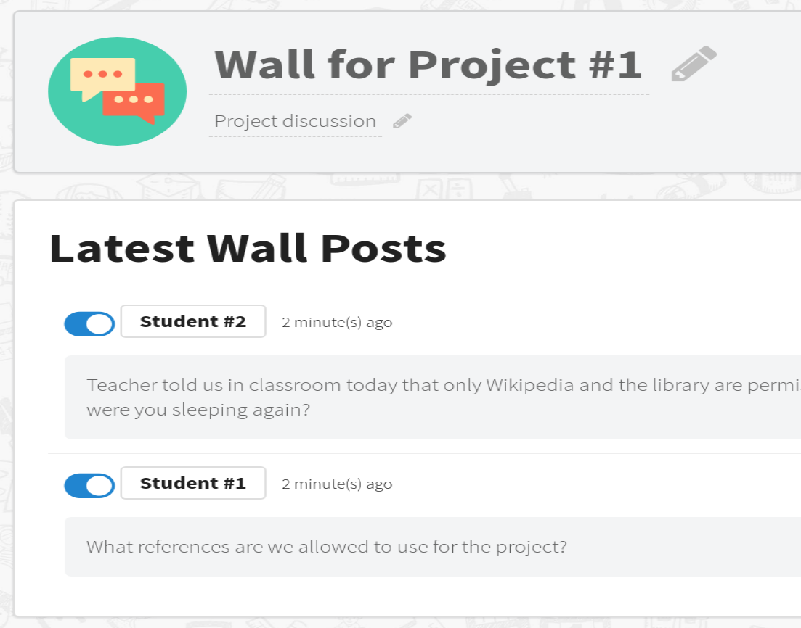
Let’s not forget ...
Fully Arabized (FR, ES, PT etc.)
Built-in secure communication
Single sign-on
Hosted in local cloud and / or in schools
Advanced real-time testing engine
Social tools -- walls, blogs etc.

Slide 30
Customization-ready
Simple integration with third-party data warehouses and BI
Custom analytics & reports
Whitelabelling & local branding

Slide 31
The illiterate of the 21st century won’t be those who can’t read & write, but those who can’t learn & unlearn
- Alvin Toffler

Slide 32
8
Questions?

Slide 33
Thanks!
Any questions?
You can find us at
www.classroomapp.com
info@oneoffice.ca

Slide 34
One last one ..
Many of our schools are good schools if only this were 1965
- Louise Stoll & Dean Fink

