Slide 1

OneOffice LITE
Only on
Overview of OneOffice LITE

Slide 2
Mission - A simple, complete & secure platform to empower productive teams

Slide 3

Why?
1. Secure
Private local servers, end-end encryption
2. Complete & Easy-to-use
All features in one convenient place
3. Cost Effective
Technology, servers, updates, IT

Slide 4
Introduction
All modules needed by the modern organization
Latest technology stack → speed & performance
Best in-class security – Advanced controls
Real-time collaboration & sharing
Mobile & desktop applications
- drive, calls, documents, emails & authentication

Slide 5
OneOffice Lite
50GB of combined email & drive
Online drive
Online document editor – DOC, XLS, PPT
Can be easily upgraded to OneOffice Standard

Slide 6

Main Features
Full productivity – Word, PPT, XLS, Visio
Real collaboration
Email, Calendar, Contacts
Files & Storage
Secure Video & Chat
Projects
Forms
Appointments
Notes
Hybrid
Military-grade Security
(* OneOffice Standard)

Slide 7
OneOffice LITE

Slide 8
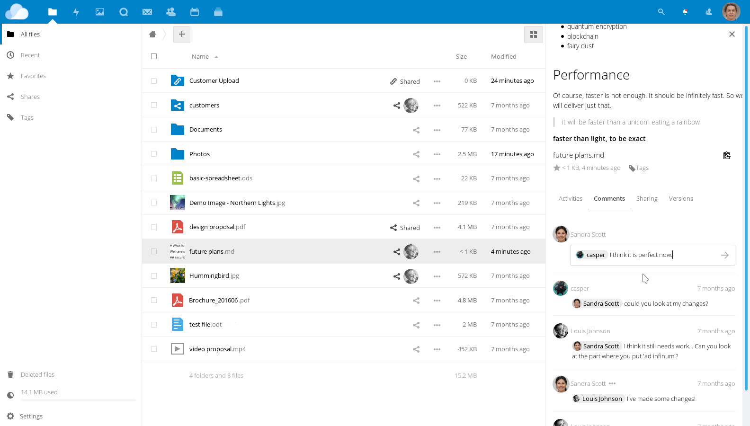
1. Files & Sharing
Folders & Files
Desktop sync
Live-chat
Internal share
External share w/ different permissions
Version control
Audit
Comments
Tags
(* OneOffice Standard)

Slide 9
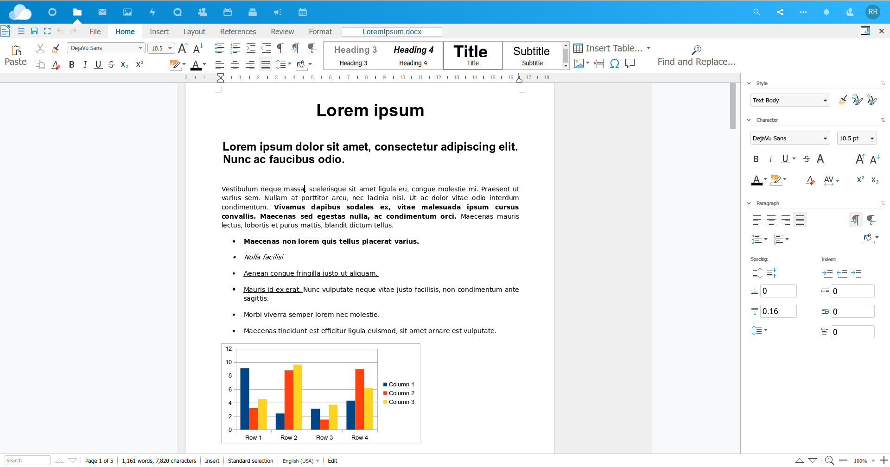
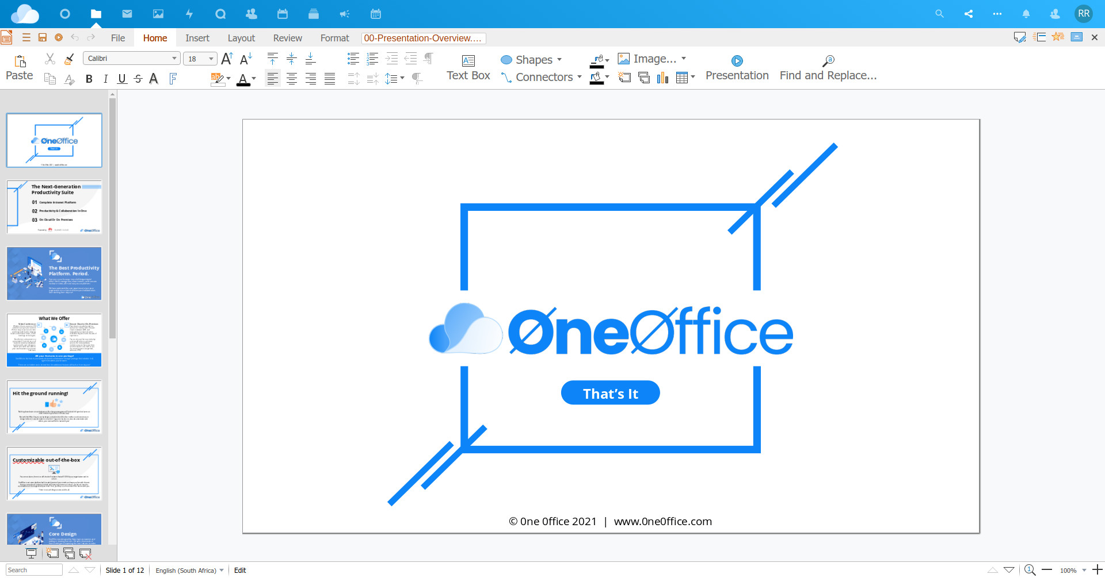
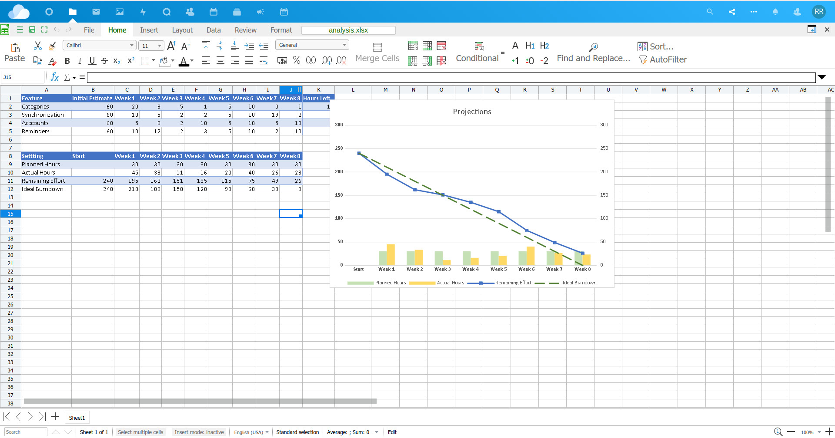
2. Documents
z
Full Online Editor
Lightning fast
Word, PPT, Excel, Visio
Live-collaboration
Comments
Track changes
PDF / format conversion
Live presentation
Live chats & calls
(* OneOffice Standard)

Slide 10
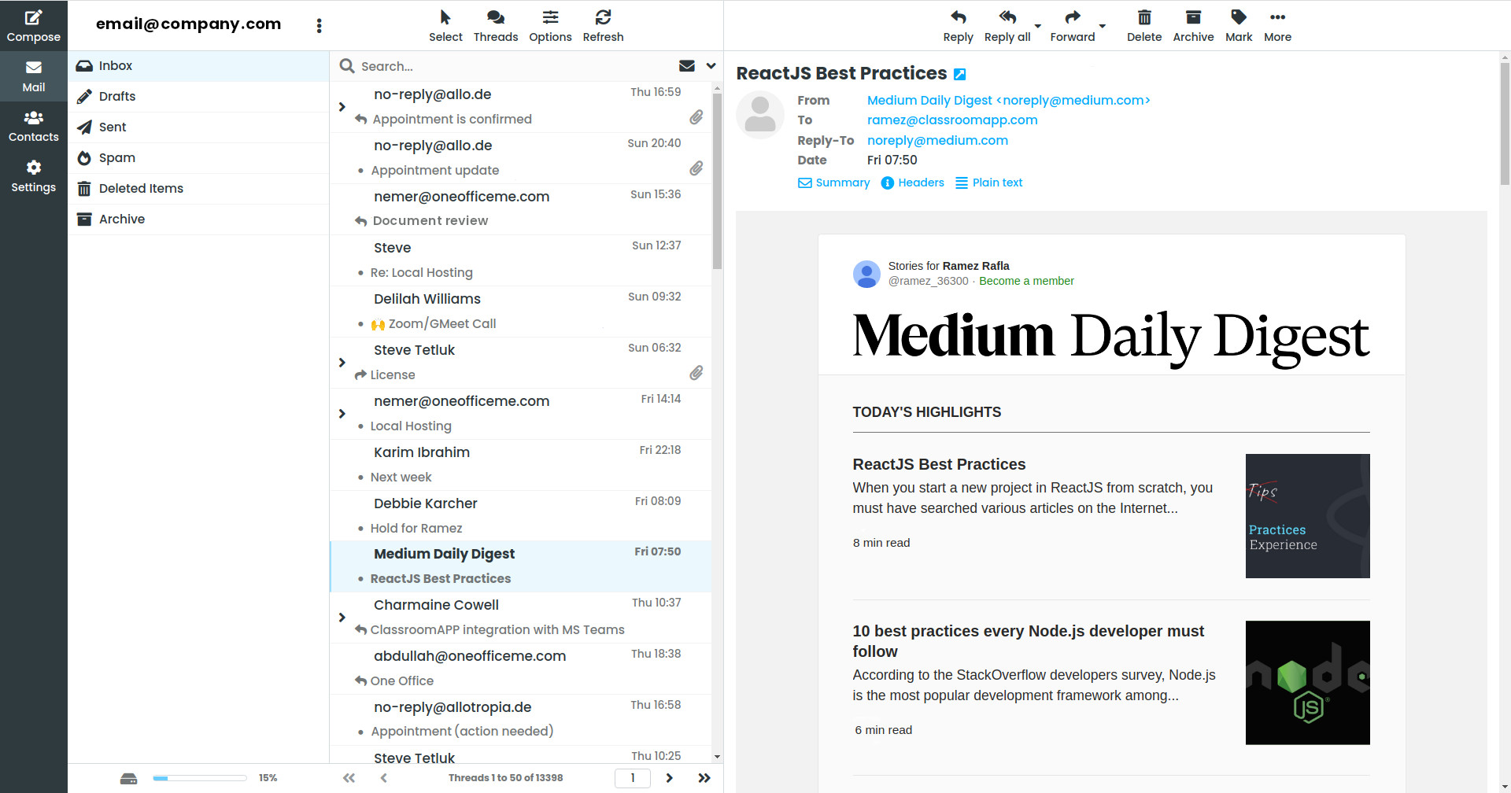
3. Emails
Secure email server
Lightning fast
Mobile sync
Out of office
Filters
Files integration

Slide 11
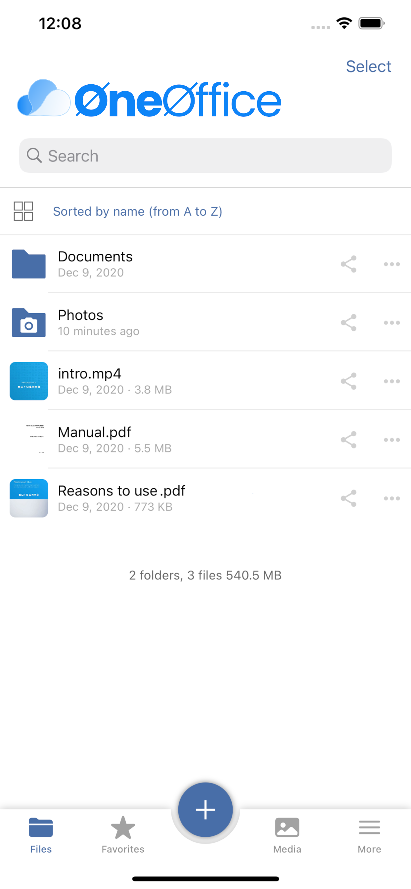
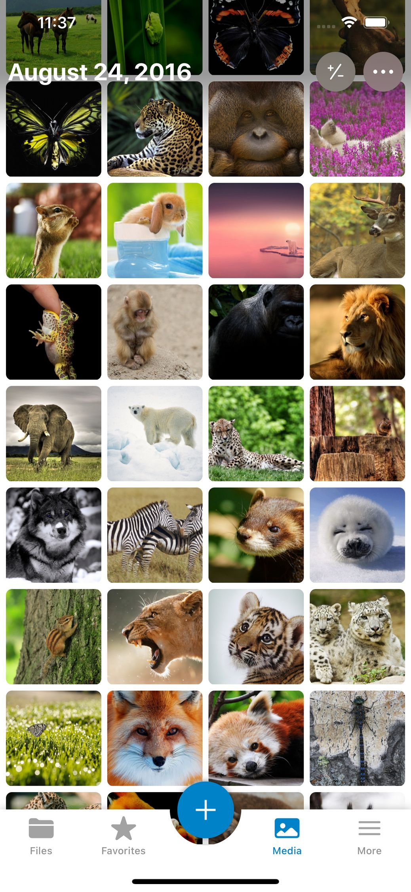
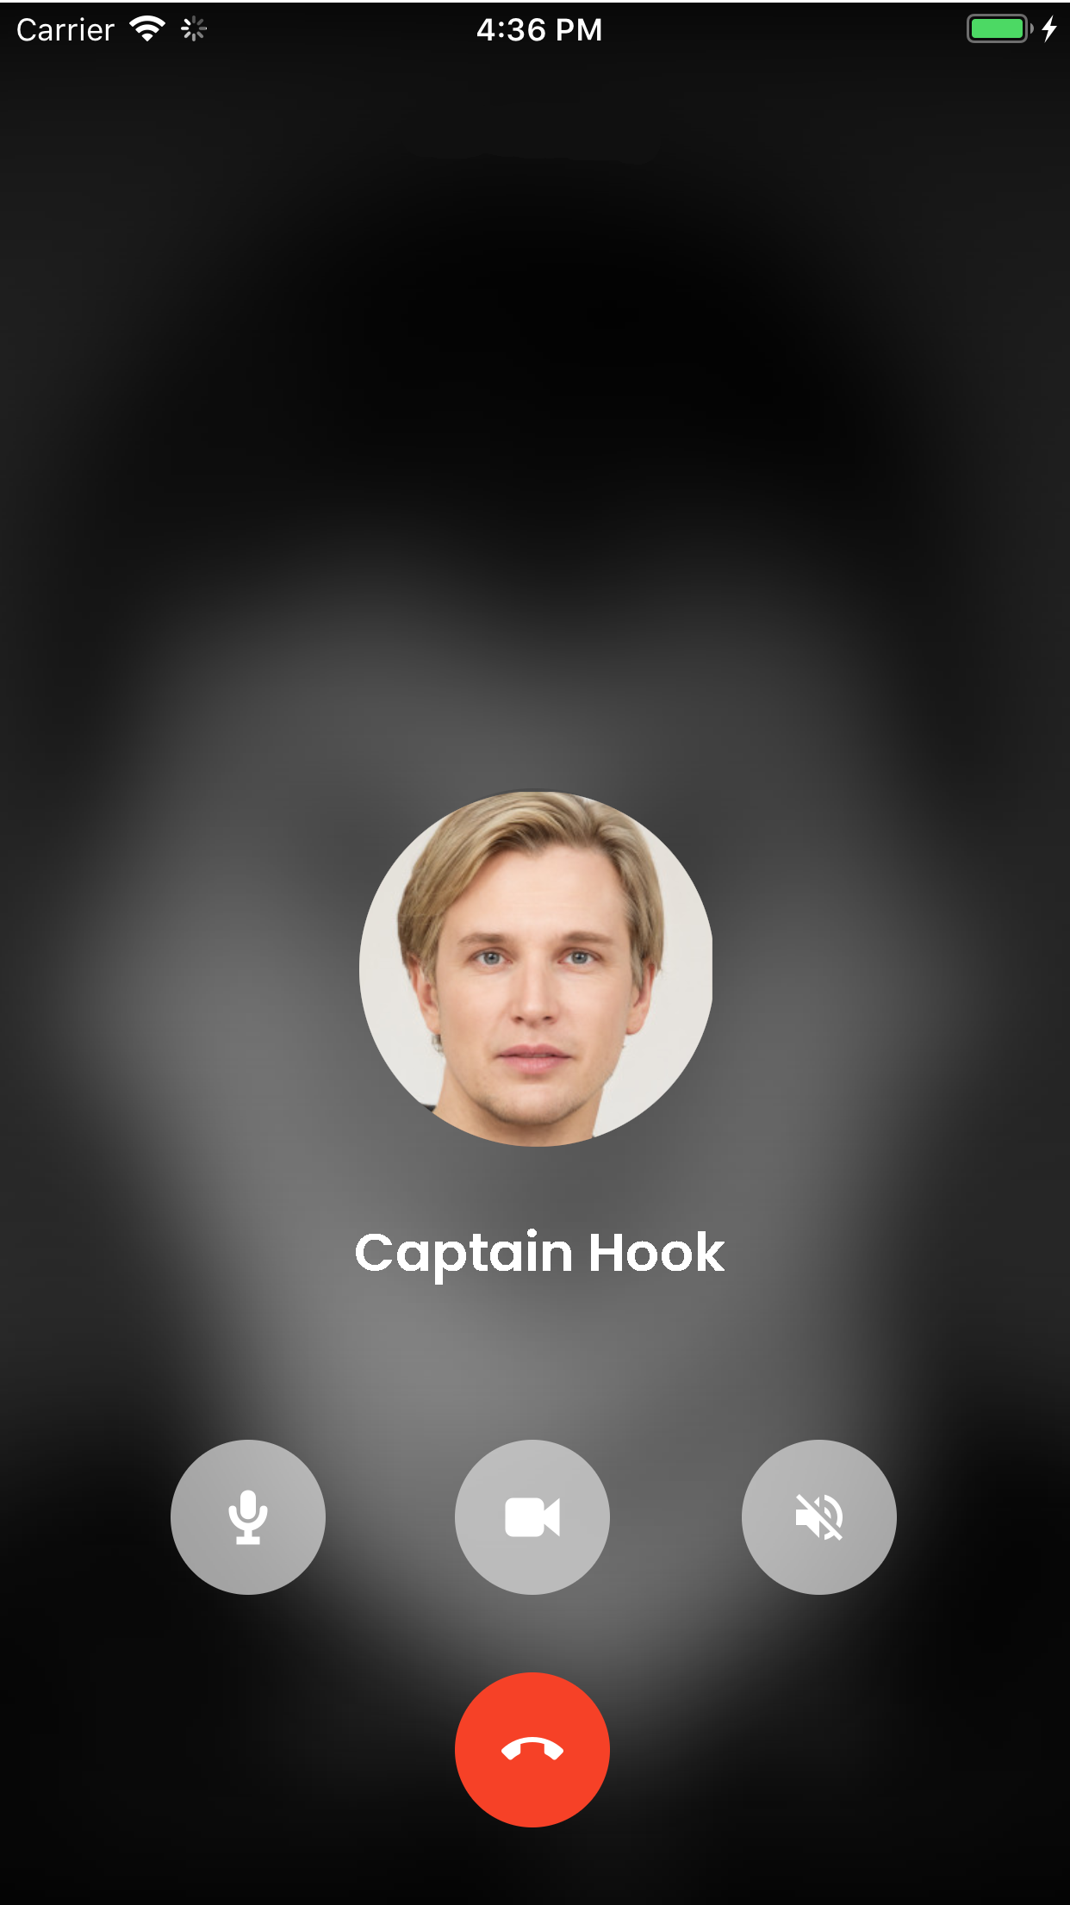
3. Apps
Drive for Mobile
Meet for Mobile
Authentication Mobile
Desktop editor
Desktop email
Desktop sync / backup
(* OneOffice Standard)

Slide 12
OneOffice Standard

Slide 13
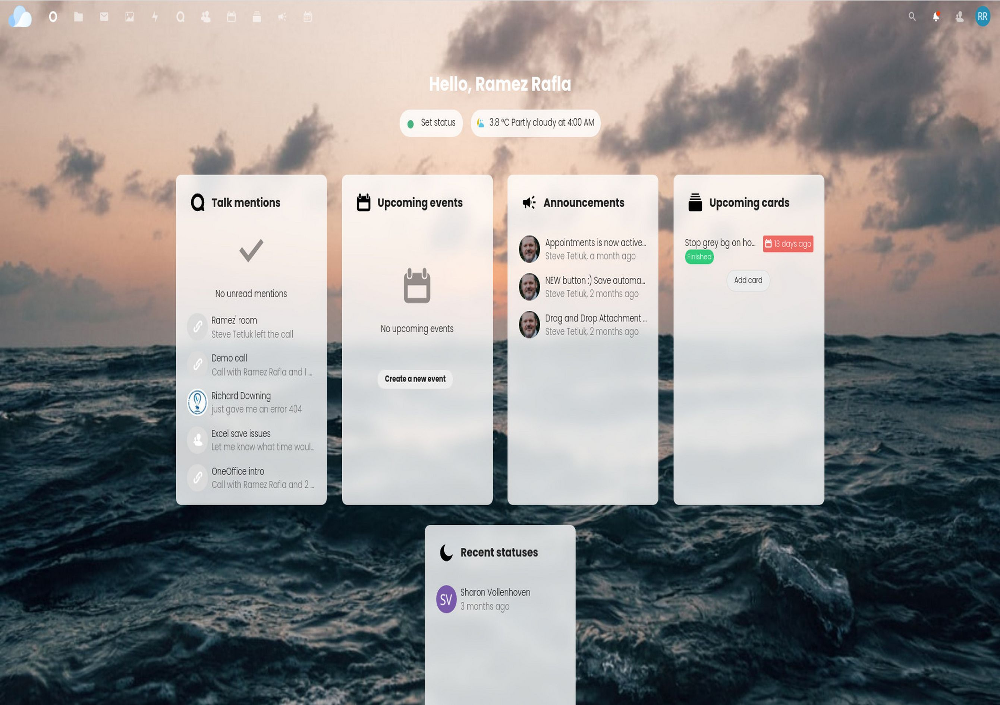
1. Dashboard
Set your status
Upcoming meetings
Missed conversations
Announcements
Upcoming tasks
Colleague statuses

Slide 14
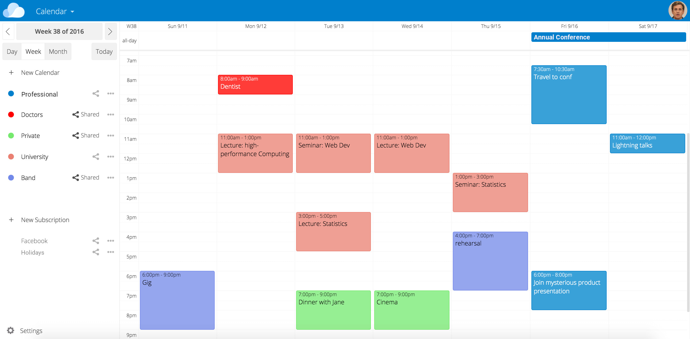
2. Calendars
Create Events
Share calendars
Automated call links
Notifications / reminders
Mobile sync
Email integration

Slide 15
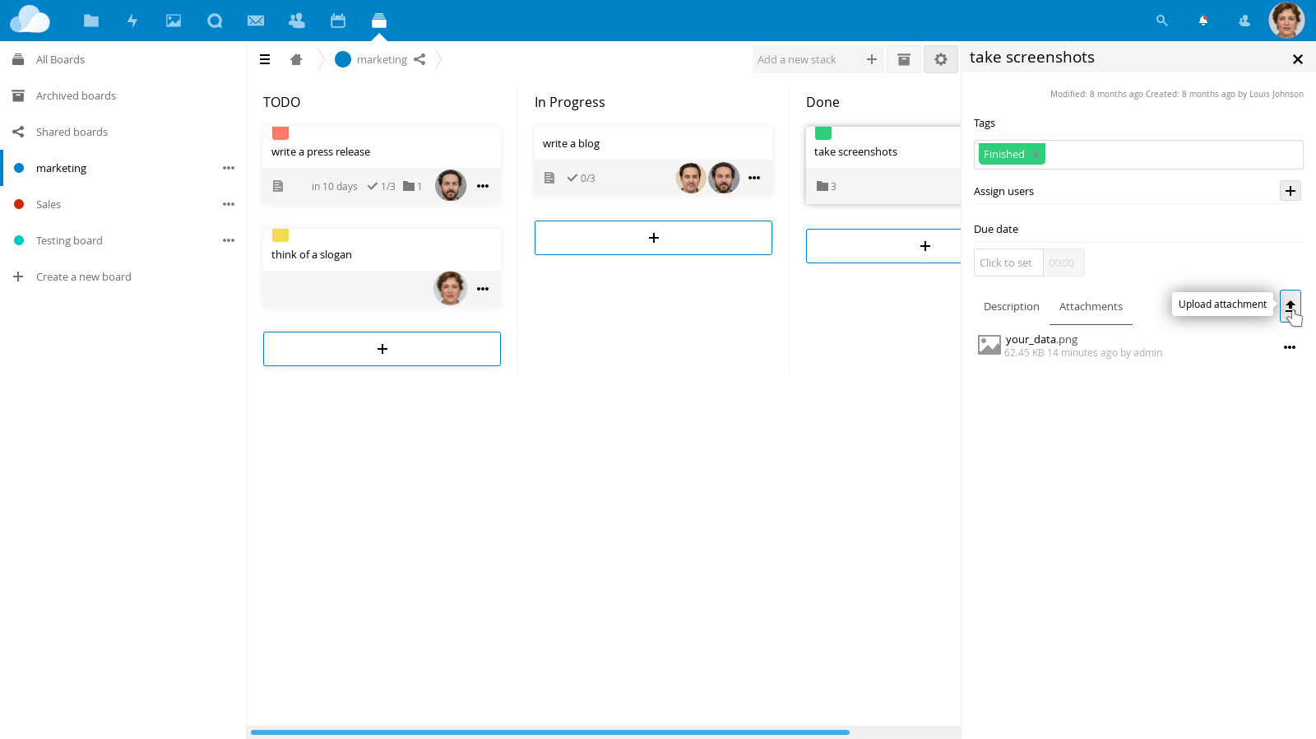
3. Agile Projects
Kanban board
Real-time tracking
Reminders / notifications
Attach documents
Integrate with group calls / chats
Drag & drop

Slide 16
4. Chats / Calls
End-to-end encrypted
Mobile app
Permanent chat / call links
Background blur
Integrates w/ docs & projects

Slide 17
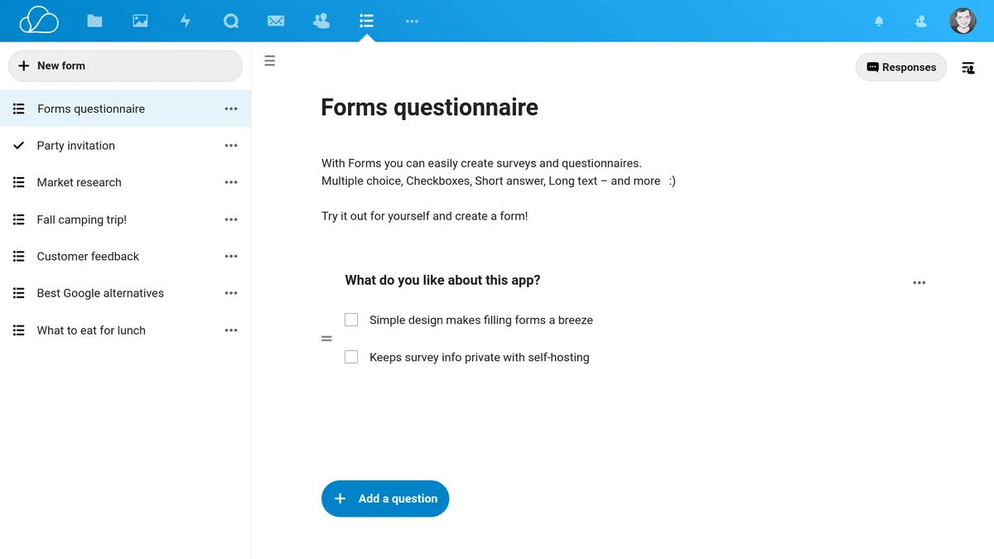
5. Forms
Simple
Drag & drop
Drop-downs
Text inputs
Multiple choice
Surveys
Reports
Results downloads
Notifications

Slide 18
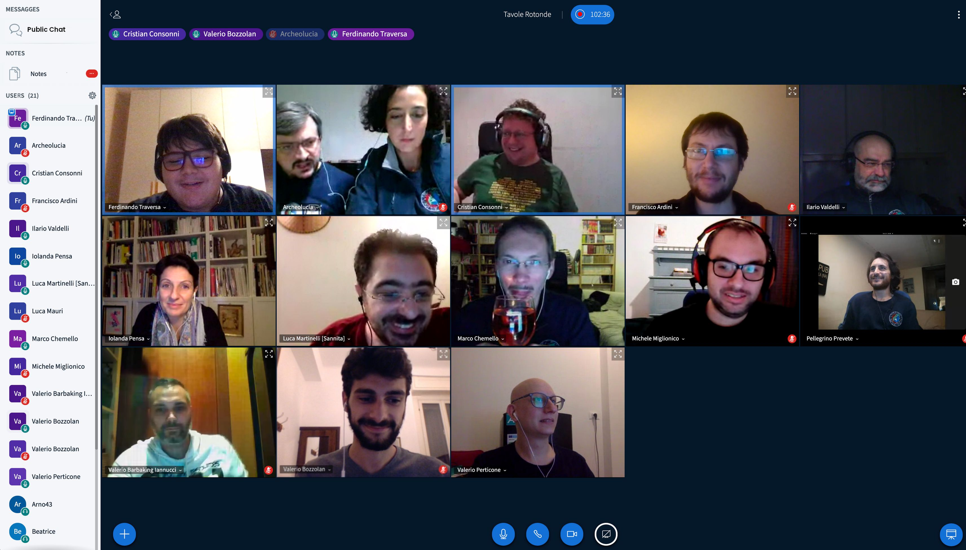
6. Webinar
Up to 1000 users
Recording
Lighting fast
Low bandwidth
Smart audio check
Whiteboard
Document sharing
External video sync
Secure chat
Mobile-ready

Slide 19
7. Apps
Drive for Mobile
Meet for Mobile
Authentication / Mobile
Desktop editor
Desktop email
Desktop sync / backup

Slide 20
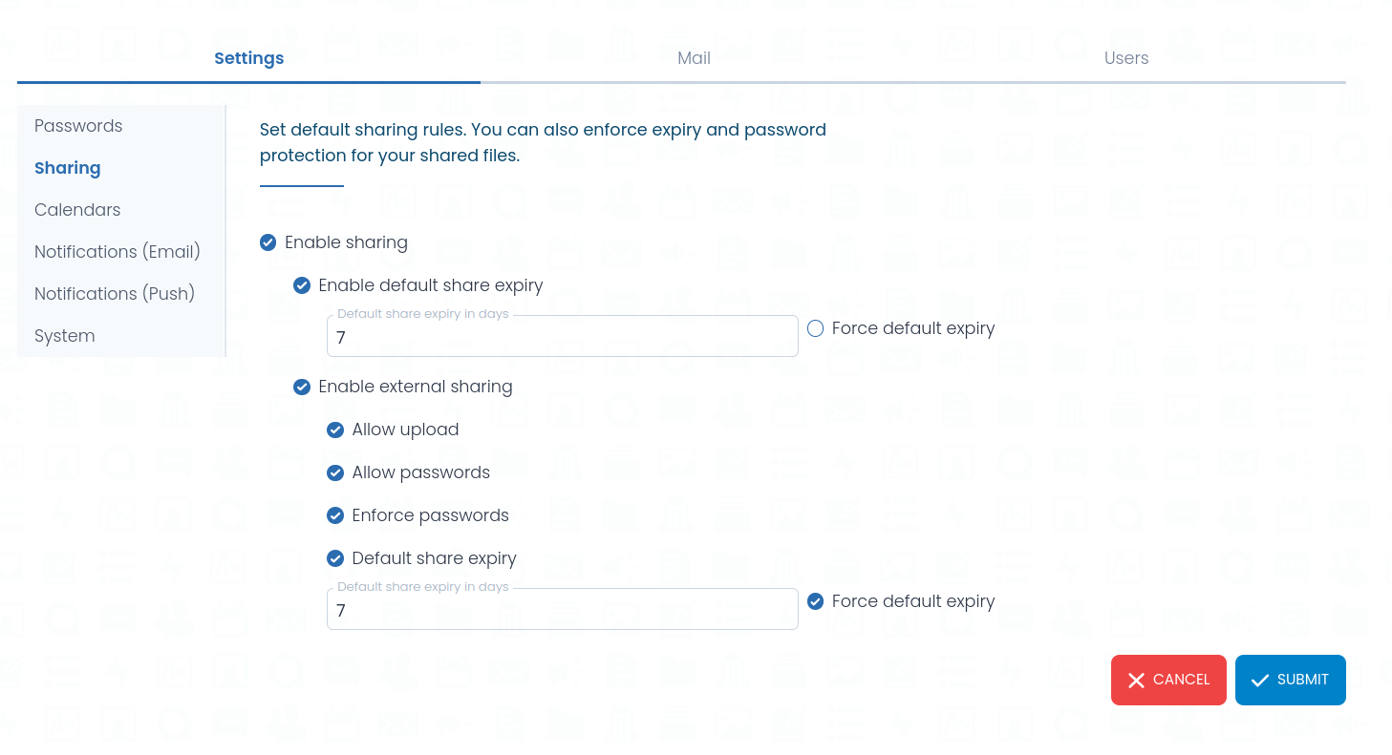
8. Admin
Simple yet Complete
Upload users easily
Create groups
Fine-tune permissions
Live notifications
Control email settings
Integrate your own domain

Slide 21

“
Having the right tool for the job is half the battle

Slide 22

Anywhere ...
is your office now

Slide 23
Please feel free to contact us
info@oneoffice.ca

