Slide 1
OneOffice Productivity
Overview & Features

Slide 2
Mission - A simple, complete & secure platform to empower productive teams

Slide 3

Why?
1. Secure
Private local servers, end-end encryption
2. Complete & Easy-to-use
All features in one convenient place
3. Cost Effective
Technology, servers, updates, IT

Slide 4
Introduction
All modules needed by the modern organization
Enterprise-grade performance & security
Latest technology stack → speed & performance
Best in-class security – Advanced controls
Built-in secure AI / Large Language Model
Real-time collaboration & sharing
Mobile & desktop applications

Slide 5

Main Features
Full productivity – Word, PPT, XLS, Visio
Real-time collaboration
Email, Calendar, Contacts
Files & Storage
Secure video & Chat
Built-in AI / LLM
Projects
Forms
Appointments
Military-grade security
End-to-end encryption

Slide 6
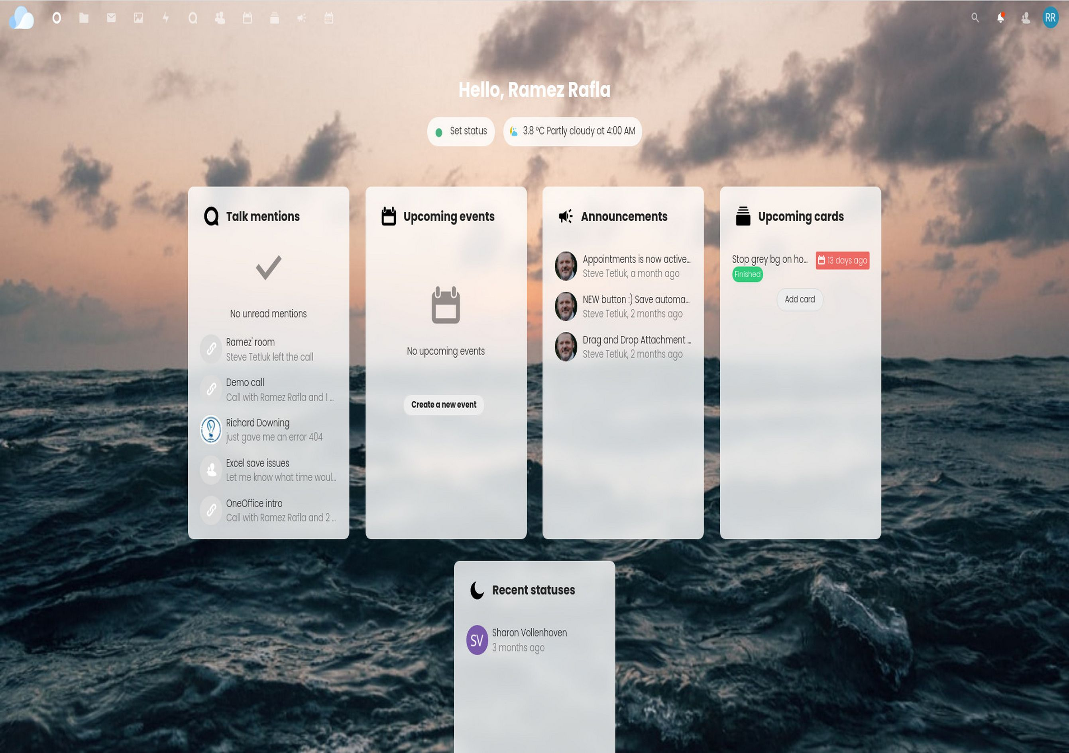
1. Dashboard
Set your status
Upcoming meetings
Missed conversations
Announcements
Upcoming tasks
Colleague statuses

Slide 7
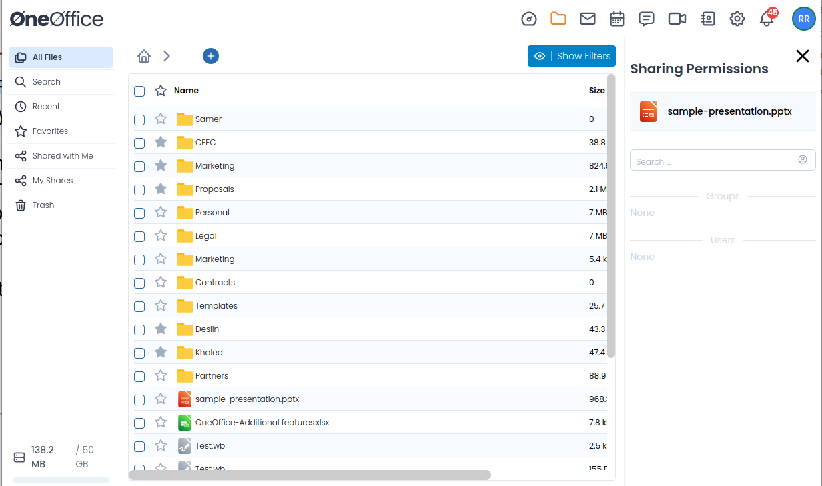
2. Files & Sharing
Folders & Files
Desktop sync
Live-chat
Internal share
External share
Different permissions
Version control
Audit
Comments
Tags

Slide 8
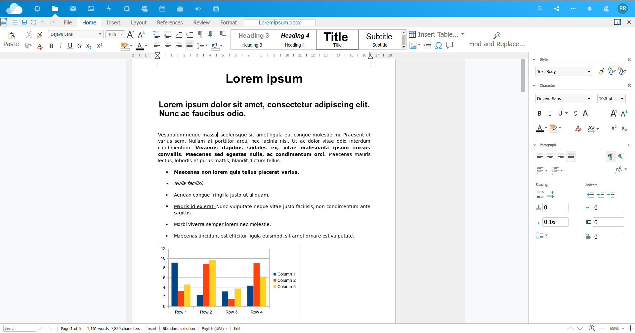
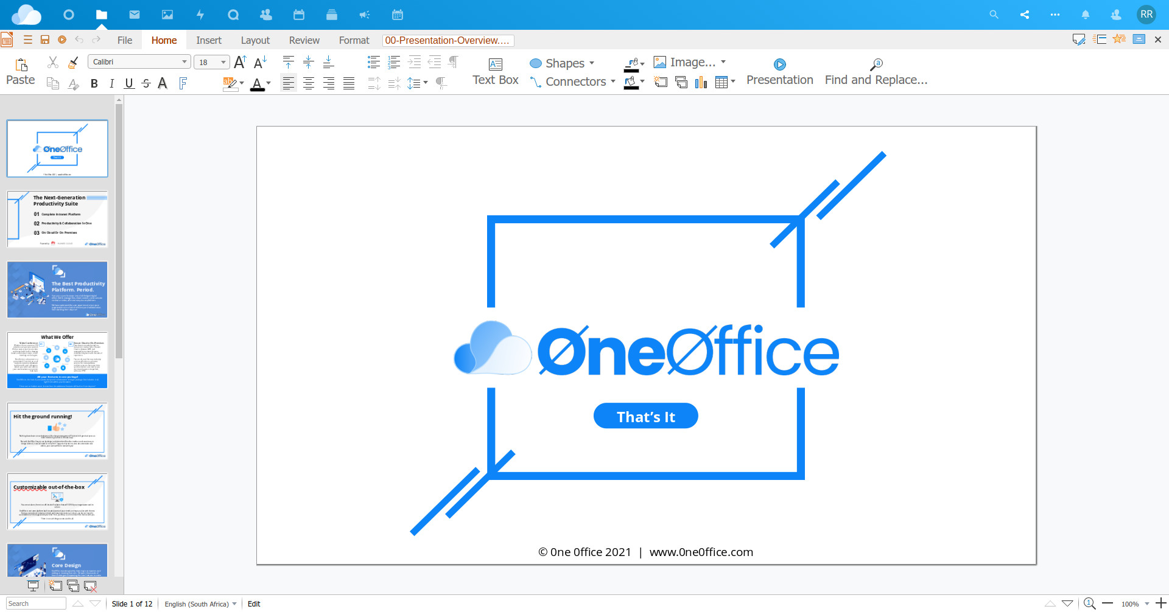
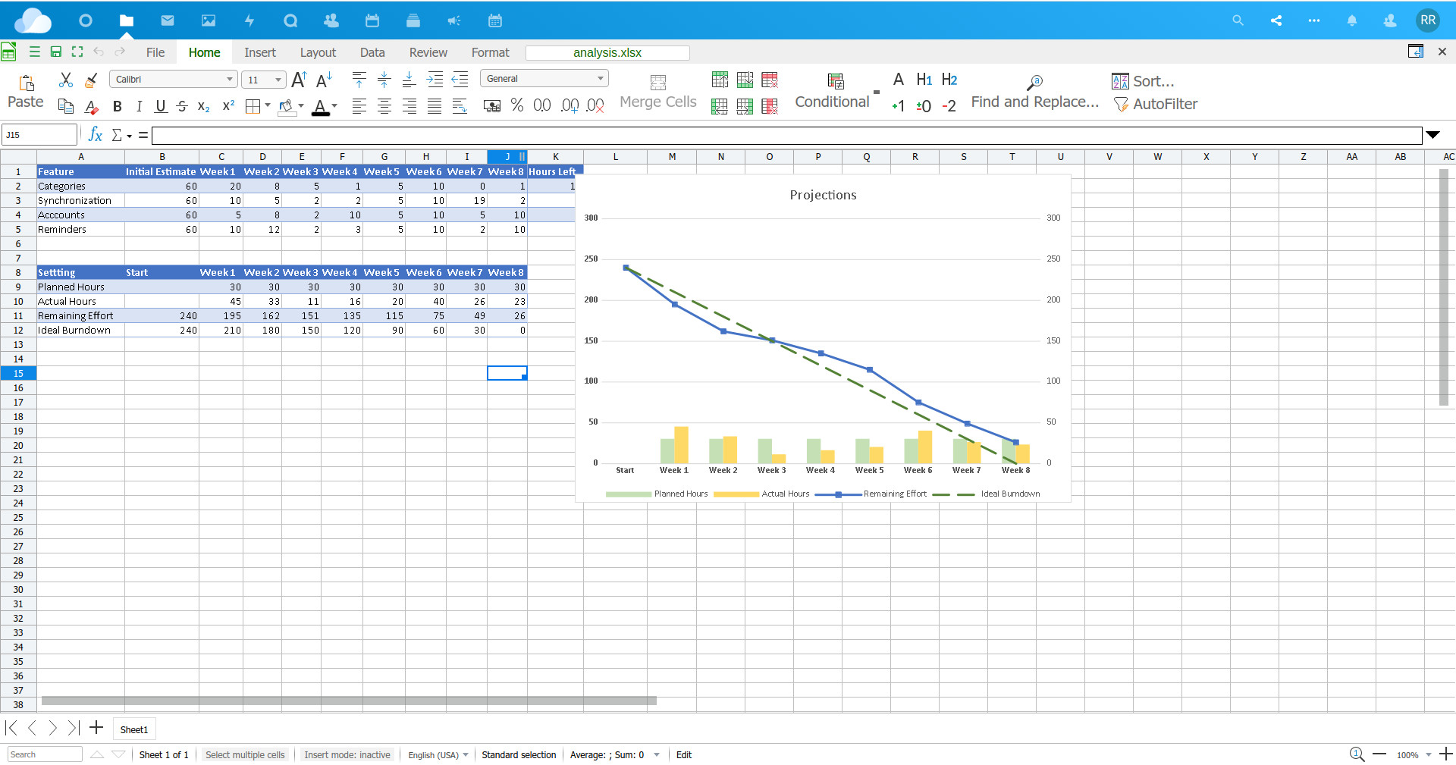
3. Documents
z
Full Online Editor
Lightning fast
Word, PPT, Excel, Visio
Live-collaboration
Comments
Track changes
PDF / format conversion
Live presentation

Slide 9
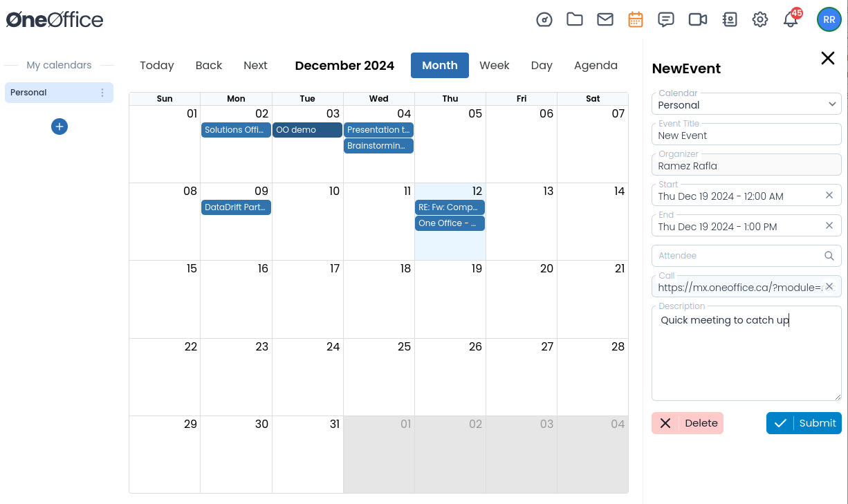
4. Calendars
Create Events
Share calendars
Automated call links
Notifications / reminders
Mobile sync
Email integration

Slide 10
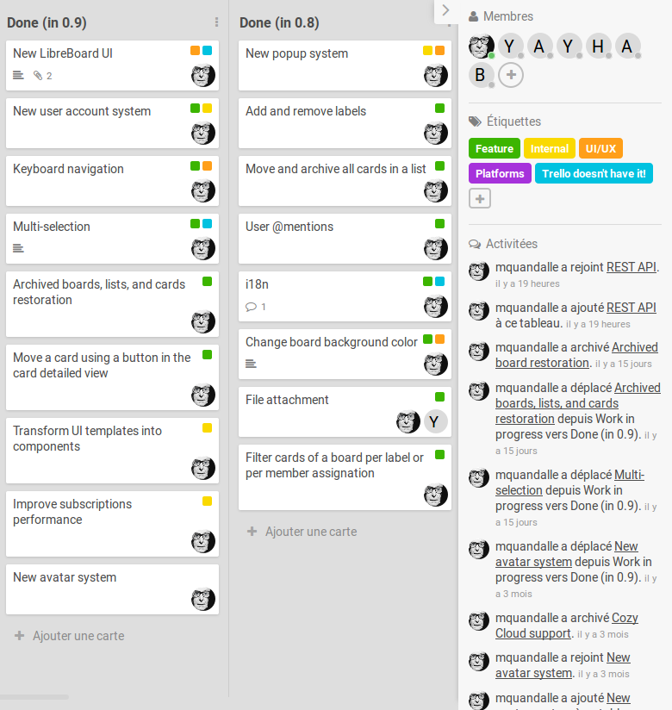
5. Agile Projects
Kanban board
Real-time tracking
Reminders / notifications
Attach documents
Integrate with group calls / chats
Drag & drop

Slide 11

6. Chats / Calls
End-to-end encrypted
Mobile app
Real-time notification
Voice notes
Permanent chat / call links
Background blur
Document share
Integrates w/docs & projects

Slide 12
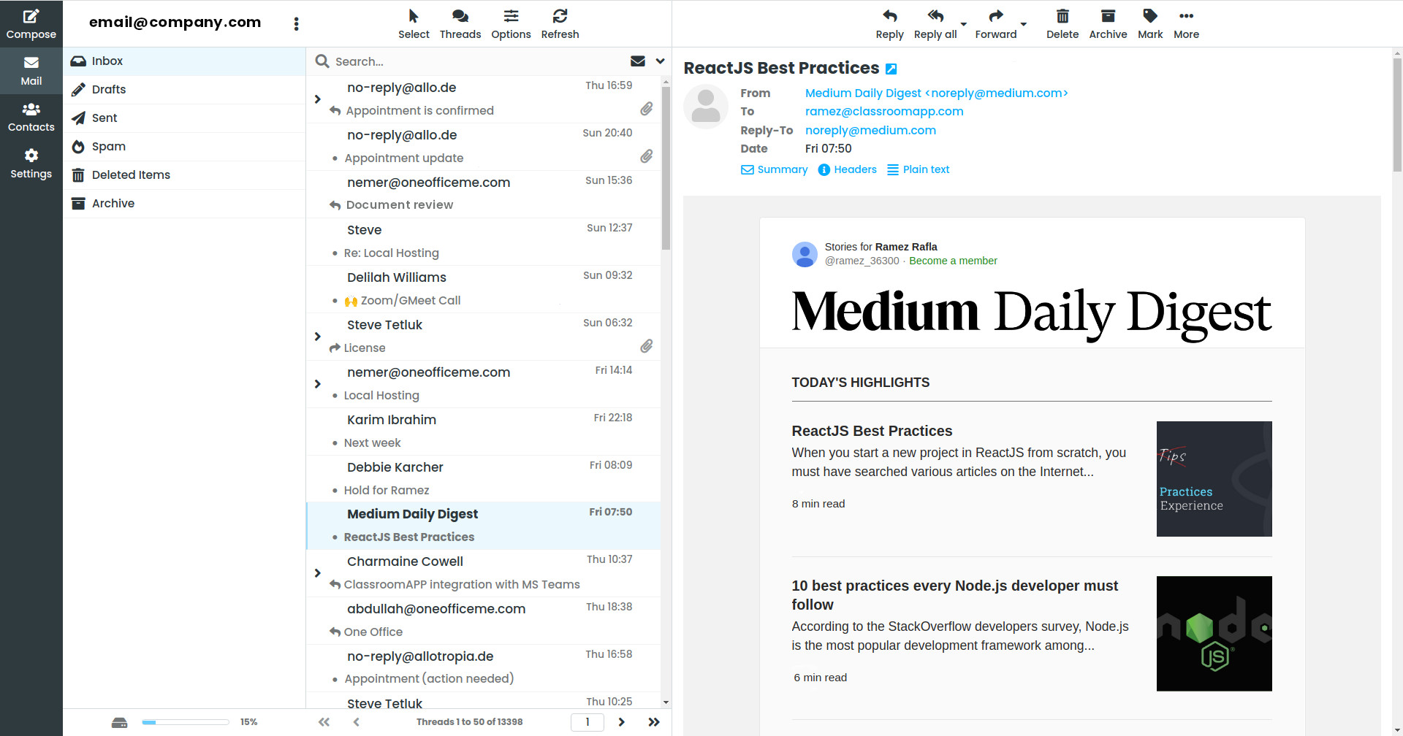
7. Emails
Secure email server
Lightning fast
Mobile sync
Out of office
Filters
Files integration
AI Spam engine
Quarantine
Detailed logs

Slide 13
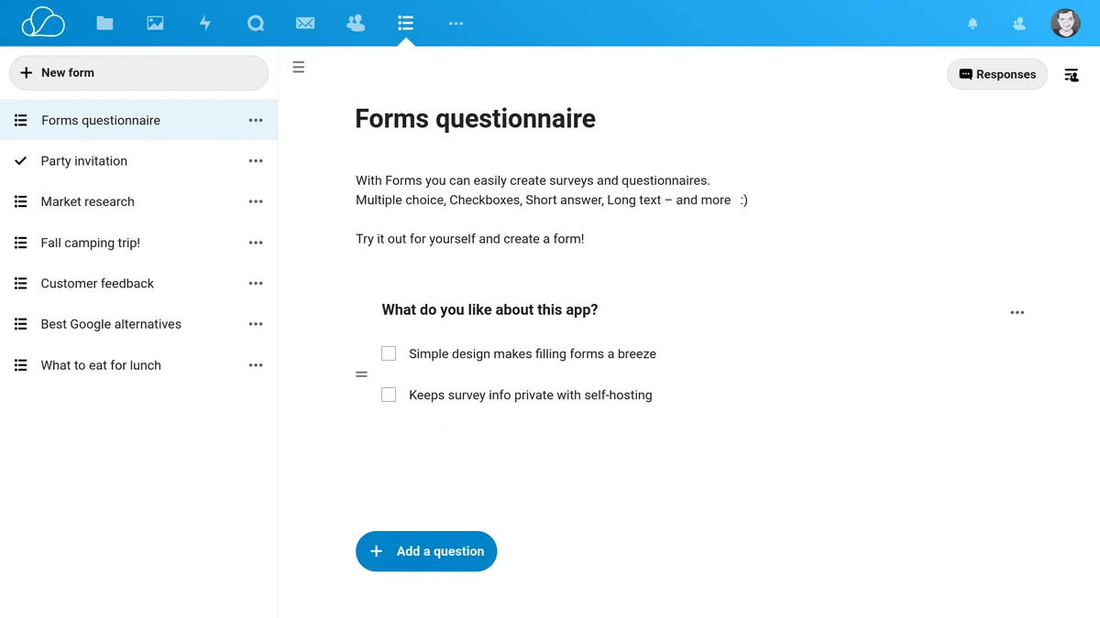
8. Forms
Simple
Drag & drop
Drop-downs
Text inputs
Multiple choice
Surveys
Reports
Results downloads
Notifications

Slide 14

9. Webinar
Up to 1000 users
Recording
Lighting fast
Low bandwidth
Smart audio check
Whiteboard
Document sharing
External video sync
Secure chat
Mobile-ready

Slide 15

10. OneSeek AI
100% Built-in – no external APIs
Semantic search (by topic)
Automated content tagging
Block leaks of confidential data
Summarizing documents / emails
Automated tasks (answering emails, creating documents ...)
Multi-language (EN, FR, AR, AK ....)

Slide 16

11. Military-Grade Security
Complete built-in security engine
Firewall
Spam / Malware / Phishing / XSS
DDoS filter
URL / domain filter
End-to-end encryption
Strong authentication controls
Protocol security
Intrusion detection
Email security

Slide 17

12. Data Loss Prevention
Built-in email backup
Built-in documents backup
Ransomware protection
Automated document versioning
Retention controls
Audit compliance tools

Slide 18
13. Data Leak Prevention
Advanced sharing controls
Download controls – web & mobile
AI-based confidential data tagging
Security policy & rules
Automated watermarks
Security & incidents dashboard
john@company Confidential
john@company Confidential

Slide 19
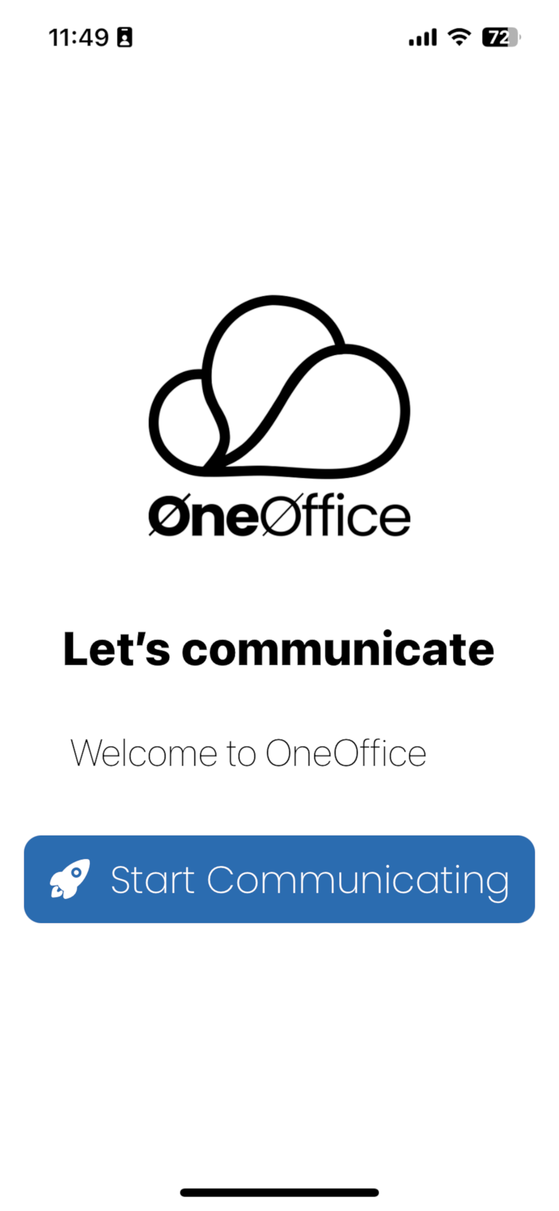
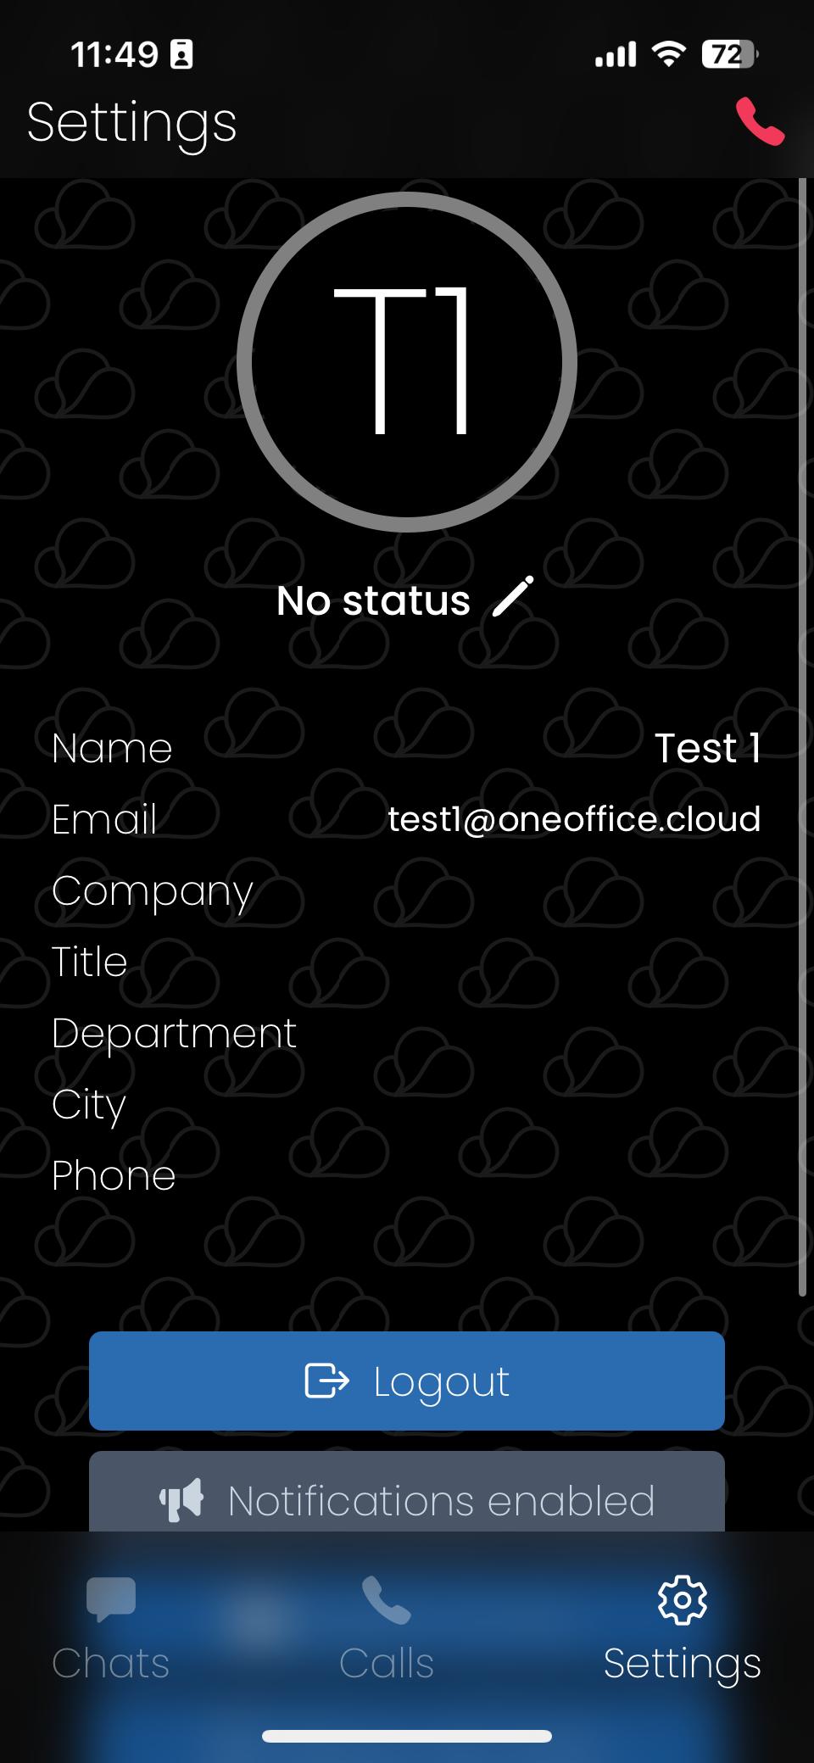
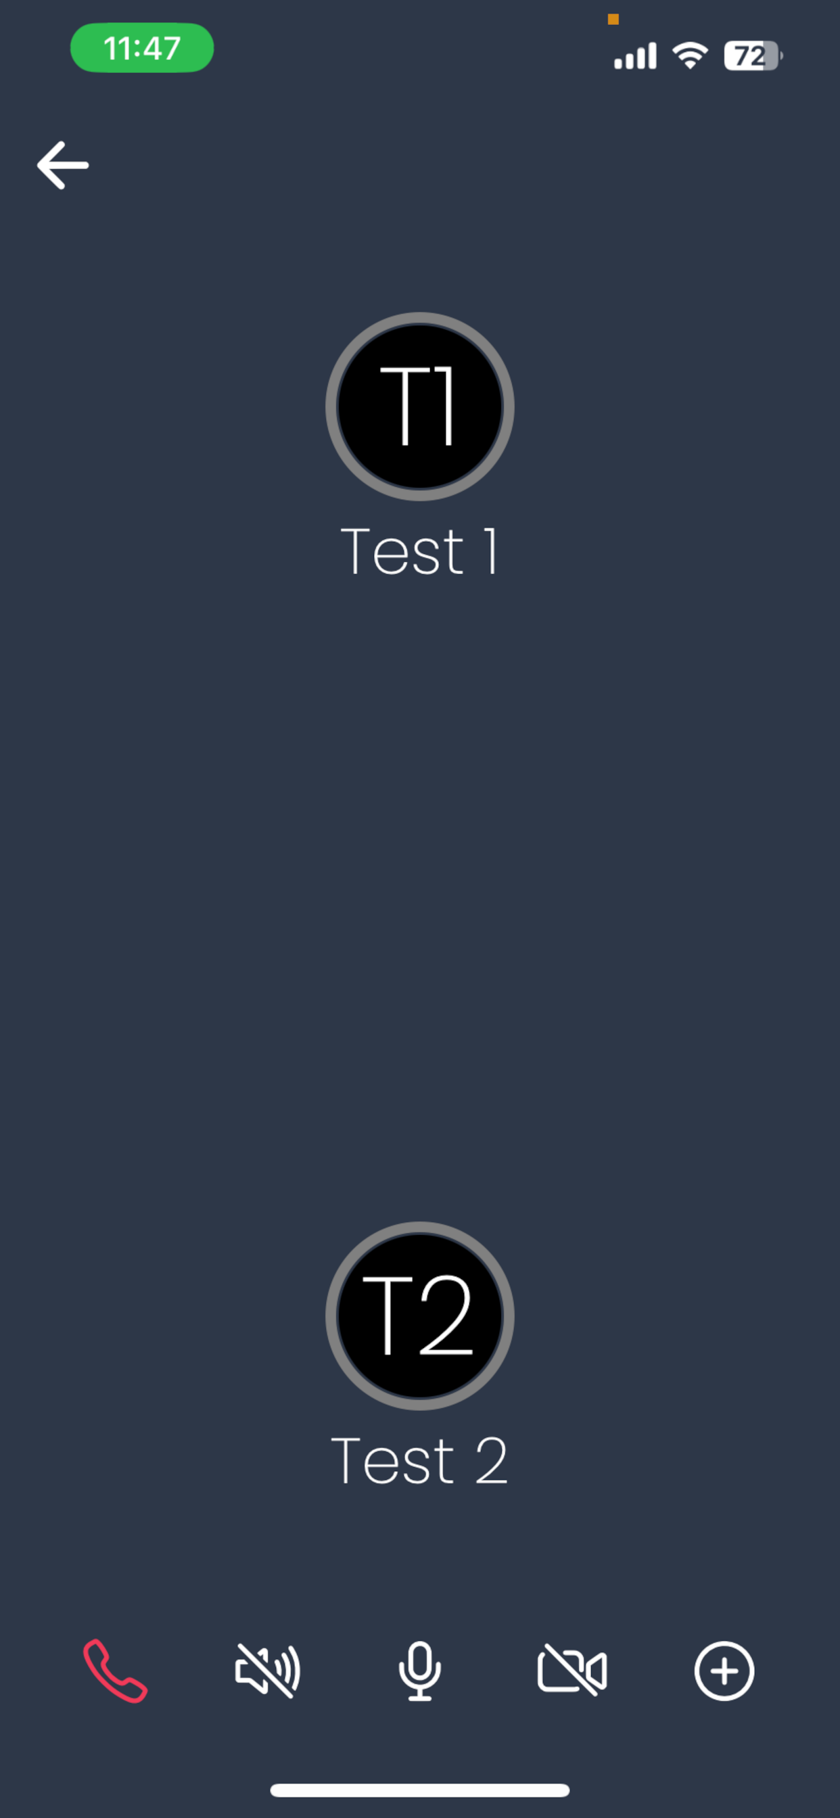
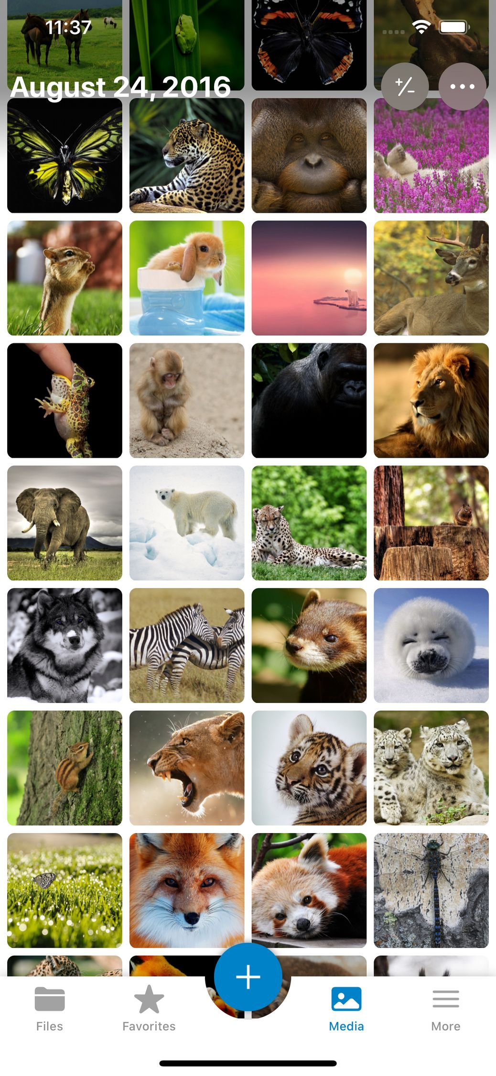
14. Applications
Collaboration
Calling / Chats
Authentication
Desktop editor
Desktop email
Sync / backup

Slide 20
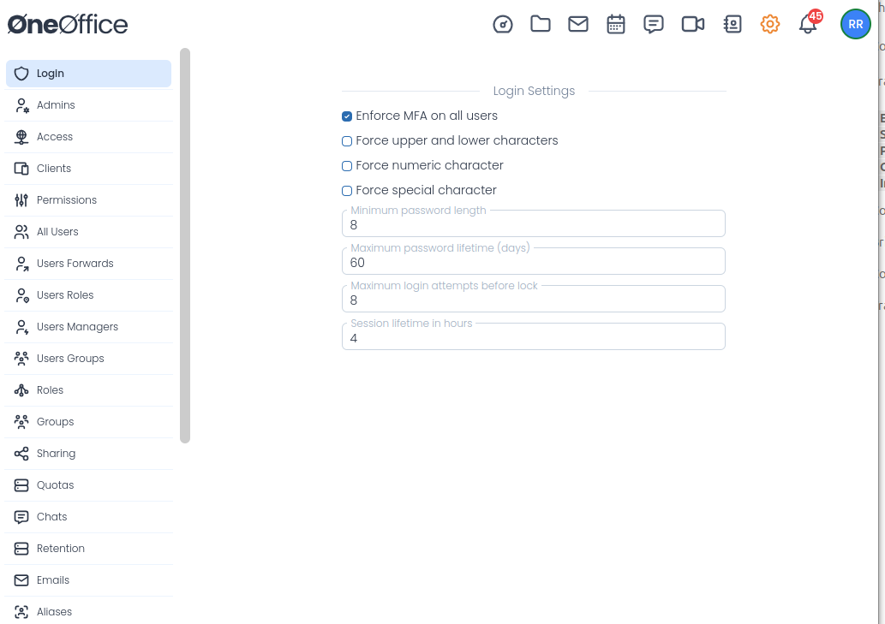
15. Admin
Simple yet Complete
Access controls
Delegated admins
Security dashboard
Groups & teams
Email rules & backups
Admin logs
Fine-tuned permissions
Live notifications
Control email settings
Integrate own domain

Slide 21

“
Having the right tool for the job is half the battle

Slide 22

Anywhere ...
is your office now

Slide 23
Please feel free to contact us
info@oneoffice.ca

