Slide 1

OneOffice Projects
Only on
Complete & Efficient Project Management

Slide 2
Mission - A simple, complete & secure platform to empower productive teams

Slide 3
Main Features
Project Portfolio Management
Project Planning
Task Management
Agile, Kanban & Scrum
Time Tracking
Team Collaboration
Product Roadmap
Workflows

Slide 4
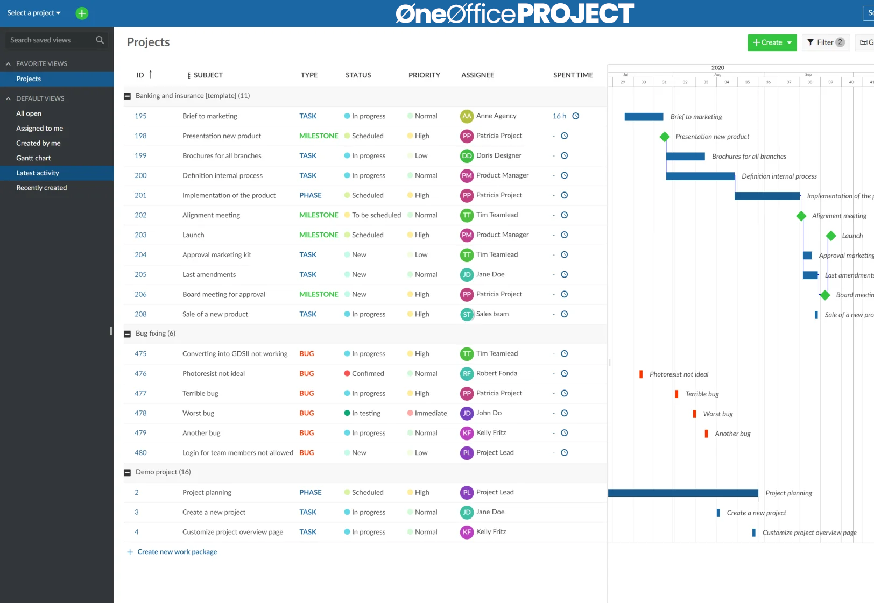
1. Project Portfolio Management
Project List
Hierarchy
Overview / dashboard
Templates
Portfolio
Reports
Stay on top of all your projects

Slide 5
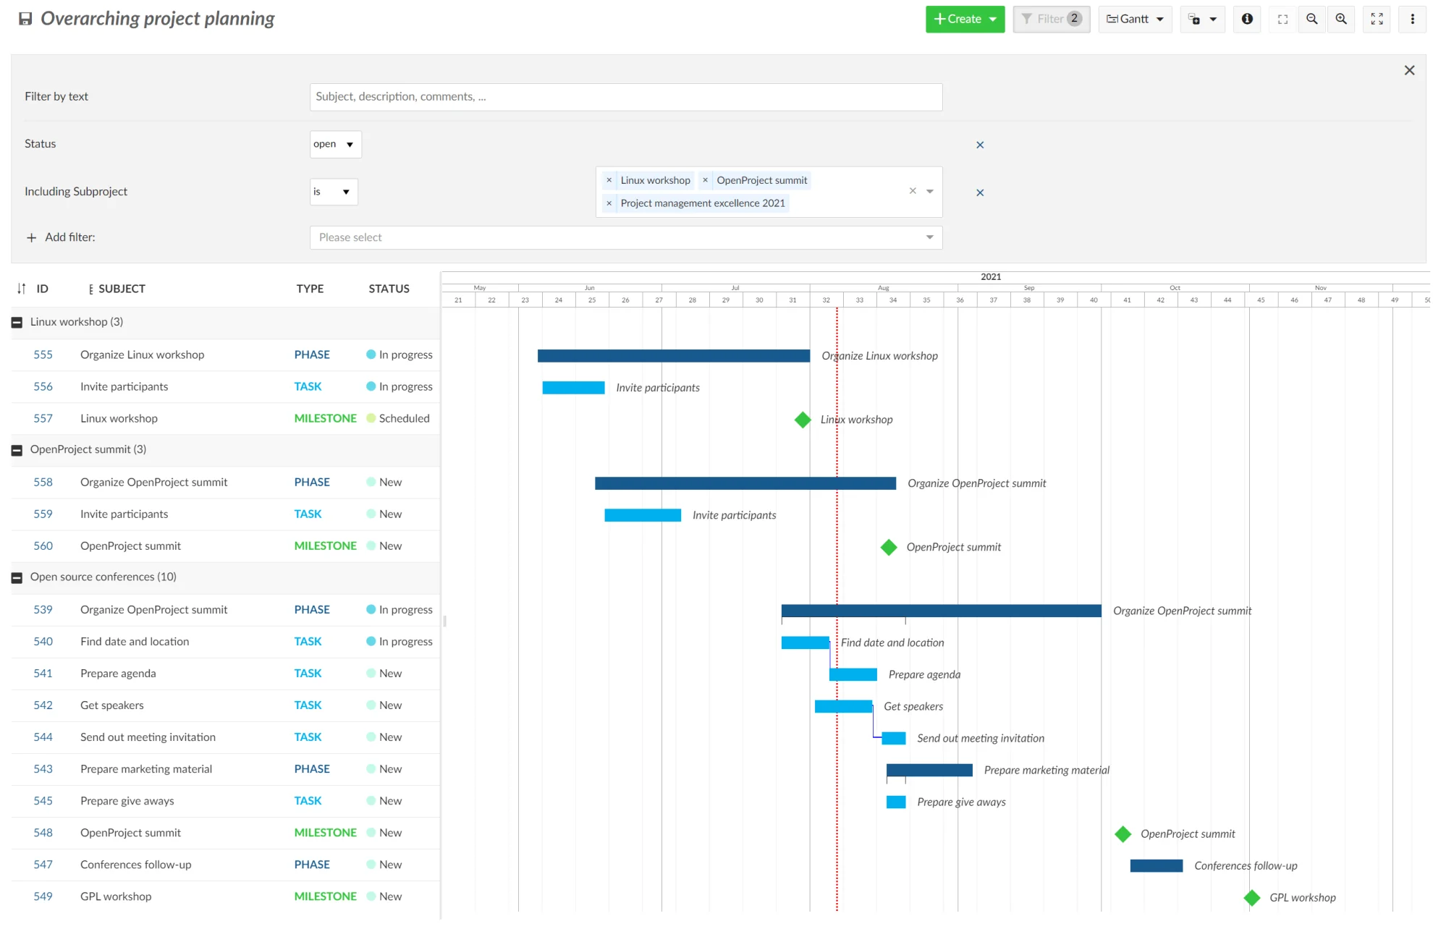
2. Project Planning & Scheduling
Gantt charts
Phases / milestones
Relations & hierarchies
Scheduling
Team planner
Calendar
Project dashboard
Deliver your projects on time

Slide 6
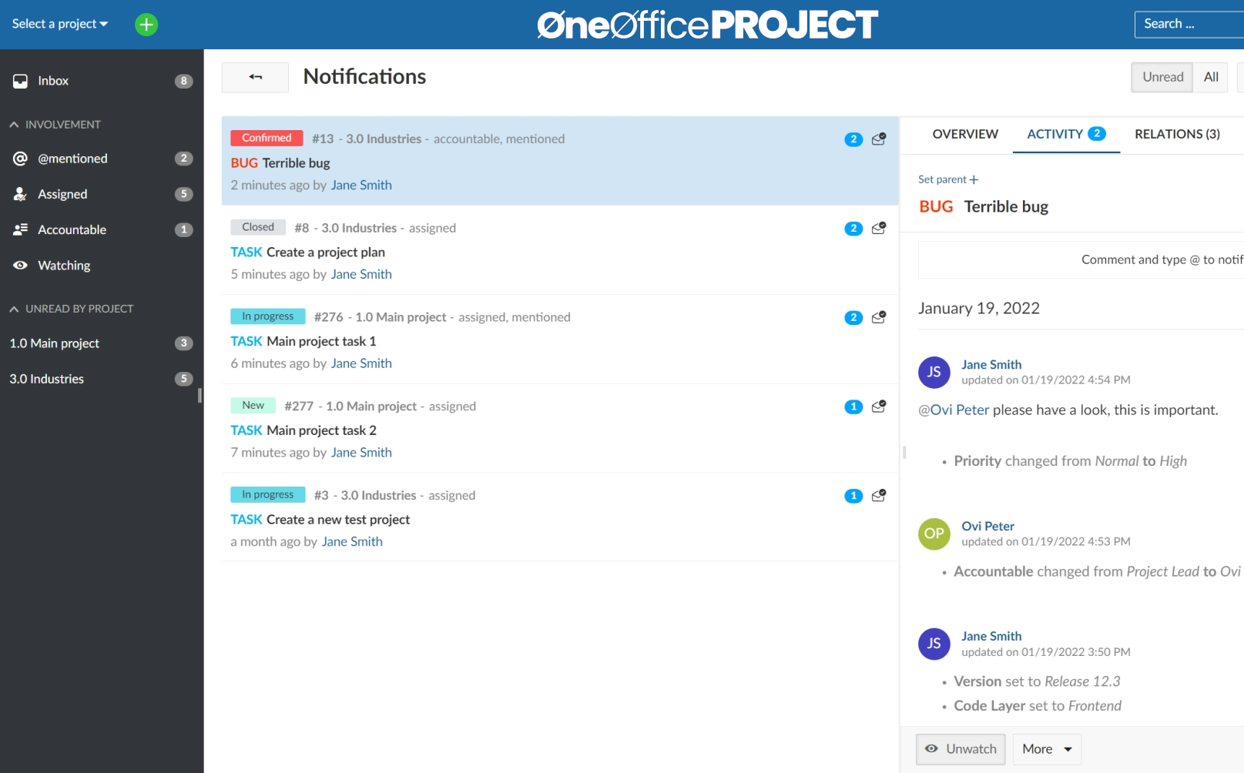
3. Task Management & Issue Tracking
Task lists
Assignee
Notifications
Comments & history
Watcher
Filters & groupings
Multi-project view
Responsibilities & Progress

Slide 7
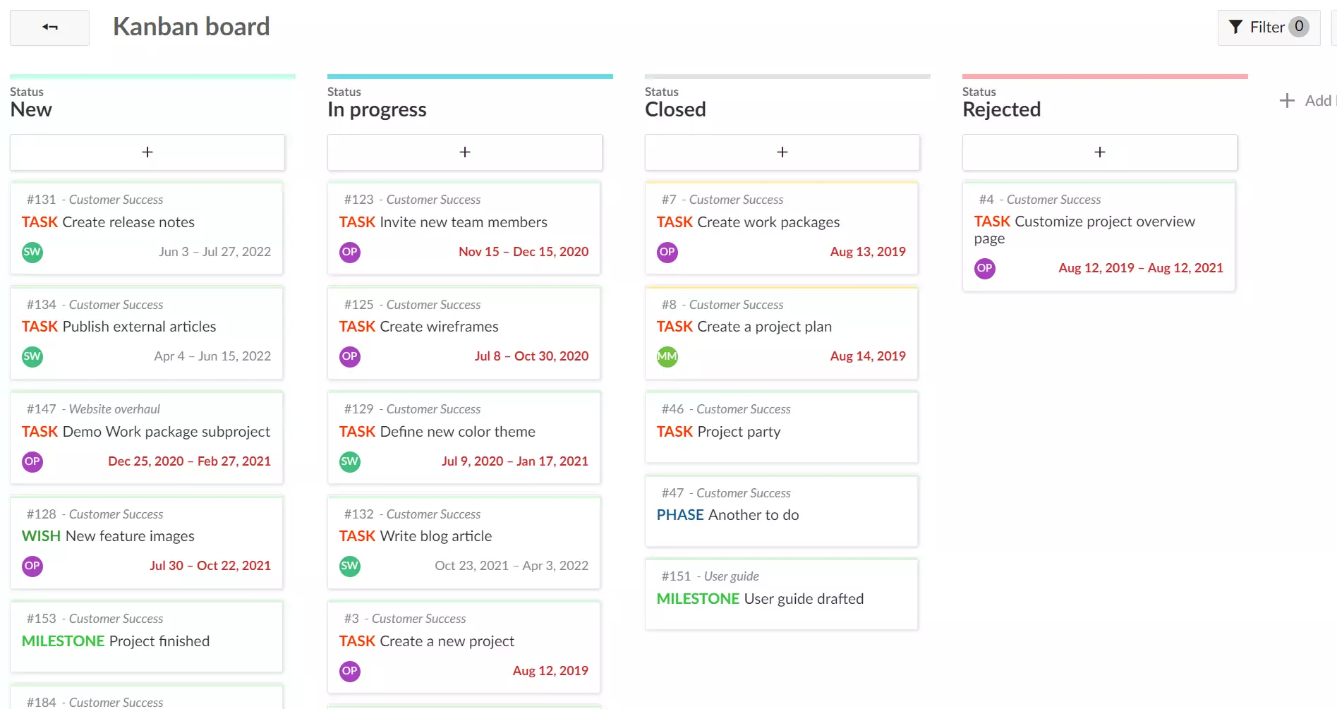
4. Agile, Kanban & Scrum
Task boards
Status boards
Team boards
Version boards
Subprojects
Work breakdown
Get more done with Agile Projects

Slide 8
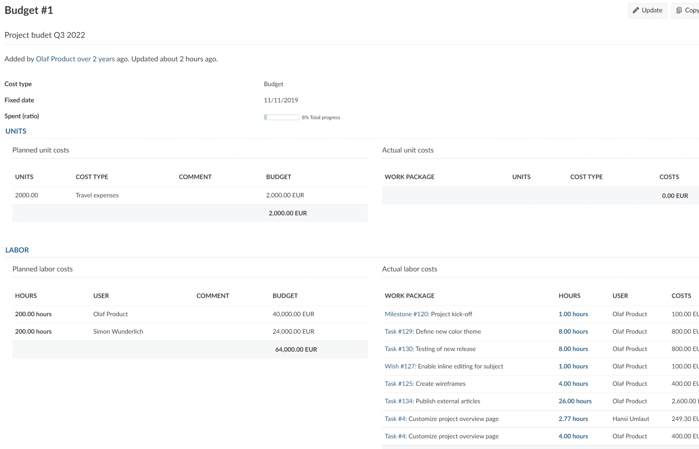
5. Time Tracking & Cost Reporting
Track time
Time reports
Labor costs
Cost reporting
Budgeting
Unit costs
Track projects efficiency

Slide 9
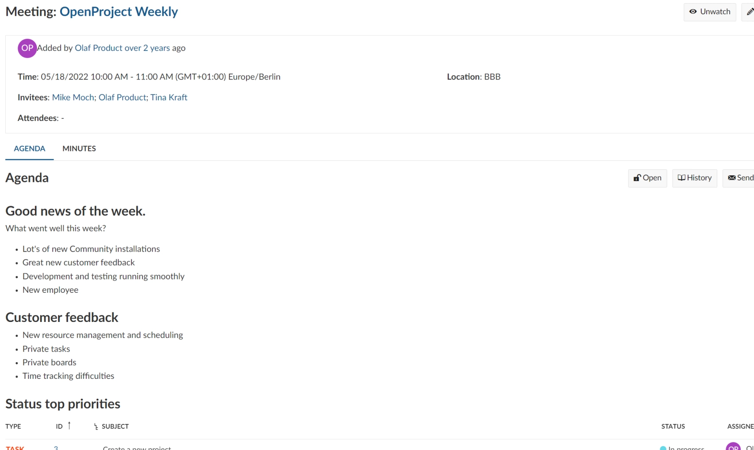
6. Team Collaboration
Activity
Meetings
News
Notifications
Wiki
Forums
Keeping it together

Slide 10
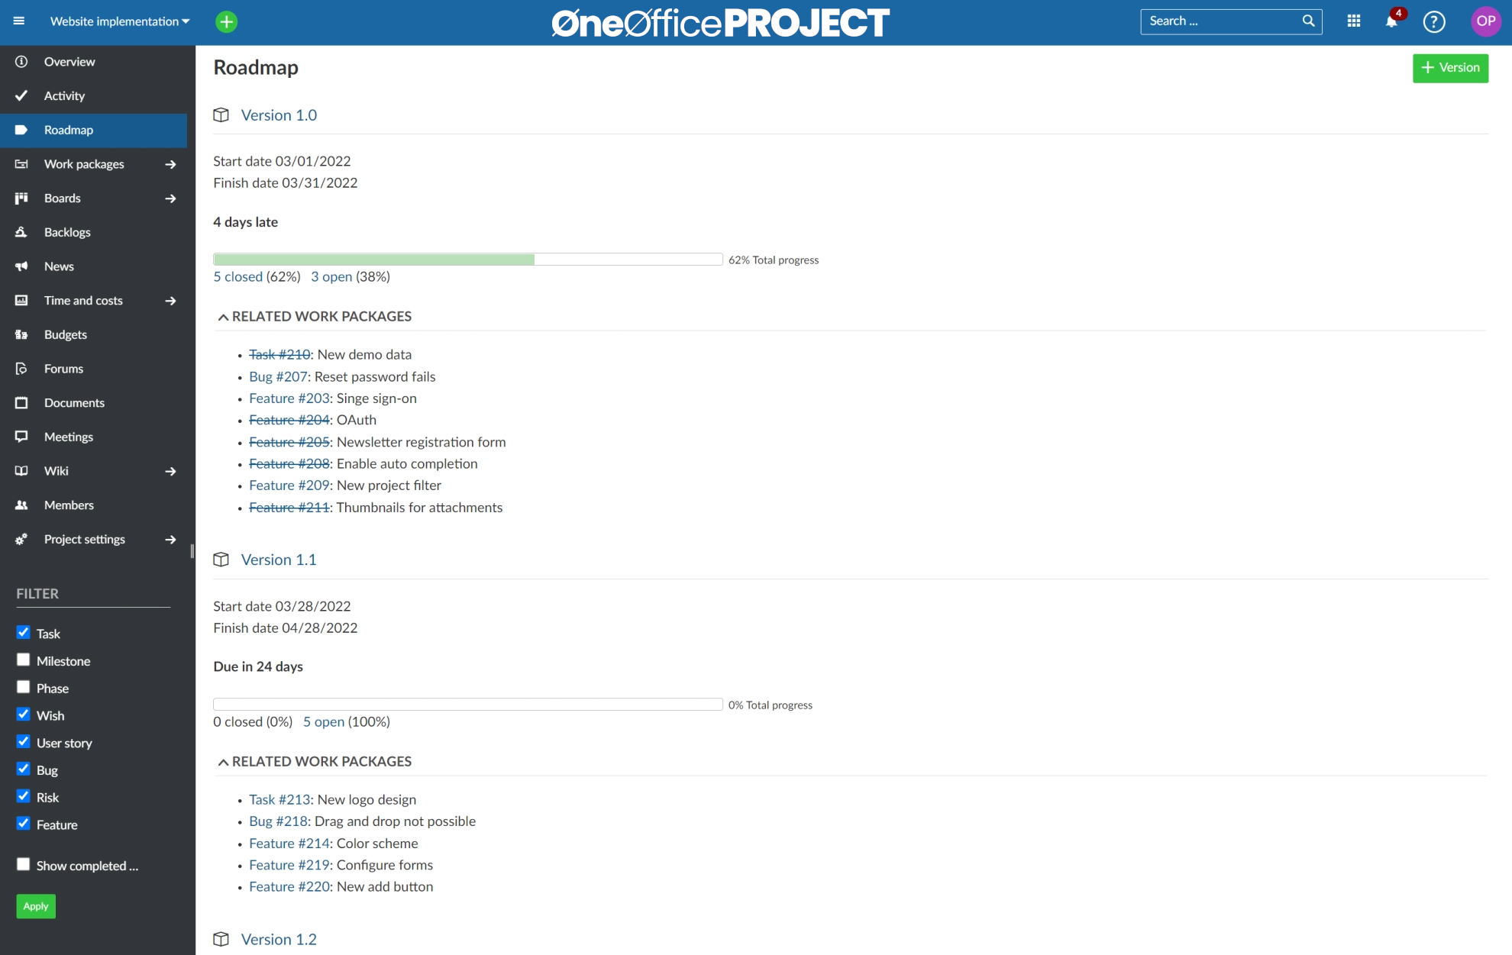
7. Roadmap & Release Planning
Roadmap
Product timeline
Repository
Code integration
Plan with all stakeholders

Slide 11
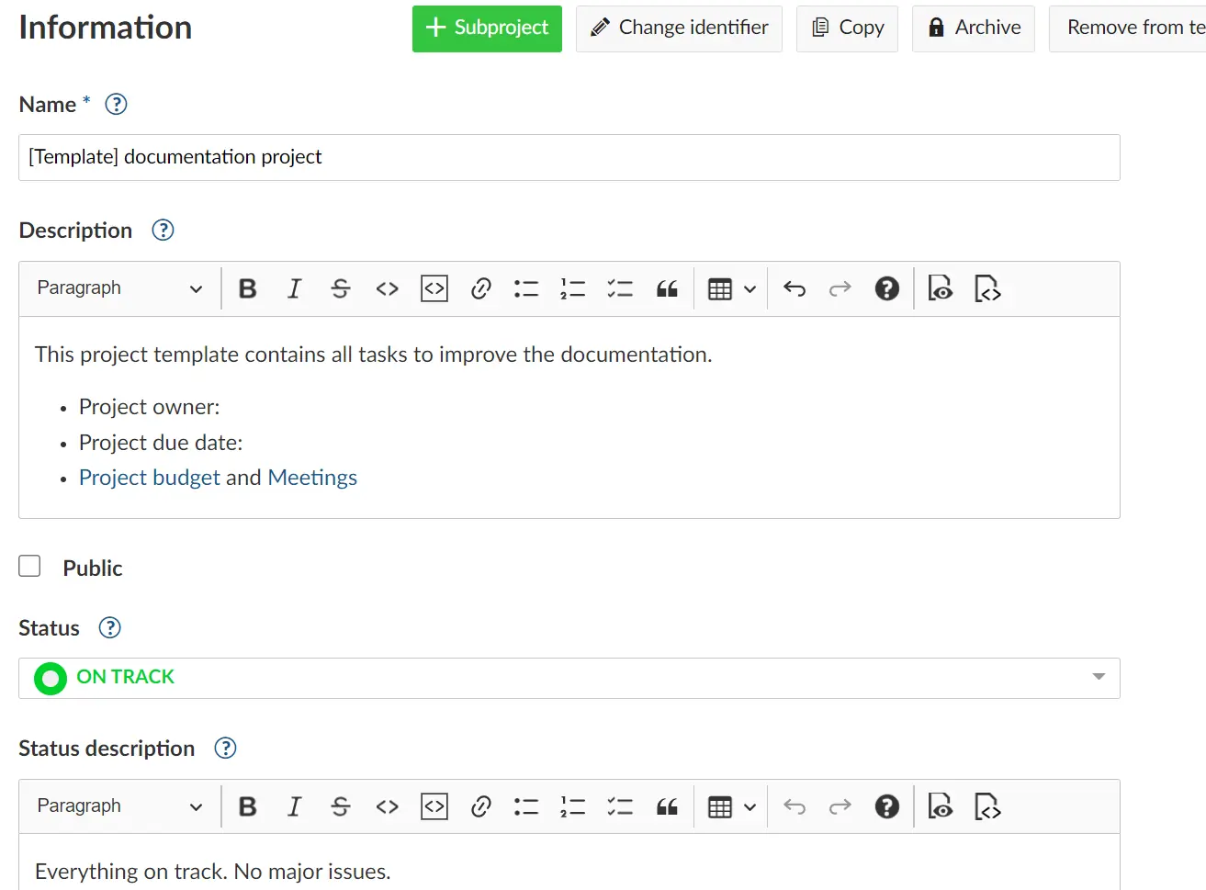
8. Workflows & Customization
Templates & Workflows
Custom actions
Custom forms / fields
Roles & permissions
Groups
External contractors
Custom fit for your organization

Slide 12

“
Having the right tool for the job is half the battle

Slide 13
Please feel free to contact us
info@oneoffice.ca

