Slide 1

Overview of OneOffice Video Conference Solution

Slide 2
Mission - A simple, complete & secure platform to empower productive teams

Slide 3

Why?
1. Secure
Private local servers, end-end encryption
2. Complete & Easy-to-use
All features in one convenient place
3. Cost Effective
Technology, servers, updates, IT

Slide 4
Introduction
Modern video conferencing built from group up
Open-source infrastructure – Linux, OpenSSL, ReactJS, V8
Designed for scalability
Secure - TLS & end-to-end encryption
Web & native apps – white-label ready
Easy integration with third-party reservation system
Easy integration with phone lines via SIP connector

Slide 5


Enterprise-grade Video Conferencing
Integrated with OneOffice Productivity

Slide 6
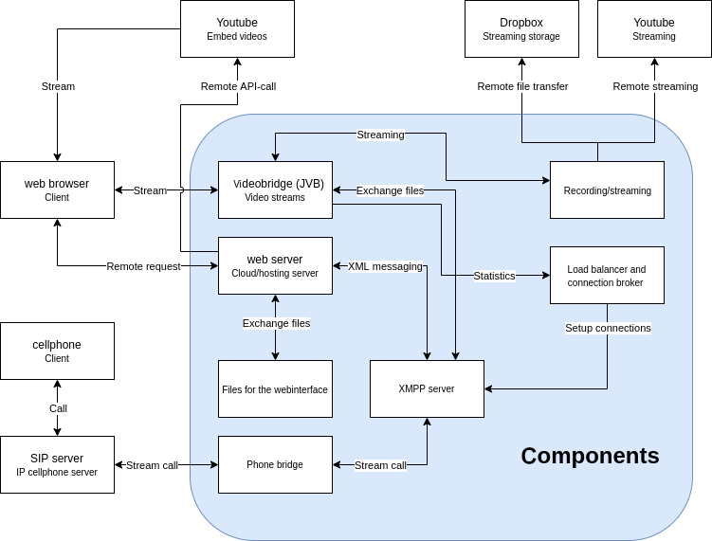
Components

Slide 7

Versatile
One-click deployment
Web app in ReactJS, easily customizable
Native React applications for iOS, Android & Huawei
Whitelabel-ready

Slide 8
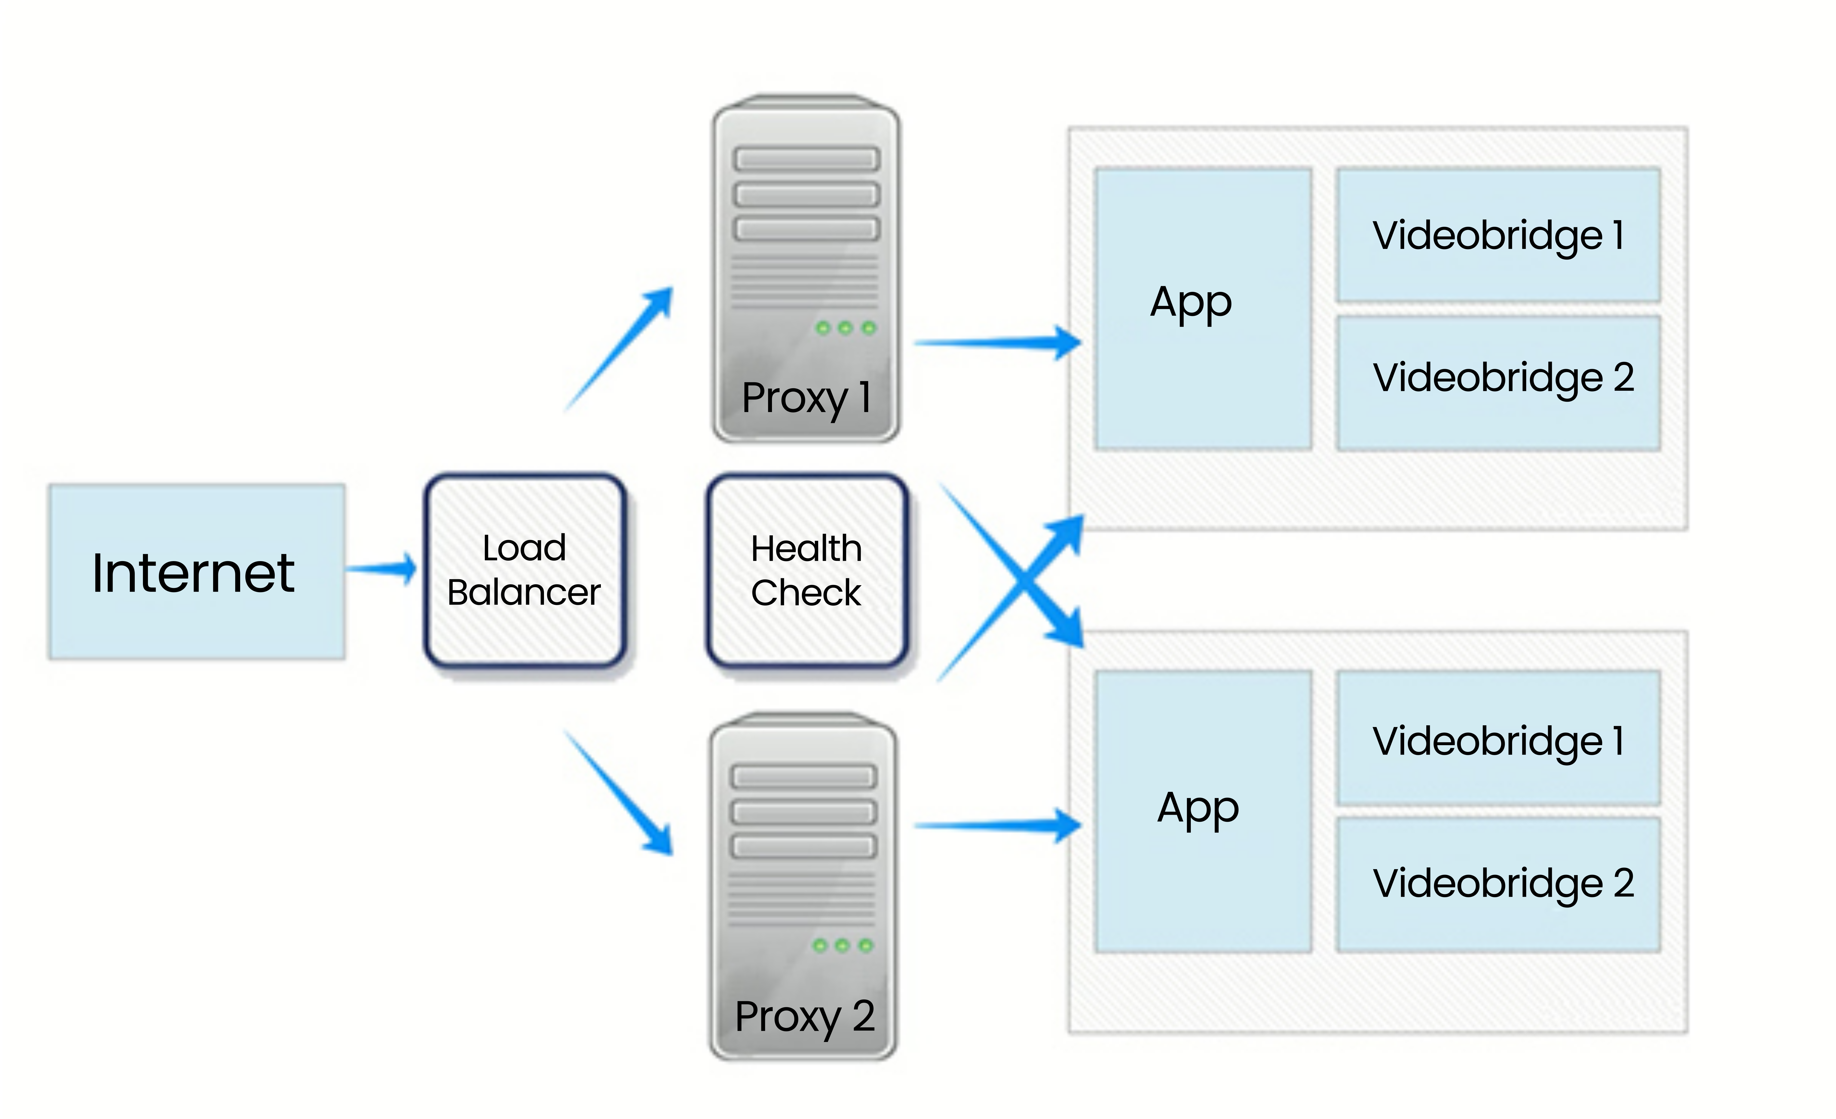
Infinite Scalability
Single online access
Launch more video-bridges
Launch more shards
Automated routing
Can be auto-scaled

Slide 9

Integration
Complete REST API
Secure token-based authentication
Conference reservation
Different services (# of users, duration etc.)

Slide 10

Phone Line
SIP & Mobile Apps
Inbound integration
Outbound integration (e.g. call center)

Slide 11

“
Having the right tool for the job is half the battle

Slide 12

Anywhere ...
is your office now

Slide 13
Please feel free to contact us
info@oneoffice.ca

